Slide 1
Overview of the day
10.05 Class in the ‘hidden curriculum’
  Reflection and discussion
11.00 Morning tea
11.20 Gender in the ‘hidden curriculum’
  Reflection and discussion
12.30-1.30 Lunch
1.30pm Tools for equality: youth voice
2.40-3.20pm Offline time - reading and reflection
3.20-4pm Discussion of reading and next steps

Slide 2
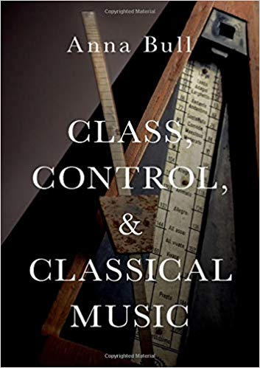
The ‘hidden curriculum’ of music education
How do class background and gender identity shape children’s experience of instrumental music education?
How can teachers be more inclusive of children from different class backgrounds and gender identities?

Slide 3
The ‘hidden curriculum’ of music education
‘the unstated norms, values and beliefs that are transmitted to students through the underlying structure of meaning in both the formal content as well as the social relations of school and classroom life’ (Giroux and Penna, 1976)

Slide 4
Inclusions and exclusions
Andy: [My parents] didn't understand the music world, they didn't get the idea of musical standards. They didn't listen to classical music and if they did want to, they wouldn't have understood the world, just the actual standard that musicians reach. It's insane, the amount of hours of practice, and nothing goes wrong in performances. It's a different world.
I always tease my friends and say my children will practise until their fingers bleed. Part of it is a joke, but part of it is – I do want them to play instruments, if I have children, and – I will make them practise.

Slide 5
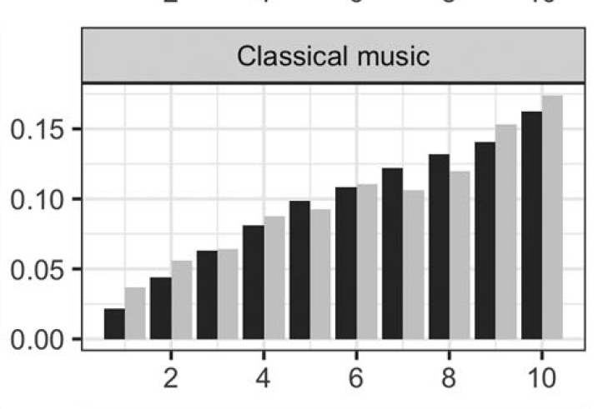
Classical music consumption and social class
IMD decile
Hanquinet, L., O’Brien, D., Taylor, M., 2019. The coming crisis of cultural engagement? Measurement, methods, and the nuances of niche activities. Cultural Trends 28, p.208
https://doi.org/10.1080/09548963.2019.1617941
Audience finder data: black
Taking Part Survey: grey

Slide 6
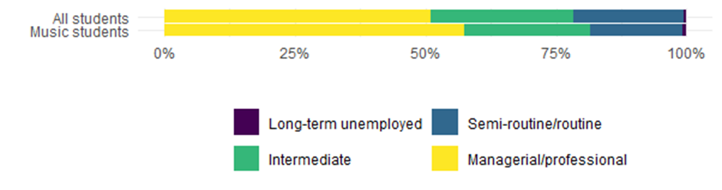
Higher education music students: class background by parents’ occupation

Slide 7
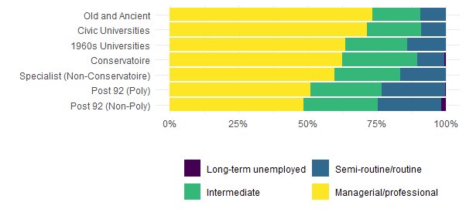
Class inequality by institution type

Slide 8
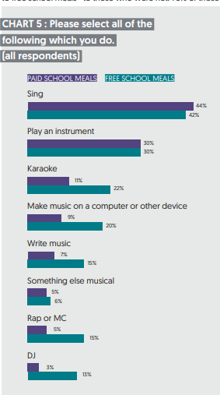
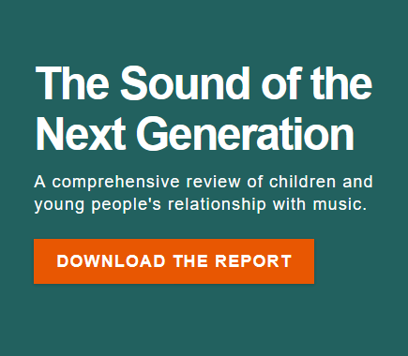
Youth Music and Ipsos Mori. 2019. “The Sound of the Next Generation.” London: Youth Music. https://youthmusic.org.uk/sites/default/files/2020-06/The%20Sound%20of%20the%20Next%20Generation.pdf.

Slide 9
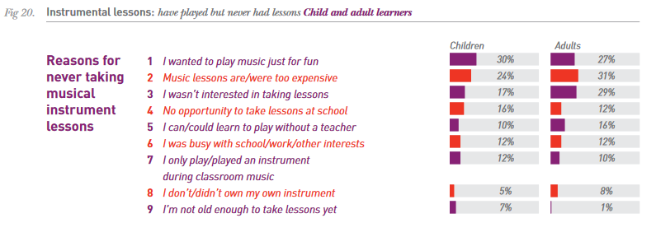
Hume, Simon, and Emma Wells. 2014. “ABRSM: Making Music.” ABRSM. http://gb.abrsm.org/de/making-music/#.

Slide 10
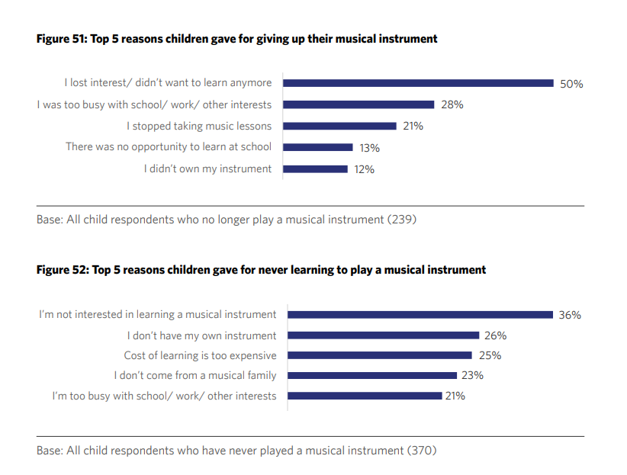
Learning, playing and teaching in the UK. ABRSM Making Music report 2021. (2021). ABRSM. https://www.abrsm.org/sites/default/files/2023-08/web_abrsm-making-music-uk-21.pdf

Slide 11
Key idea
Class background affects not only economic barriers to music education
…But also, different classes have different cultures, and different attitudes to music and music education
Music education’s ‘hidden curriculum’ can lead to some groups feeling more welcome and comfortable in music education than others

Slide 12
Is the ‘hidden curriculum’ contributing to children’s lack of interest in music education?
What is the ‘hidden curriculum’ that you learned in your music education?

Slide 13
How important were these 'norms' in your own music education/background?
You need to have a teacher if you want to learn music
You have to practice at home in between lessons
You have to learn technique before you can be musical
Learning music happens mostly on your own
It’s important for parents to support their children to learn music
Taking it seriously is more important than having fun
Being musical usually involves playing an instrument or singing

Slide 14
Who would be included/excluded if music education held these values?
You don’t have to practice at home in between lessons
You can be musical without playing an instrument or singing
You don’t have to learn technique before you can be musical
You don’t need a teacher if you want to learn music
You can learn music with others
It’s not necessary for parents to support their children to learn music
For learning music, taking it seriously is less important than having fun

Slide 15
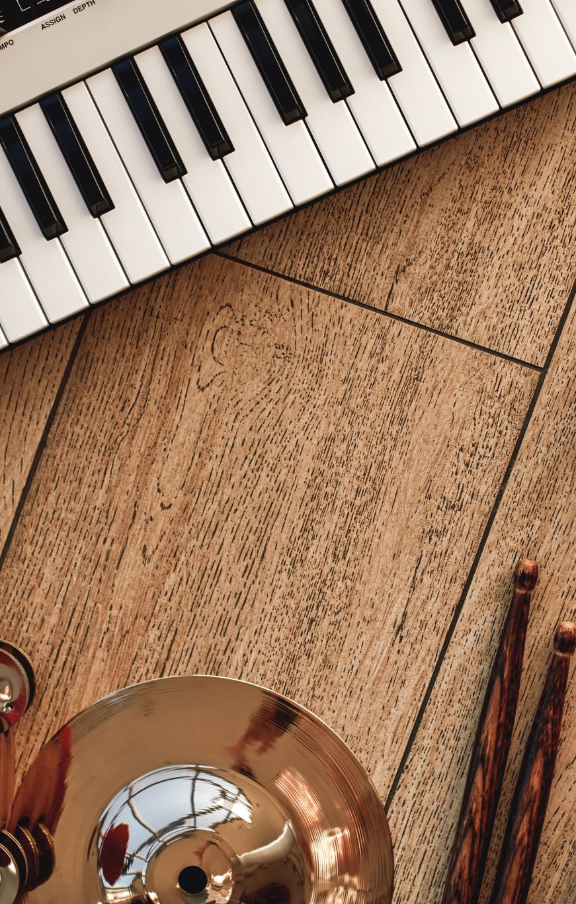
Discuss in your groups
How did your class/cultural background shape what you think counts as ‘music’ or ‘being musical’?
Was there anything in this presentation that resonated with your own experience (either as similar or different)?

Slide 16

tea break

Slide 17
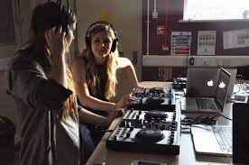
Gender in music education

Slide 18
Why do music teachers need to be aware of gender?
“School was a nightmare. I wished I was dead every day because I didn’t want to go. The only thing that kept me going was knowing that I would be able to go and play [in band] and I would be able to go and sing [in choir], because that was the one thing that no one could take away from me was my music. I could express myself the most freely through music. So that, to me, was my safe zone because it was my outlet.” - Rie
Nichols, J. (2013). Rie’s Story, Ryan’s Journey: Music in the Life of a Transgender Student. Journal of Research in Music Education, 61(3), 262–279. https://doi.org/10.1177/0022429413498259

Slide 19
Evidence from the UK
LGBTQIA+ young people are marginalised in music education
  they are less likely to feel that they have the same opportunities as everyone else,
  to feel supported with making music
  to have enjoyed music lessons
Youth Music. (2024). Sound of the Next Generation

Slide 20
Girls love music … but disappear from music spaces over time
Girls in the UK participate in music-making in higher numbers than boys. Music is a hugely important part of girls’ lives:
More girls than boys agree with statements such as
  ‘I couldn’t live without music’ (+15%)
  ‘music makes my world better’ (+7%)
  ‘music is a big part of who I am’ (+11%)’
Youth Music. (2024). Sound of the Next Generation

Slide 21
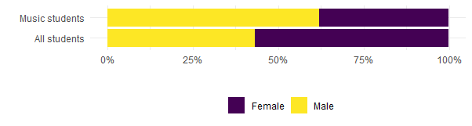
Gender in music higher education
Bull, A., Bhachu, D., Blier-Carruthers, A., Bradley, A., & James, S. (2022). Slow Train Coming? Equality, Diversity and Inclusion in UK music higher education. Equality, Diversity and Inclusion in Music Studies network. https://edims.network/report/slowtraincoming/

Slide 22
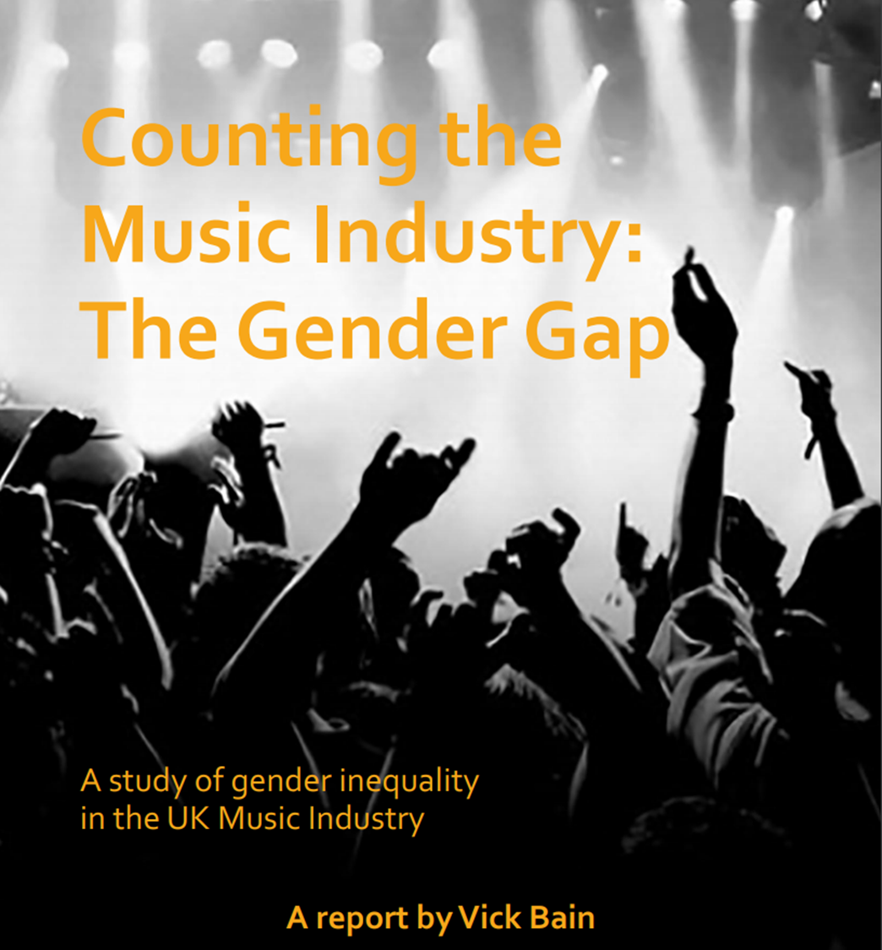

Slide 23
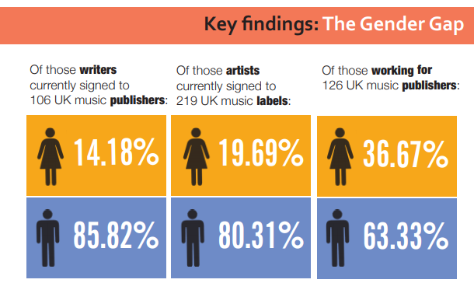
Vick Bain (2019). Counting the Music Industry

Slide 24
What’s going on?
What happens to girls and music-making as they grow up?
What happens to boys and music-making as they grow up?
What happens to non-binary pupils and music-making as they grow up?

Slide 25
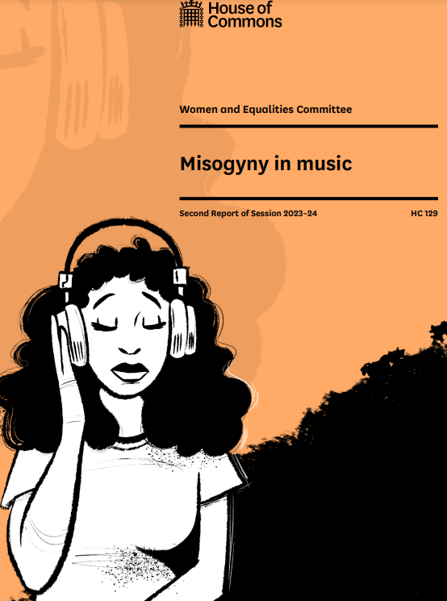
Misogyny in Music report (2024)
Recommendation: Music colleges, conservatoires and other educational settings need to do more to address the gendering of instruments, roles and genres and improve the visibility of and support for female role models.

Slide 26
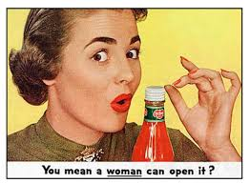
Gender norms and stereotypes:
Gender norms are ideas about how women and men should be and act

Slide 27
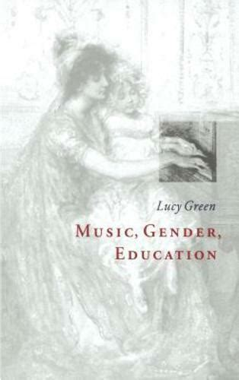
How do gender norms get into music education?
‘We do not have to listen to a man playing the drums; we can listen to the music played on the drums.’
Green, Lucy. 1997. Music, Gender, Education. Cambridge: Cambridge University Press.

Slide 28
Discussion
How were gender inequalities or stereotypes present in your own music education? Think about:
  Leadership
  Different technologies
  Instrument choice
  Creativity
  Clothing/the body
  Behaviours that you get praised for
  Behaviours you get blamed for
What strategies have you used/could you use to address gender inequalities and stereotypes in your teaching?
How can we create inclusive spaces for gender-diverse children and young people?

Slide 29
Staying within a feminine gender role:
Singing/playing string or high woodwind instruments
Being ‘cooperative and conformist’ (Green, 1997, p.166)
Bodily movements being controlled/instructed by others
Playing roles/characters that represent ‘normal’ femininity
SATB choral singing (?)
Wearing ‘appropriate’ clothes
Resisting feminine gender roles:
Playing brass instruments
Conducting/using your body to take up space
Taking a public/senior leadership role
Using technology
Being creative
Being gender-nonconforming/queer/non-heterosexual

Slide 30
Trans students’ advice to music teachers
On including and honoring trans students: “The first thing I would tell [music teachers] it is that if a student talks to them about something that they don’t understand, don’t respond immediately . . . Don’t just go with your gut feeling. Ask questions, look it up online or wherever, ask other music teachers who might have dealt with this before (if you haven’t). Talk to the student” - Skyler
‘Acting like trans students are “an issue” that need to be addressed rather than just another student with another situation is, I think, the main problem . . . It’s addressing it: “OK here’s the situation, this is what we’re going to do about it,” – Jon
Palkki, J. (2020). “My voice speaks for itself”: The experiences of three transgender students in American secondary school choral programs. International Journal of Music Education, 38(1), 126–146. https://doi.org/10.1177/0255761419890946

Slide 31
Lunch break

Slide 32

This afternoon
1.30pm Tools for equality: linking to youth voice:
2.40-3.20pm Offline time - reading and reflection
3.20-4pm Discussion of reading and next steps

Slide 33
Having a say in your own music education
Think of a time when you had a say in your music education
And a time when you didn’t have a say

Slide 34
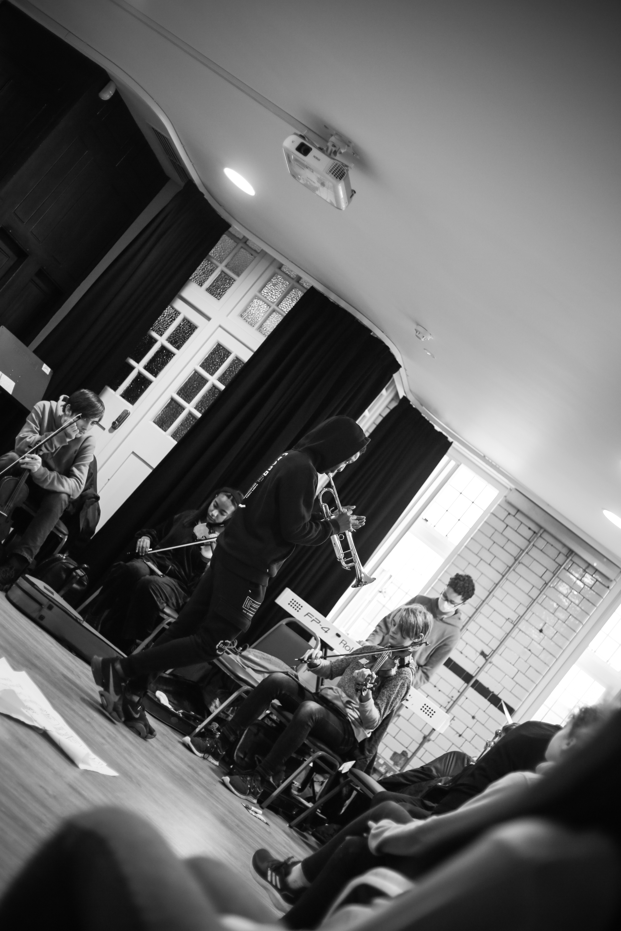
What do young people say about youth voice?
  ‘[I get a voice] when I choose the grade pieces I do’.
  ‘My violin teacher normally chooses the pieces and if I'm going to skip a grade. The time I had a decision was deciding to play the violin for the first time.’
  ‘For music GCSE composition […] while our teacher gives suggestions, we still retain full creative control over our piece’.
  ‘Once with a teacher, I put in my own phrase and breath marks but my teacher told me it was incorrect and changed them all - but I didn't think it sounded good!’
  ‘I wanted to add other aspects to the piece I was playing, but when I tried it out, [my teacher] listened and said it wasn’t how to play’

Slide 35
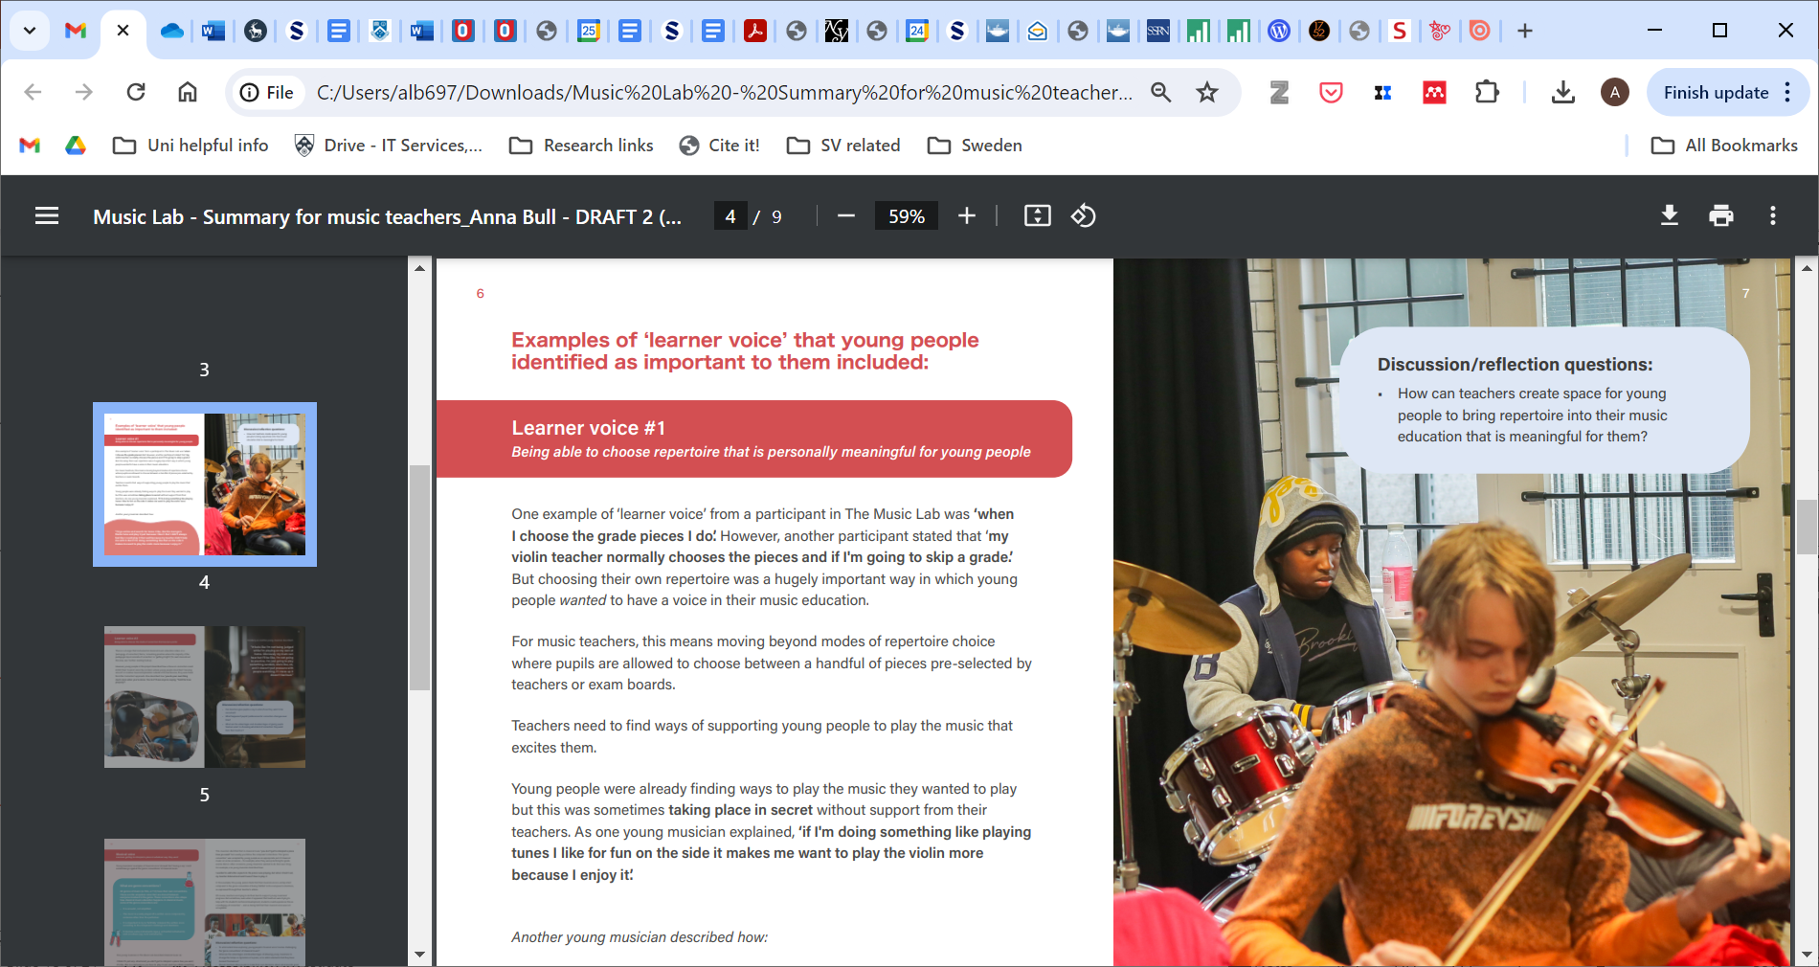
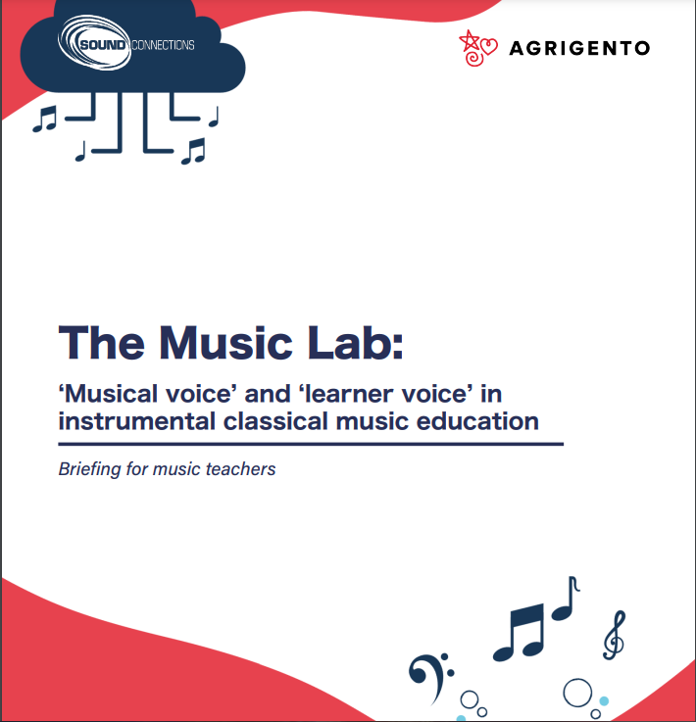

Slide 36

‘learner voice’
the extent to which learners have a say in their own teaching and learning
‘musical voice’
the development of young people’s musical, expressive capacities

Slide 37
Discussion: Musical and learner voice
Learner voice: Can you think of a time when you/your pupils had a say in how learning took place (‘learner voice’)? Think about:
  Repertoire choice
  Learning goals
  Teacher input
Musical voice: Can you think of a time when you/your pupils were supported to find your ‘musical voice’?
What preparation or skills do children need in order to be able to use ‘learner voice’ or ‘musical voice’?
How can youth voice help make children from diverse class backgrounds/gender identities participate in music education?

Slide 38
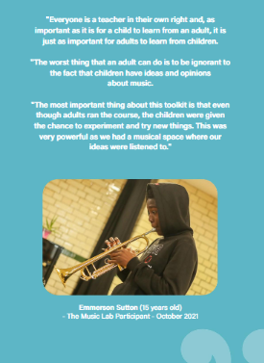
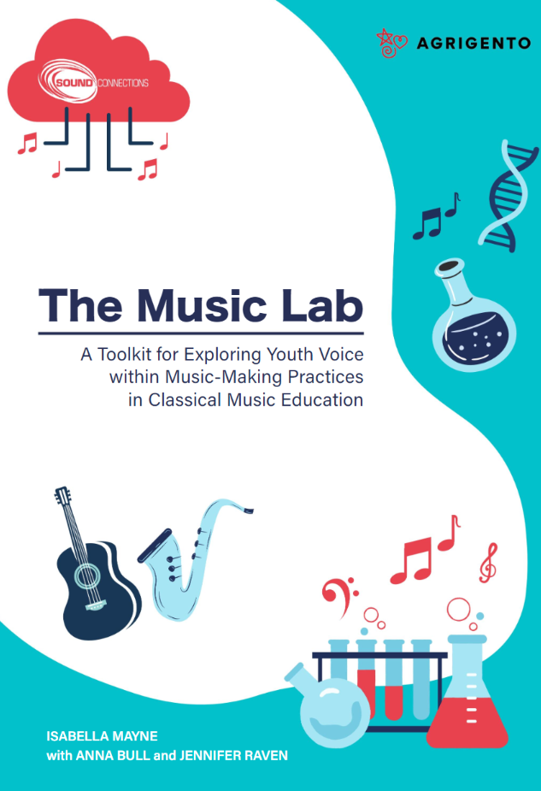

Slide 39
tea and reflection

Slide 40
Questions for reflective writing on ‘pedagogy of correction’ piece:
What is your initial reaction to this piece? Eg discomfort, disagreement, curiosity
What was your own experience of correction from teachers as a music student?
What do you think of the idea that correction can impact on pupils’ sense of inclusion and belonging, and/or might affect pupils from different identity groups in different ways?
What role does correction play in your teaching?
What do you think of the idea of a pedagogy of ‘non-interference’? What would this look like for you? What are the benefits and drawbacks?

Slide 41
Wrapping up
What would you like to try next week with your pupils?
  If you feel ready to make changes in your teaching, write down ideas for
    one short-term change
    one medium or longer-term change
If you don’t feel ready to make any changes just now, that’s totally fine.
  What is your main takeaway from today’s session?

