Slide 1


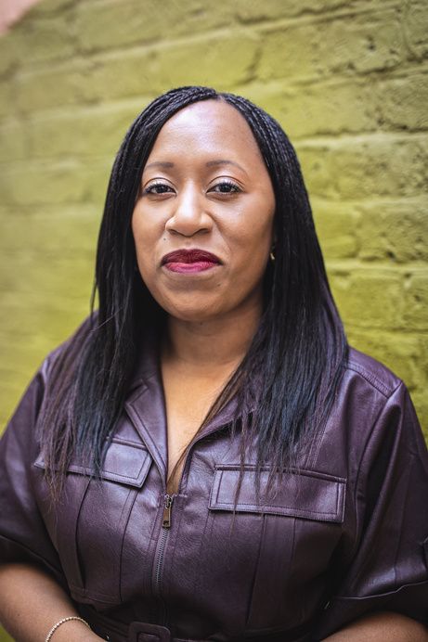
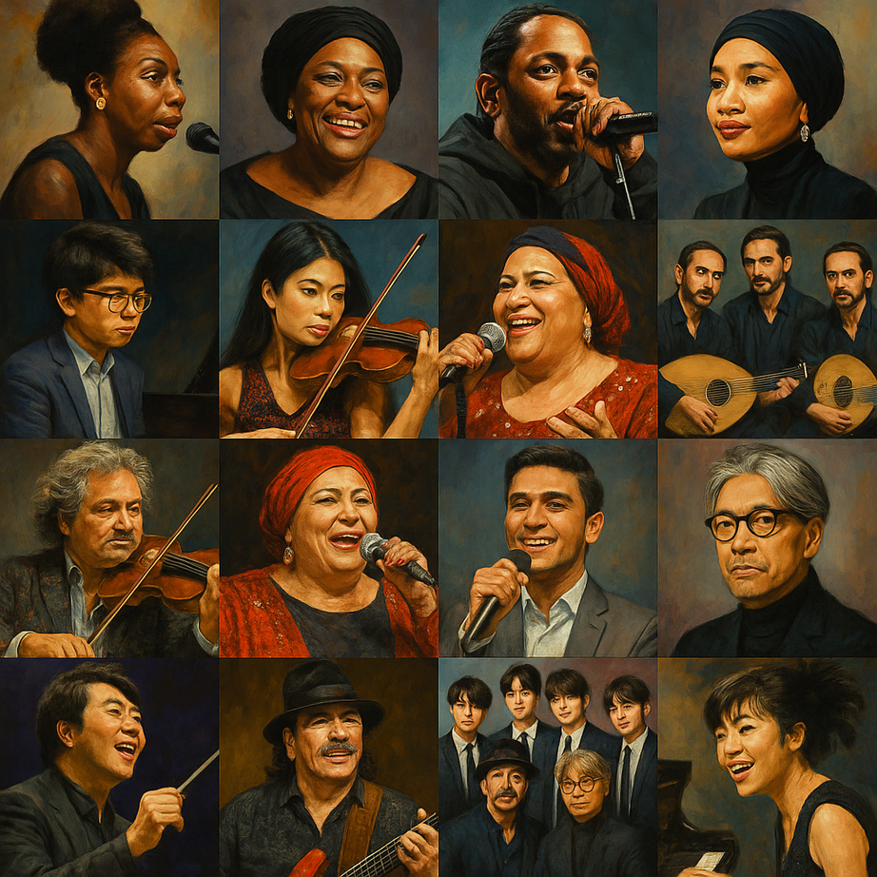
Diverse Cultures & Communities in Music Education
Please add to the chat a current success or area of celebration &
a challenge in your teaching.
Jenetta Hurst
Secondary School leader &
music specialist
Founder - The Creative Educator
Chair - Lewisham Music Hub
Alumus - BCU PGCE Secondary & The Birmingham Conservatoire
Sunday 26th April, 2026
3:00 pm
Zoom

Slide 2
Diversity in Orchestral Repertoire
Assessed over 16k compositions from across 111 orchestras and 30 countries.
The report found 7.5% of works performed in 2023/24 were composed by women – a 0.2% decrease on the charity’s research covering 2021-22.
The findings illustrate that 89.3% of pieces performed were written by white men. Going forwards, there is increased work to be done on diversifying concert programming, future composers and this all links back to education.
Equality & Diversity in Global Repertoire 2024, by
Donne, Women in Music
Declining representation of women and individuals from the Global Majority in 2023/4 compared to their study in 2021/22.

Slide 3
Resources and sequencing the learning
Curriculum Assessment Review (CAR), 2025
National Curriculum for Music
Model Music Curriculum (MMC), 2021.
National Plan for Music Education (NMPE2), 2022.

Slide 4
What the theory says
Model Music Curriculum, 2021.
Teacher-led curriculum development
Takes account of the many different school contexts that exist
The shared foundation will provide schools with a launchpad to access wider musical culture in which all can thrive and share the joy of music
Blog: A Model Music Curriculum
(Jenetta Hurst)
Suggested Listening:
Jai Ho – Slum Dog Millionaire; A R Rahman
Runaway Blues: Ma Rainey
Take the A Train: Duke Ellington Orchestra
I Feel Good: James Brown
Say My Name: Destiny's Child
'21st Century Music'

Slide 5
Resources
ISM Resources
Nate Holder - posters, podcast & worksheets
I Can Compose Black History Month Calendar
I Can Compose Women’s History Month Resources
BBC Bitesize How to Rap
BBC Ten Pieces
The Black Curriculum
Times Educational Supplement (various)
Every Copy Counts Free Teachers’ Resources
Sing Up free resource bank
Charanga Sing
National Curriculum for Music
Jules Buckley Metropole Orkest
Passing Notes Education

Slide 6
Key Texts
The Belonging Effect - Diversity in the curriculum toolkit
Bennie Kara - A Little Guide for Teachers: Diversity in Schools
Donne, Women in Music Report
Hannah Wilson & Bennie Kara - Diverse Educators: A Manifesto
Inclusive Practice in the Early Years - Liz Pemberton, The Black Nursery Manager

Slide 7
The Bottomline
Diversity means engaging pupils from varying demographics.
Inclusion is making all students feel welcome and included.
Diverse and inclusive learning environments have the potential to engage all children.
Inclusive practice begins with showing an awareness of our biases and stereotypes.
Great teaching begins with holding high expectations for all pupils.

Slide 8

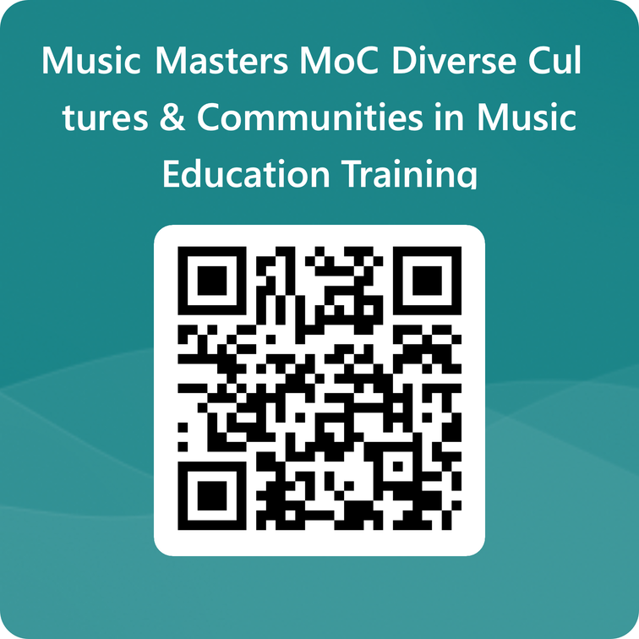
Feedback form
Please take a few minutes now to complete the Microsoft Forms feedback form by scanning this QR code.
Please complete 7 short questions
and remember to submit your responses!

