Slide 1
Questions to consider during the day
Does your teaching philosophy and practice align?
In what ways might traditional pedagogies be prohibitive to inclusive teaching?
What does pupil-led learning really mean? How does it look and sound like in a lesson?
What might an alternative approach look like? Sharing a practical toolkit and findings about a new pedagogy.

Slide 2
‘Participation rates in WCET are increasing, but the number of children achieving foundation level standards is diminishing – is this a necessary pay-off?’
Martin Fautley and Adam Whittaker, Key Data on Music Education Hubs 2016 (2017), https://www.artscouncil.org.uk/sites/default/files/download-file/key_data_music_report.pdf, p. 47.

Slide 3
Thinking about your own teaching philosophy
What are you trying to achieve with your pupils through your teaching?
What should a pupil expect when they learn with you?
Write down your current philosophy in a couple of sentences.

Slide 4
My teaching philosophy
Teach pupils to make music musically with other musicians

Slide 5
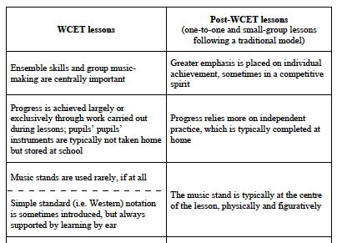
Common features of WCET and post-WCET teaching (Dromey, 2024)

Slide 6
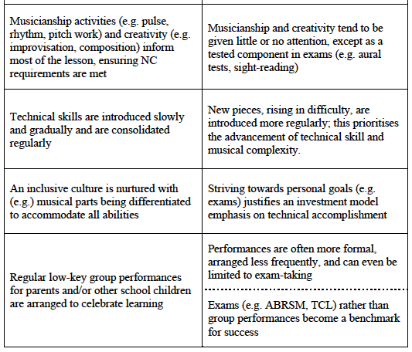
Common features of WCET and post-WCET teaching (Dromey, 2024)

Slide 7
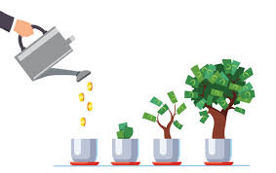
The Investment Model of Pedagogy

Slide 8
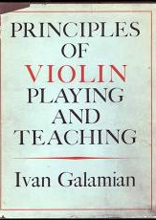
Students ‘must become fully equipped with all of the technical tools so that [their] music ideals may be fully realized.’
Ivan Galamian, Principles of Violin Playing and Teaching [1962] (Dover, 2013), p. 5.

Slide 9
Pedagogical barriers
Potentially prohibitive features –
Concept of investment
Corrective pedagogy
Intensity of the learning environment
Notation reading
Demands of practice routines
Parental involvement

Slide 10
Questions for self-reflection
Do you have pupils who have experienced any of these pedagogical barriers? Which ones? Are there any additional barriers not mentioned?
Can you relate to the challenges faced when teaching using a traditional pedagogy? Is there a single feature that stands out for you as particularly challenging (or more than one)?
Does your own teaching follow an “investment” model?
When is this model beneficial for pupils? When is it not?

Slide 11
The dichotomy of Evelyn and Jake: Two types of post-WCET learner
Evelyn – the “ideal” pupil
Jake – the most common type of post-WCET learner
Had I encountered many more ‘Evelyns’ in my post-WCET teaching, I may not have recognised the need for continuation pedagogies to be considered and tested at all. Instead, I came to realise that I was teaching ‘Jakes’ as if they were ‘Evelyns’, with disappointing results that now seem obvious, but which did not at the time (p. 231).
I am acutely aware that for many years, I imposed on ‘Jakes’ rigid musical and behavioural expectations to which they would probably need to adhere if they were to be successful. All too often, pupils who are unable to meet such expectations are still considered either unsuited to the demands of instrumental learning or, worse, unmusical (p. 235).
Who is instrumental teaching for?
When we rely exclusively on traditional pedagogic models, we are in danger of using inclusive rhetoric such as ‘music for all’ but the subtext/reality is ‘music for the few, able to respond well to the demands and contexts of traditional pedagogy.’

Slide 12

“Be A Musician” (BeAM)
A new instrumental pedagogy to improve engagement and progress?
Bridging the gap between WCET and traditional lessons
Pupil-led and (more) “democratic”
Prioritising the quality of musical process (in the present)
Developing musical voice from the earliest stages
Allowing pupils to act like, and be, musicians

Slide 13
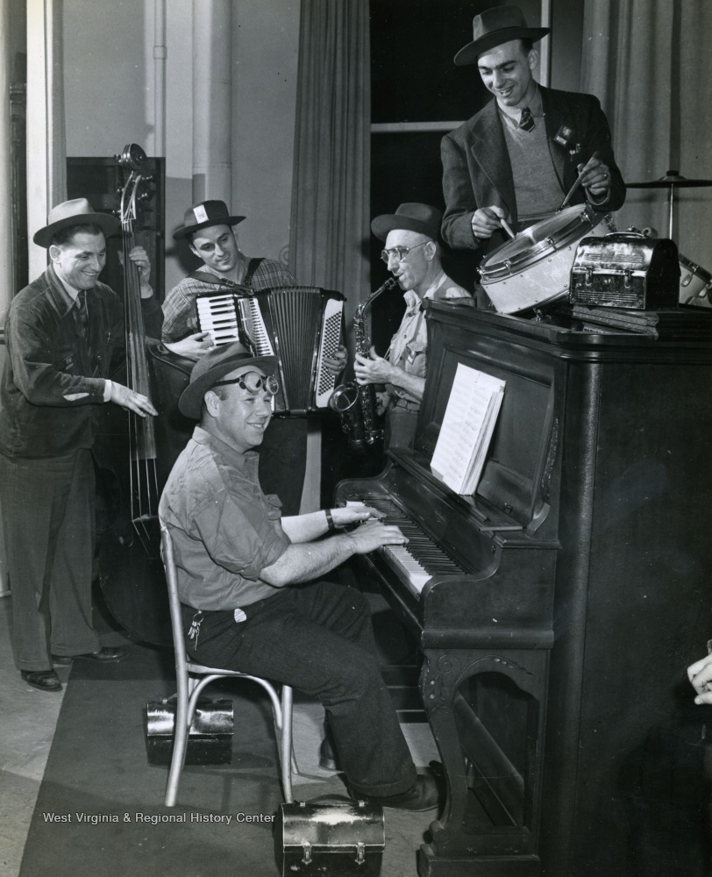
What do musicians do?
Make musical decisions about musical elements, e.g. tempo, articulation, phrasing, balance, etc.
Collaborate and make music together
Can be spontaneous and respond to a given musical situation
Problem-solve together in a rehearsal
Appraise one another’s music-making – ideally in a constructive, diplomatic way!
Communicate their musical ideas and vision to one another and to an audience
How regularly do these qualities feature in your lessons?

Slide 14
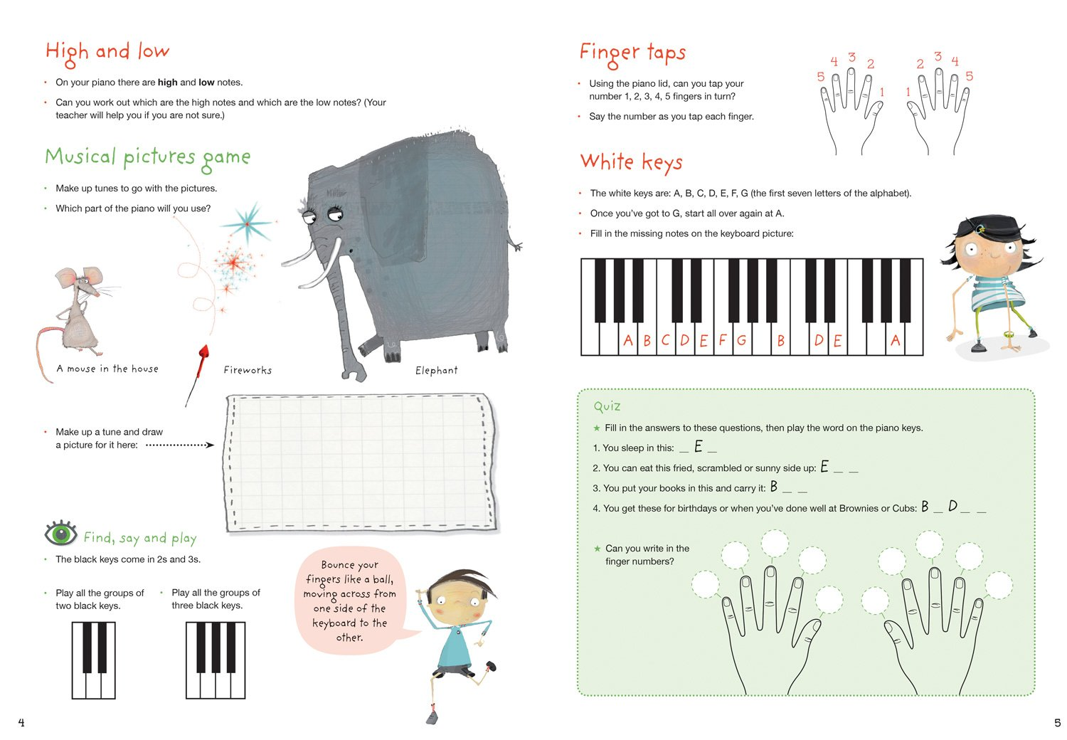


Thinking about pupil-led learning
Consider the following questions:
Does choosing resources with fun images and attractive backing tracks make your approach pupil-led?
Does allowing pupils to introduce their piece to the audience or what to wear in a concert make your approach pupil-led?
Does a 1-2-1 lesson focussing on the technical or musical development of that individual pupil make the lesson pupil-led?
Does taking an holistic approach (incorporating musical games, singing, creativity) make your approach pupil-led?

Slide 15
What does a pupil-led approach really involve?
Pupil-led learning requires teachers to design and deliver activities where pupils are encouraged to make ‘musical decisions that matter’ (Shieh & Allsup, 2016)
Short term: The decisions shape the music and/or change the musical discourse of the lesson.
Long term: The decisions help shape the learning journey (process) and the level accomplished (product)

Slide 16

A Practical Toolkit (based on BeAM teaching strategies)
Strategies you could use with any existing piece you teach
Change your lesson formation
Find and try out “ways in”, e.g. “pass the parcel”
Devise activities in which pupils lead and follow one another, encouraging them to make musical decisions
Look for 1–2 minute playing sequences (to include lots of repetitions)
Set up creative opportunities with existing repertoire, i.e. variations and/or improvisations within a framework, playing around with musical elements

Slide 17
A Practical Toolkit
Divide pieces
Choose a part in an ensemble: find others who have made the same choice; find others who have made a different choice.
If a pupil can do something, can they teach it to others?
How does it sound? Encourage peer and personal appraisal
Always think – what do pupils’ decisions tell you about their learning and understanding?
What are the “next steps”?

Slide 18
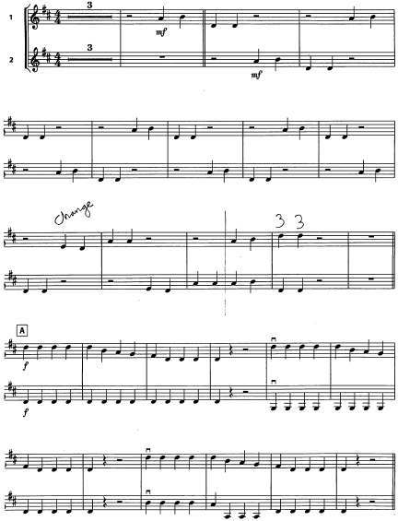
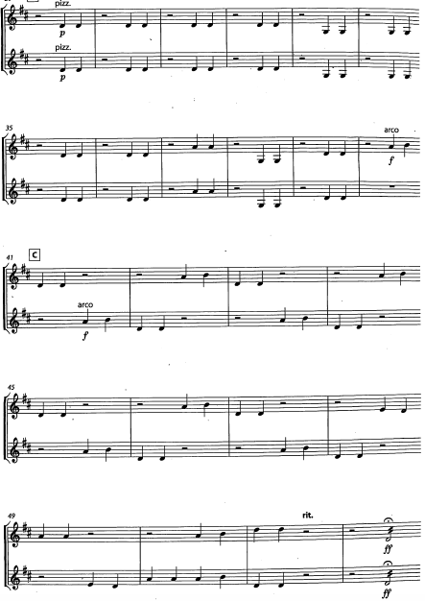

“Pass the parcel”

Slide 19
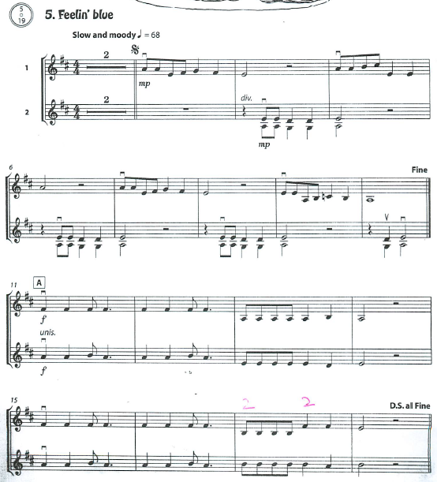

Slide 20
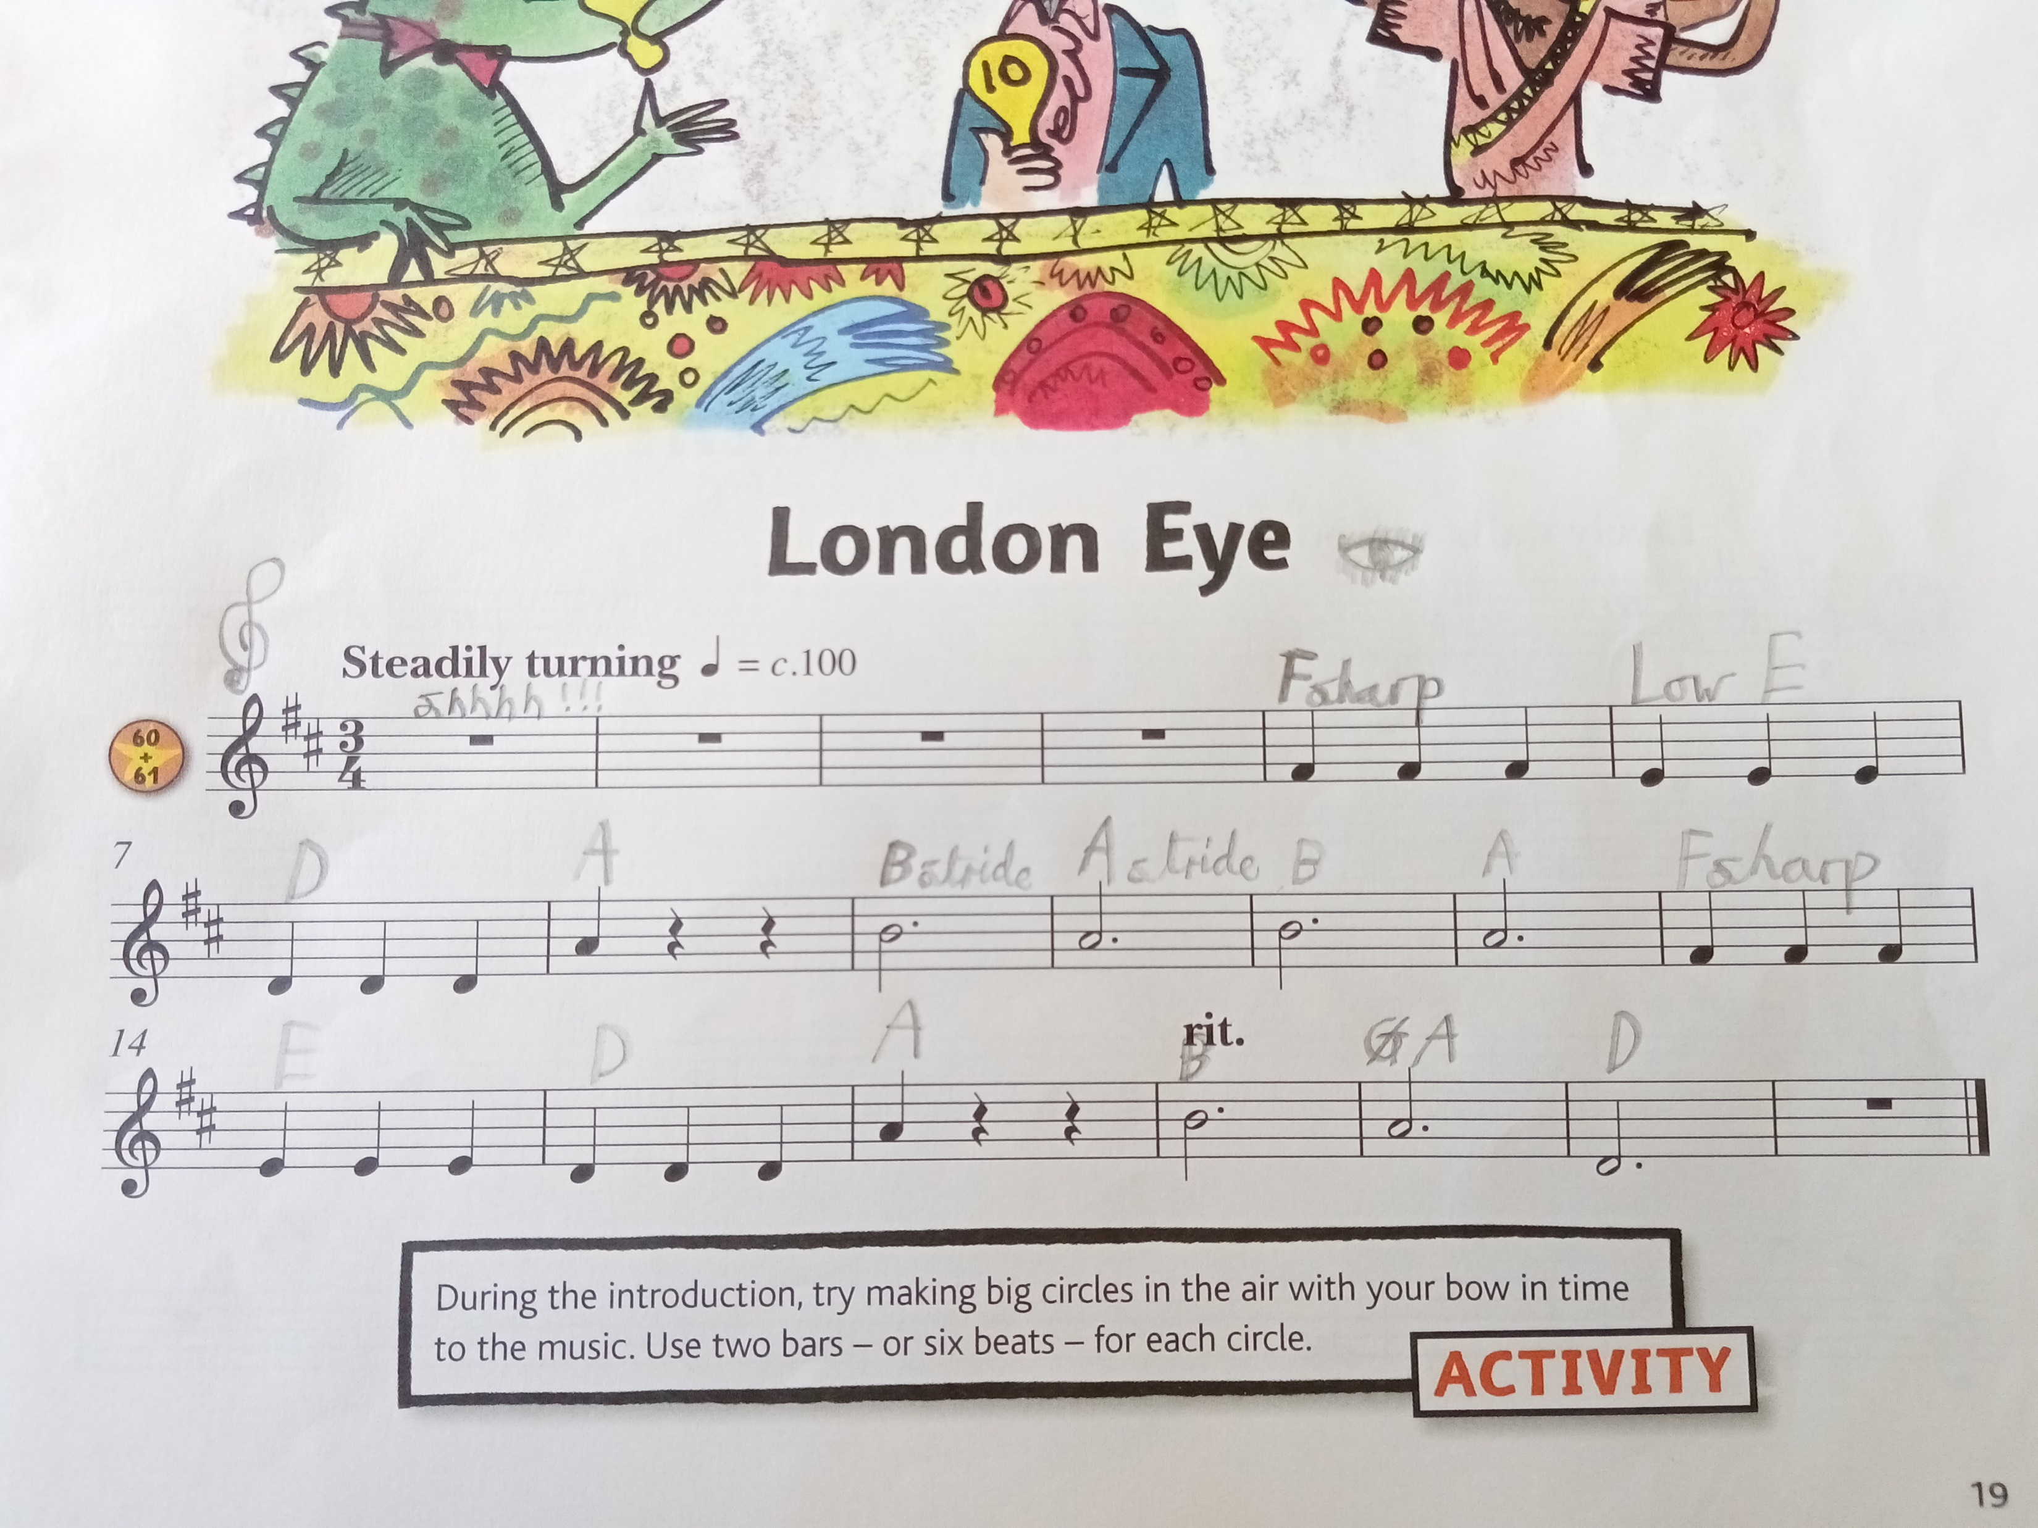
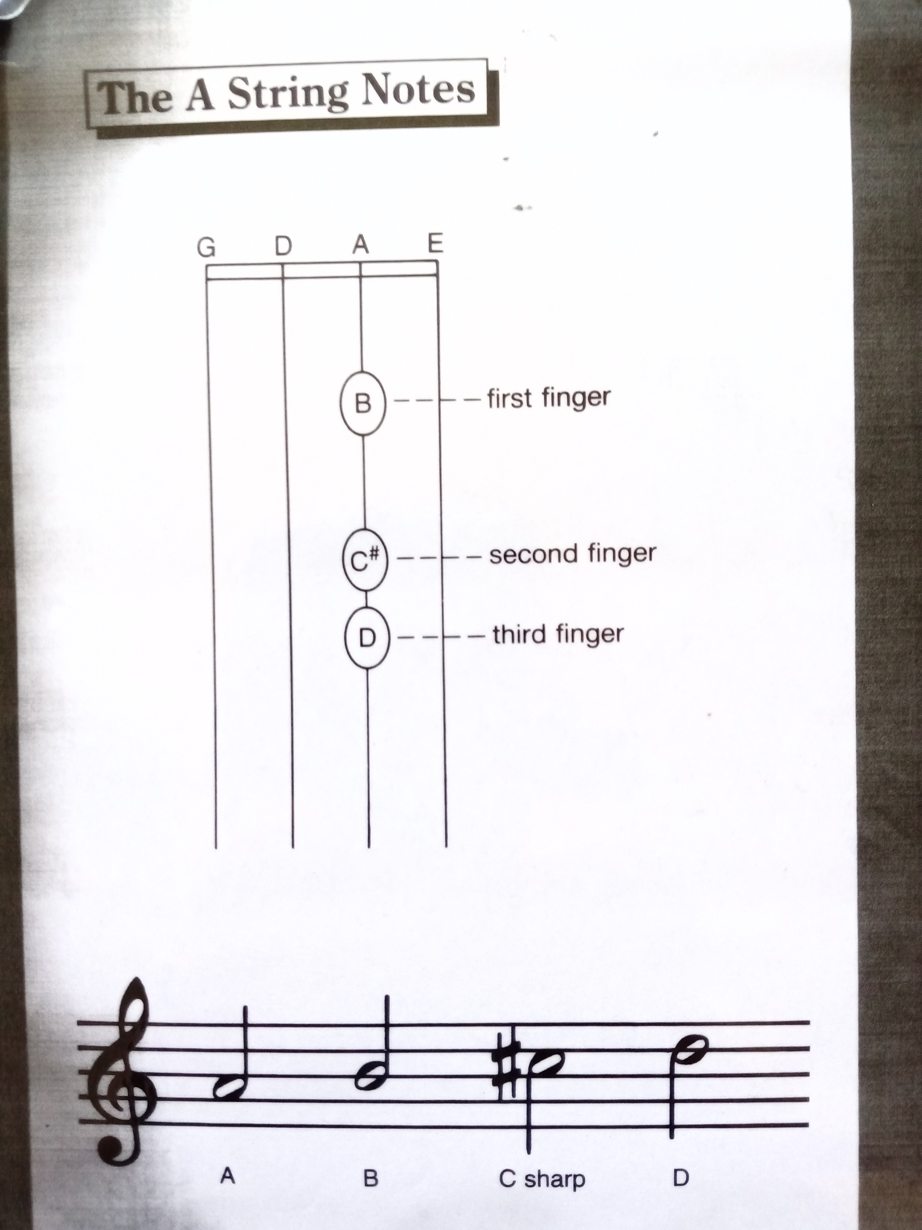
Problem-solving – Notation

Slide 21

Approaches to assessment – “Growing power”
‘I believe that interests are the signs and symptoms of growing power, I believe that they represent dawning capacities. Accordingly, the constant and careful observation of interests is of the utmost importance for the educator.
I believe that these interests are to be observed as showing the state of development that the child has reached.
I believe that they prophesy the stage upon which he is about to enter.’
John Dewey, My Pedagogic Creed (1897), p. 15.
Notes:
Dewey’s concept of ‘growing power’ allows us as teachers to acknowledge a much broader variety of pupil behaviours as signs of progress/positive educational outcomes. They might not always be about music directly but they have happened through music. This is a much more holistic perspective than in traditional pedagogies which only take account of the musical product. Here we focus on the quality of the musical processes in the present – in the lesson. Are pupils engaged in the activity? Are they alert and ready to start? Are they asking questions that show understanding? Are they getting confused about something – this could be an important interim step towards deeper understanding? Are they helping others understand? Are they putting their own ideas forward and trying new ones? Are they commenting on their playing and showing awareness of others playing? This is all evidence of learning even though they might not be able to play something “correctly”.

Slide 22
Four findings
Pupil-led learning can help better engagement as pupils continue lessons after WCET
It is possible, and desirable, for instrumental teachers to conceptualise and identify progress in new ways
Pupil-led pedagogies are better positioned to support an instrumental teaching agenda (such as the NPME) that aims to engage all children
Drawing a distinction between training and educating will help instrumental teachers emulate or build upon non-traditional pedagogies

Slide 23
Five ways in which pupil-led learning improved engagement
Lead and follow activities fuelled pupils’ willingness to repeat activities and to actively follow their peers.
Pupil-led activities centring repetition reduced the need for corrective pedagogy and increased pupils’ engagement in such activities.
Pupil-led activities that reconfigured the learning space or which asked pupils to move improved engagement.
Creative activities led by pupils prompted an unexpected interest in exploring instrumental techniques.
Collaborative, problem-solving activities involving musical discussion involved pupils in new and more varied ways, helping them to stay engaged.

Slide 24
“What advice would you give to violin teachers planning lessons for their pupils?”
Make pupils more involved in choosing a piece and make sure they look like they are enjoying it and don’t be too strict.
Warm up with very easy pieces and creating and leading like I really enjoy it when you go out of the room and then we all crowd together and decide what to do and one time we chose the notes to make a different version of some song.
Make the lessons fun and warm up before going into a tricky piece.
My advice is make the lesson fun by letting pupils make up their own music. They could get a really easy piece and let them change it up a bit with the same rhythm but different bits. Let them have a choice about what they play.
We’ve not done much of it because a lot of the music I like doesn’t fit the violin but if you were doing one on one lessons you could say “Are there any songs that you like and listen to?” and that might make it a lot funner.
Make it fun and get to know what they like so they enjoy things.
Make sure they trust you so you have to make sure that they trust you are teaching them right. Play the copying game with See a Little Monkey.
To ask peoples’ opinions and get to know them.
Make it fun to learn and play fun pieces, not missing out on anything you like, and make it spacious.

Slide 25
“Can you write down the thing you’ve enjoyed most about playing the violin and your lessons this year?”
“Is there anything you haven’t enjoyed?”
I’ve enjoyed playing the pieces.
Playing with my friends and getting to play my own pieces.
There is nothing I have not enjoyed
We played together and (in response to the second question) nothing.
Can I say copying where one of us makes up a piece and the other one copies it?
I like learning pieces. My favourite thing is working with friends and mostly with Mrs Dromey
I have enjoyed learning the violin with my friends. I haven’t enjoyed missing out on PE.
I enjoyed my own holiday Screech Holiday because it involved all my favourite notes….I enjoyed making up your own Beach Holiday because you didn’t have to conscript [restrict?] the notes.
I’ve enjoyed learning new pieces which are fun to play… I like Walk on Mars and Mellow D. The thing I haven’t enjoyed is sometimes on the bow it makes my knuckles get stuck and also when we miss PE.
I like Walk on Mars, Mellow D, when you go out the room, Beach holiday, making up our own music, spiccato thingy. I didn’t like doing lessons over the computer because it went glitchy and that’s when my violin went wrong and my G string and I didn’t like Skye Boat Song – it was horrible.

Slide 26
Time for questions

Slide 27
Next steps…
What might you try next week with your pupils?
Write down ideas for:
one short-term change
one medium or longer-term change
If you’d like to read more –
Helen Dromey, A Pedagogy for Continuation: Rethinking Instrumental Teaching after WCET (University of York, 2024). Available from: https://etheses.whiterose.ac.uk/35699/1/Dromey_208063079_Thesis.pdf

Slide 28

Final thoughts –
“If we teach today’s students as we taught yesterday’s, we rob them of tomorrow.” (John Dewey, Democracy and Education)
Pupils want to be heard and have something musically valuable to share
Pupil voice can be developed through musical choice
Work with what pupils bring to the lesson, not what you wish they had brought to the lesson
Aim for pupils to be musically engaged and working at their capacity – but not beyond it
Utilise the group teaching situation
Celebrate musical communities
We all play a part in establishing what is musically celebrated

