Slide 1
Assignment 2
Chris Jolly – 5th January 2026

Slide 2
What is assignment 2?
15 minute in person presentation
Based on one theme from a list on the assignment brief
Demonstrating how you are reflecting and developing an understanding

Slide 3
Themes
Planning
Approaches to teaching
How learning happens
Creativity
Behaviour Management
Assessment

Slide 4
Learning Outcomes
Demonstrate a critical understanding of a selected theme and the wider module content.
Apply your understanding to a critical analysis of your own experience as a learner.
Critically analyse the learning and teaching you have observed in the contexts of the course.
Demonstrate an ability to communicate to an audience.

Slide 5
1. Demonstrate a critical understanding of a selected theme and the wider module content
Don’t just give your perspective on the theme
Do bring in theories you have learnt about on the course and in your reading
What have you learnt about the theme you have chosen?

Slide 6
2. Apply your understanding to a critical analysis of your own experience as a learner
Don’t give examples of when you were learning as a child
Do reflect on what is happening in the classroom for you now as a teacher
What has brought about this more in-depth thinking on your theme?

Slide 7
3. Critically analyse the learning and teaching you have observed in the contexts of the course
Don’t give your opinion on someone's teaching
Do relate what you have observed to both your own teaching and wider course content (weekend sessions and reading)
What have you seen in other’s teaching that relates to your theme?

Slide 8
4. Demonstrate an ability to communicate to an audience
Don’t read a script
Do take your audience on a journey
What tools will you use to best get your point across in a succinct way?

Slide 9
Learning Outcomes – in short
1. Research
2. Reflect
3. Observe
4. Communicate

Slide 10
Any questions so far?

Slide 11
What you should take from today
Identify a theme in your teaching to explore further – LO2 – reflect
Identify some teaching you have observed or will observe that is linked to your theme – LO3 – observe
A book/chapter/presentation/author to explore on your chosen theme – LO1 – research
Tools you will use to present – LO4 – communicate

Slide 12
In breakout rooms
Spend some time choosing a theme that you would like to focus on. Think about the situation that brought you to that theme (reflection and/or an observation)
  Planning for learning in your specialist subject area
  Approaches to teaching: signature pedagogies in your specialist area
  How learning happens, barriers to learning and the impact of pedagogical decisions
  Creativity: teaching creatively; learning to think in new ways and teaching for creativity
  Behaviour Management: setting, achieving and maintaining expectations
  Assessing learning and measuring impact: adapting teaching to meet learning needs

Slide 13
Prompts for discussion
Don’t have a theme yet
  Which theme interests you most or is most relevant right now?
  What have you seen recently that has made you think about your own teaching?
  Which sessions at the teaching weekends have had most impact?
Have a theme
  What is it that has brought you to your theme?
  Where are the holes in your assignment – can you hit all the learning outcomes?
  Where do you need to spend most time working?
    Research
    Reflection
    Observation
    Communicate

Slide 14
Presenting – my general rules
No reading from a script
Reading a short quote on your thoughts has more impact
One minute per slide
Elaborate verbally on minimal slides
Practice a lot!

Slide 15
On the day of the presentation
Breathing
What are you going to do with your hands?
How do you prepare to perform?

Slide 16

Behaviour Management
The Importance of Establishing Expectations and having Flexible Consistency
Chris Jolly

Slide 17
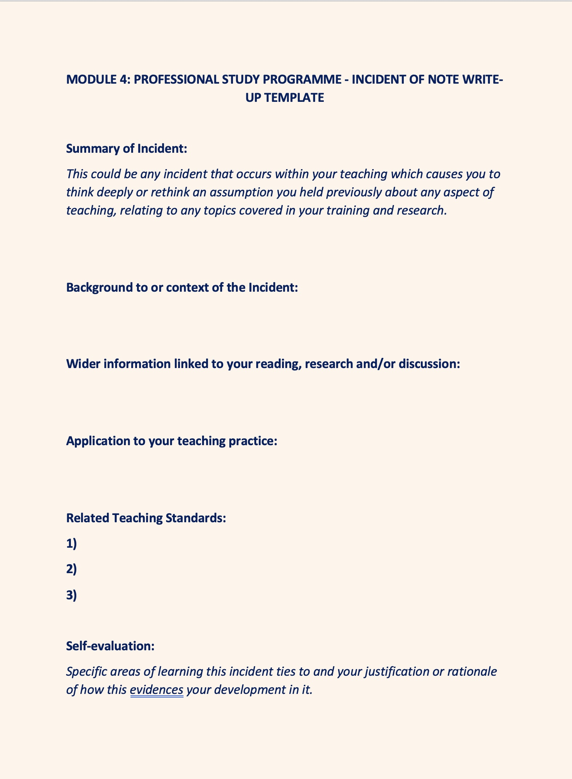
What brought me to my theme

Slide 18
Reflection on my own practice
Can I establish rules and expectations so late in the year?
Have I ever discussed my expectations with my class?
I was relying too heavily on existing class rules that I haven’t established
With rules I will have consistency when it comes to incentives and sanctions!
“Specialist teachers at primary school will not have the luxury of time to develop their rules [in many ways] but are well served, nonetheless, by discussing the rules in their first meeting with their class.”
Rogers (2011: 129)
Notes:
I found these questions and statements that I had to investigate further

Slide 19
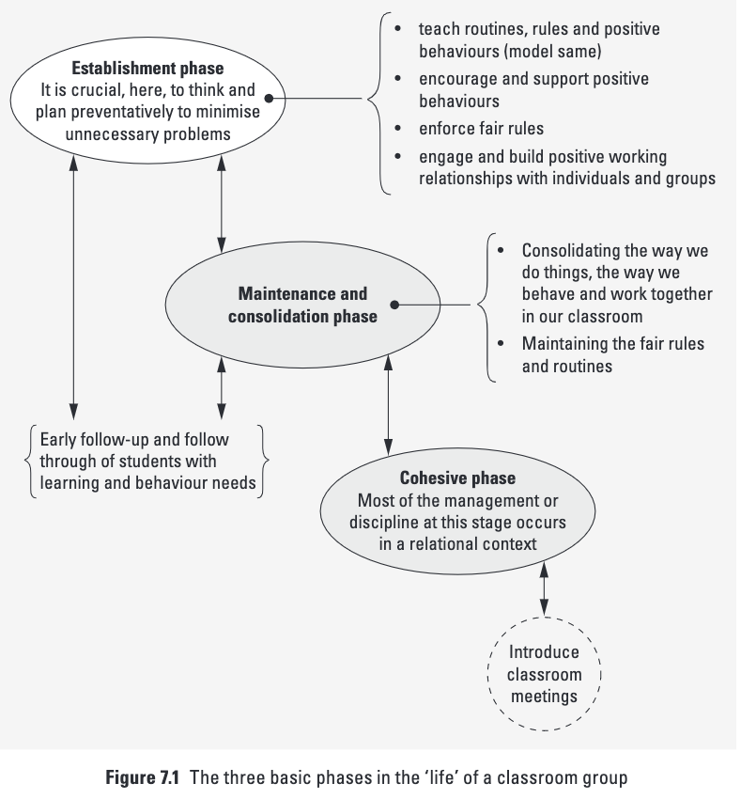
“Teachers need to explain - and discuss - these rights, responsibilities and rules with their students in the establishment phase of the year.”
(Rogers 2011:8)
Rogers (2011: 192)
Notes:
2'45'' at beginning of slide?
The Three Basic phases in the life of a classroom

Slide 20
Consistency
“The more consistent you are, the more your students will know what to expect from you.”
Cowley (2010: 211)
Now I have my rules I can be consistent
Consistency turns into habit and “the way we do things”. This in turn helps maintain the rules that have been established.
Rogers (2011: 192)

Slide 21
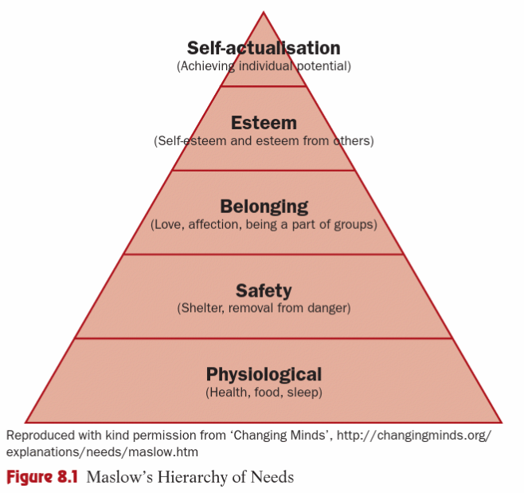
Consistency
“In the classroom [safety] manifests itself in the need for rules, routines and sanctions: in other words, well-defined boundaries designed to govern pupil behaviour.”
Dixie (2011: 86-87)

Slide 22
Flexibility
Now I have my consistency I can be flexible
“As with academic development, pupils of the same age differ in their social development – whereas some will arrive highly motivated to engage with learning, others will need more encouragement.”
(Chaplain 2014: 181)

Slide 23


Flexibility
Flexibility allows the chance to move back and adjust rules if they are not being understood
Rogers (2011: 192)

Slide 24
Flexible consistency
Consistency
Flexibility
“Don’t lower your standards, but use your professional judgement to make decisions about the right balance between consistency and flexibility.”
(Cowley 2010: 41)

Slide 25
What would a successful assignment 2 look like?
LO1 - You demonstrate a sophisticated and perceptive understanding of the selected theme and the wider module content
  You have done your research
LO2 - You applied a sophisticated and perceptive understanding to the critical analysis of your own experience as a learner
  You have reflected on your own practice
LO3 - Your critical analysis of the learning and teaching you have observed in the contexts of the course was sophisticated and perceptive
  You have observed your theme in other teaching
LO4 – You demonstrated that you have exceptional skills that have complimented your ability to communicate to an audience
  You have communicated
And if you do all that…

Slide 26

CONGRATULATIONS
YOU HAVE PASSED ASSIGNMENT 2
Any questions?
Thank you

