Slide 1

Behaviour Management
Chris Jolly – 18.01.26

Slide 2
The session this afternoon
What I will hopefully do
  Give you some tools and ideas to adjust your approach
  Dig into and reflect on a few theories
  Help you realise it’s not just you!
What I won’t do
  Give you tried and trusted techniques
  Give you a quick fix (sorry)
  Be unhelpful

Slide 3
Who are we?
Dad
Husband
Friend
Musician
Colleague
Manager
Teacher
Advocate

Slide 4
Who are we?
Good communicator
Inspiring
Courageous
Positive
Organised
Approachable

Slide 5
Who do you want to be when you are teaching?
What does poor/good behaviour look like?
Go to menti.com and use the
code 8945 2192

Slide 6
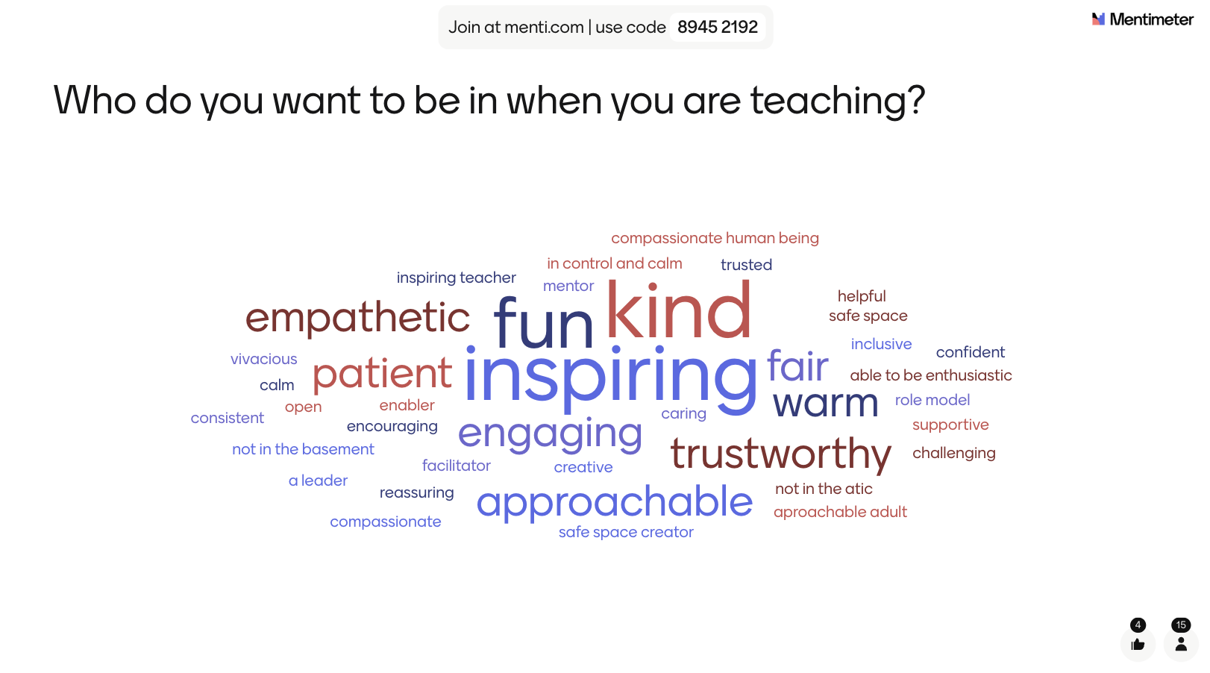

Slide 7
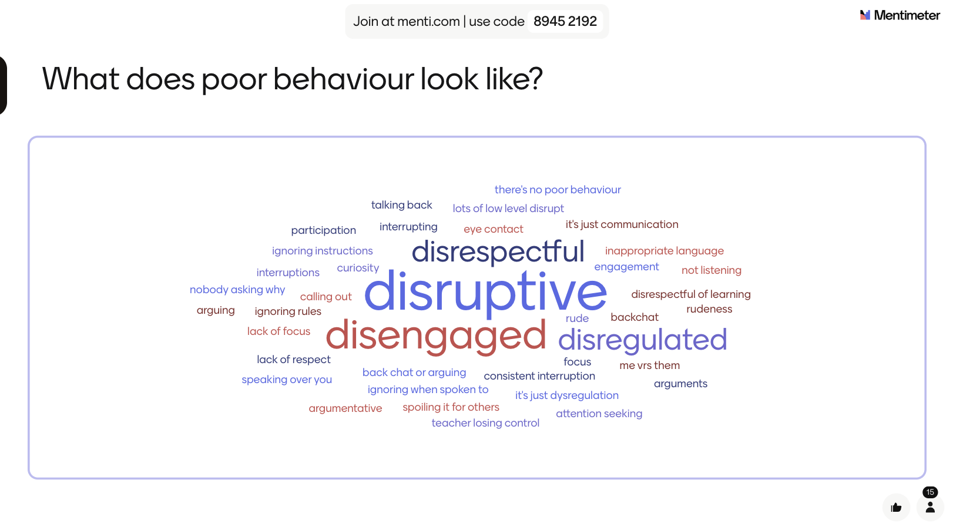

Slide 8
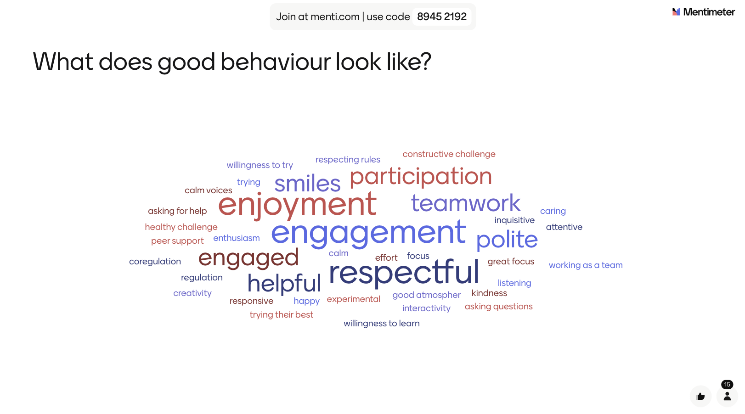

Slide 9
Behaviour for Learning

Slide 10
Behaviour leadership

Slide 11
What’s the difference between management and leadership?

Slide 12
We are in the mucky middle

Slide 13
Flexible Consistency
Routines
Self-determination Theory
Scenarios

Slide 14
Flexible Consistency

Slide 15
Story time

Slide 16
Reflection on my own practice
Can I establish rules and expectations at any point in the year?
Have I ever discussed my expectations with my class?
With rules I will have consistency when it comes to incentives and sanctions!
Do I rely too heavily on existing class rules that I haven’t established
“Specialist teachers at primary school will not have the luxury of time to develop their rules but are well served, nonetheless, by discussing the rules in their first meeting with their class.”
Rogers (2011: 129)
Notes:
I found these questions and statements that I had to investigate further

Slide 17
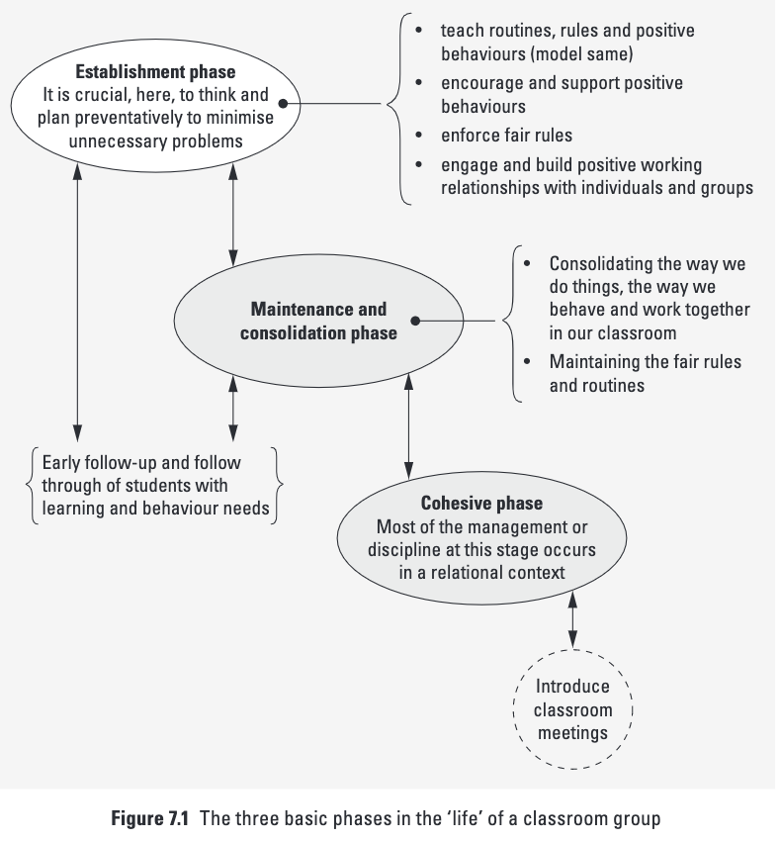
“Teachers need to explain - and discuss - these rights, responsibilities and rules with their students in the establishment phase of the year.”
(Rogers 2011:8)
Rogers (2011: 192)
Notes:
2'45'' at beginning of slide?
The Three Basic phases in the life of a classroom

Slide 18
”Having clear expectations, and sharing these with your class, is a key factor in effective behaviour management.”
(Cowley, 2010: 25)
Notes:
5'40'' at beginning of slide?

Slide 19
Consistency
“The more consistent you are, the more your students will know what to expect from you.”
Cowley (2010: 211)
Now I have my rules I can be consistent
Consistency turns into habit and “the way we do things”. This in turn helps maintain the rules that have been established.
Rogers (2011: 192)

Slide 20
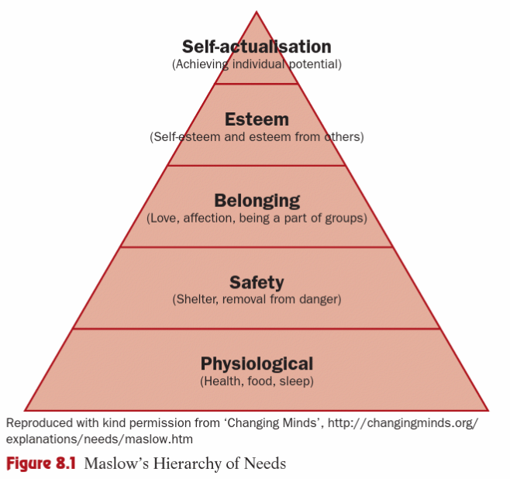
Consistency
“In the classroom [safety] manifests itself in the need for rules, routines and sanctions: in other words, well-defined boundaries designed to govern pupil behaviour.”
Dixie (2011: 86-87)

Slide 21
Flexibility
Now I have my consistency I can be flexible
“As with academic development, pupils of the same age differ in their social development – whereas some will arrive highly motivated to engage with learning, others will need more encouragement.”
(Chaplain 2014: 181)

Slide 22
Flexibility
The different behaviour issues will come from different students
  Does it just need a look
  Does it need verbal reinforcement
  Do we need to go back and re-write the rules so they are better understood

Slide 23


Flexibility
Flexibility allows the chance to move back and adjust rules if they are not being understood
Rogers (2011: 192)

Slide 24
Flexible consistency
Consistency
Flexibility
“Don’t lower your standards, but use your professional judgement to make decisions about the right balance between consistency and flexibility.”
(Cowley 2010: 41)

Slide 25
Routines

Slide 26
Routines
Elements of a lesson
Macro and micro routines
Impact on behaviour and progress

Slide 27
Elements of a lesson
List as many elements of your lessons as possible
In breakout rooms – compare and discuss your elements

Slide 28
Elements of a lesson
How would you sequence these elements?
Have you ever thought about being consistent with this sequence?

Slide 29
Macro and micro routines
Macro (long term)
Micro (short term)

Slide 30
How routines impact behaviour and progress
Let’s dig in and reflect

Slide 31
Self-determination Theory

Slide 32
Self-determination Theory
Competence
Relatedness
Autonomy

Slide 33
Self-determination Theory
Competence – student’s skill on an instrument

Slide 34
Self-determination Theory
Relatedness – student’s connection with the environment

Slide 35
Self-determination Theory
Autonomy – students have ownership over their own learning

Slide 36
Self-determination Theory
Competence – student’s skill on an instrument
Relatedness – student’s connection with the environment
Autonomy – students have ownership over their own learning

Slide 37
Discuss
Competence – student’s skill on an instrument
Relatedness – student’s connection with the environment
Autonomy – students have ownership over their own learning
Think about ways in which we can support the three psychological needs

Slide 38
Discuss
Competence – student’s skill on an instrument
Relatedness – student’s connection with the environment
Autonomy – students have ownership over their own learning
Think about what we could be doing that is blocking these three psychological needs

Slide 39
Menti.com
Code – 3233 4139

Slide 40
Intrinsic vs Extrinsic Motivation
Intrinsic – Internal
Extrinsic - EXternal

Slide 41
Discuss
What does it look like?
Intrinsic – Internal
Extrinsic - EXternal
What does it feel like?

Slide 42
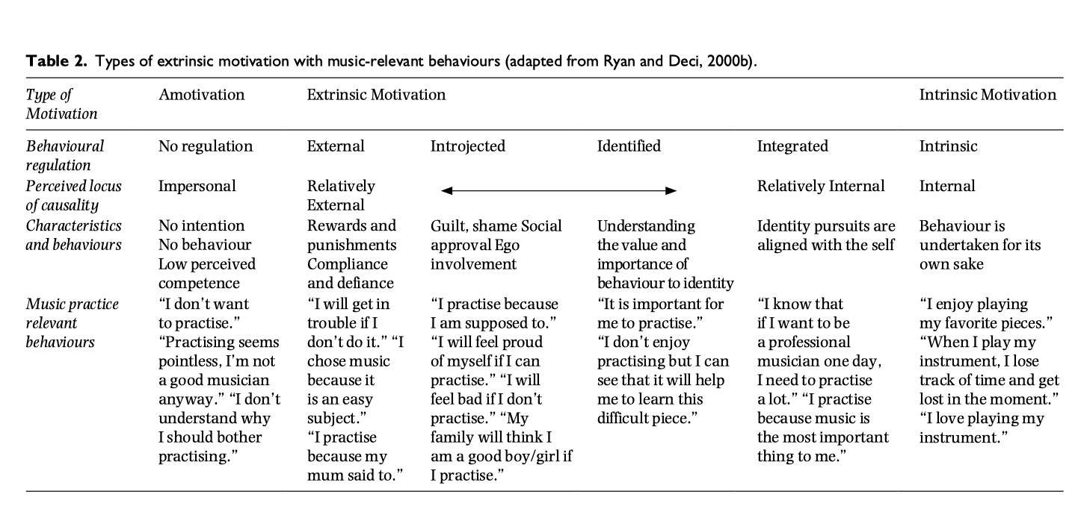

Slide 43
Competence – student’s skill on an instrument
Relatedness – student’s connection with the environment
Autonomy – students have ownership over their own learning
Think about ways in which we can support the three psychological needs

Slide 44
To finish…
“Teachers, parents, and peers of music students can do things to ensure that basic psychological needs are fulfilled—providing opportunities for competence motivation, providing an environment of social connectedness and belongingness to support relatedness, and providing choice, acknowledging feelings, and nurturing inner motivational resources to support autonomy.” (Evans 2015: 77)

Slide 45
Scenario
I'm struggling at the moment, with whole group disruption. It's a low but constant level. I have to stop endless times trying to say the same sentence to the group. I move children, but they just disrupt from their new position. I try loads of positive reinforcement , raffle tickets, stickers, names on the board of who's 'ready to learn'. But it gets hard to reinforce positively when you're running out of patience with the whole group.

Slide 46
Thank you
Questions?

Slide 47
Bibliography
Chaplain, R., Cremlin, T., Arthur, J. (2014) Learning to Teach in the Primary School. Hoboken: Routledge
Cowley, S. (2014) Getting the Buggers to Behave, Bloomsbury Education
Daubney, A. (2017) Teaching Primary Music. Sage
Dixie, G. (2011) The Ultimate Teaching Manual : A Route to Success for Beginning Teachers. Bloomsbury Publishing Plc
Evans, P. (2015) Self-determination theory: An approach to motivation in music education, Sage
Harris, P. (2012) The Virtuoso Teacher: the inspirational guide for instrumental and singing teachers. London: Faber, p. 30
Rogers, B. (2011) You Know the Fair Rule. 3rd edition Camberwell, Vic : ACER PRESS
Rogers, B and McPherson, E. (2014) Behaviour Management with Young Children: Crucial First Steps with Children 3-7 Years. Sage

Slide 48
Useful videos from Sue Cowley
https://www.youtube.com/watch?v=b97TNZisixM&list=RDCMUCexXWCxK6L-Iz0Fxg2DZMMA&start_radio=1&rv=b97TNZisixM&t=5
https://www.youtube.com/watch?v=bgs2jwDc2bE&list=RDCMUCexXWCxK6L-Iz0Fxg2DZMMA&index=2
https://www.youtube.com/watch?v=qo3c0iHhyEw&list=RDCMUCexXWCxK6L-Iz0Fxg2DZMMA&index=3
https://www.youtube.com/watch?v=0_O-kGuPmuM&list=RDCMUCexXWCxK6L-Iz0Fxg2DZMMA&index=4
https://www.youtube.com/watch?v=_uiYAAkkTaE&list=RDCMUCexXWCxK6L-Iz0Fxg2DZMMA&index=5
https://www.youtube.com/watch?v=NvCh0jN_IHw&list=RDCMUCexXWCxK6L-Iz0Fxg2DZMMA&index=6
https://www.youtube.com/watch?v=U70LSDL2_Xs&list=RDCMUCexXWCxK6L-Iz0Fxg2DZMMA&index=7

