Slide 1


Using AI
Notes:
Alice?

Slide 2
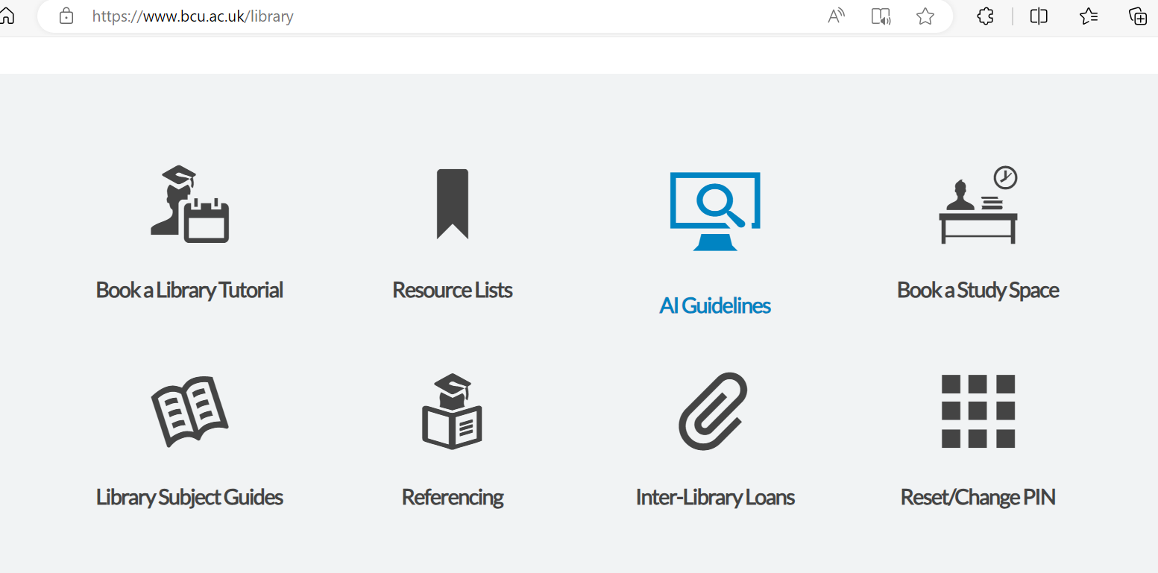
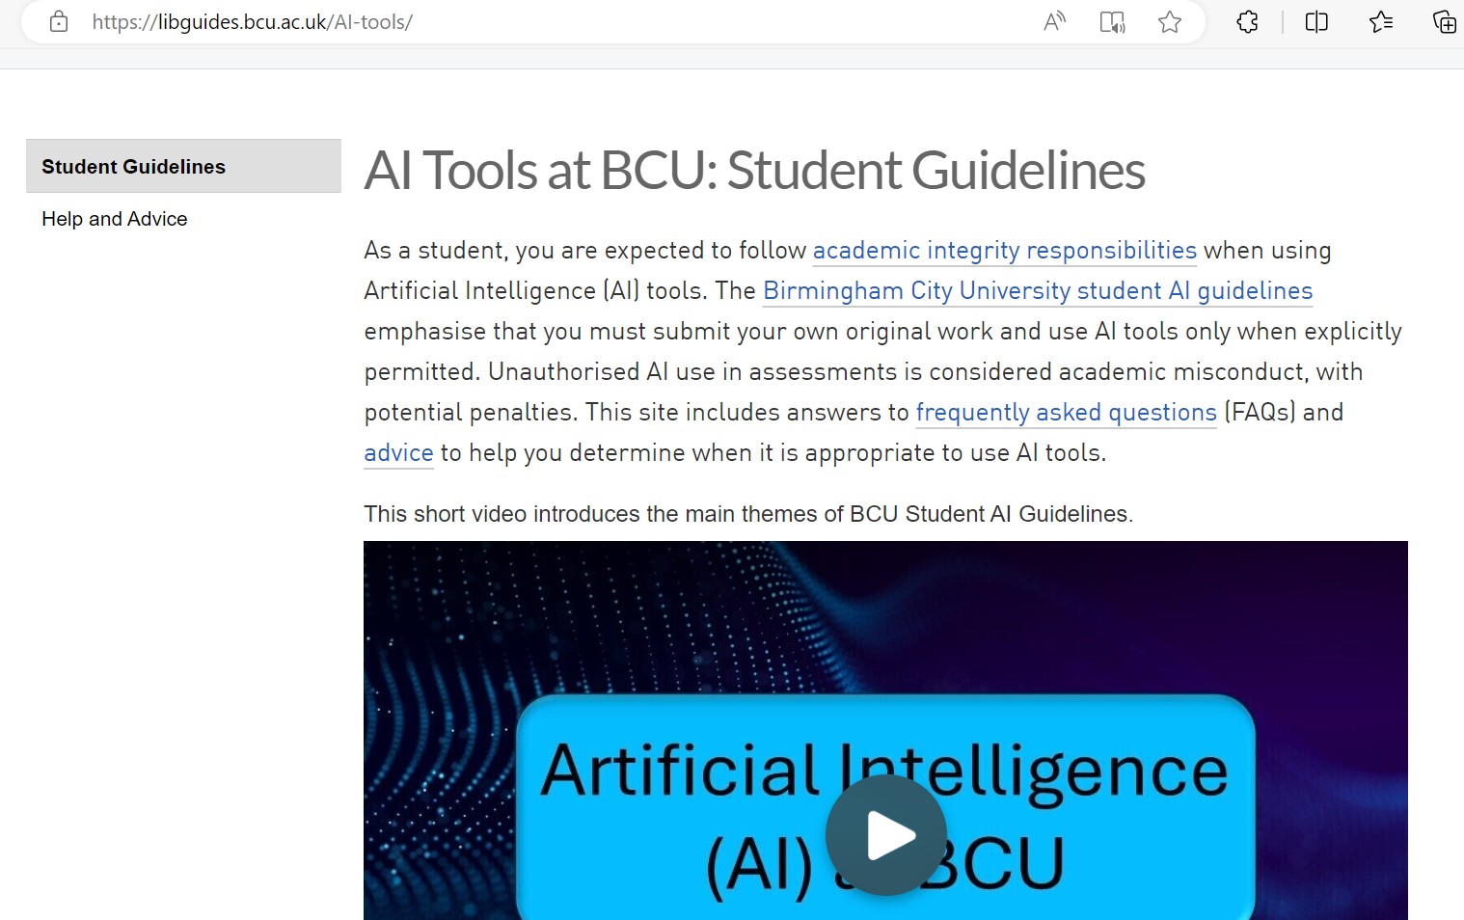
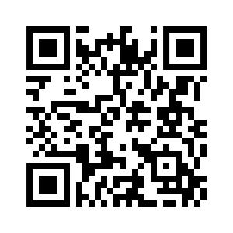
BCU Student AI Guidelines
Please ensure read the Student AI Guidelines, https://libguides.bcu.ac.uk/AI-tools/

Slide 3

Video link

Slide 4


Are these OK uses of AI?
Copying and pasting from an AI tool into your assignment?
Using AI to help you understand/break down a difficult concept?
Using references the AI tool gives you without reading or checking them yourself?
Using AI to help you find possible sources for your work?
Using AI to rewrite your work?
Using AI to help you with grammar and spelling?
Using AI to help you plan/structure your work?
Using AI to paraphrase for you?
Using AI to help you brainstorm ideas?
Using the information AI gives you without checking it in a reliable source?
Using AI to create quizzes to help you revise for an exam?
Try MS Word’s in-built Editor function for help with proofreading (demo video included at end of these slides)
See more detail at: https://libguides.bcu.ac.uk/AI-tools

Slide 5

What is AI literacy?
Notes:
Alice?

Slide 6

What is ‘AI literacy’?
What do you think is meant by this term?

Slide 7
What is ‘AI literacy’?
There are varying definitions of 'AI literacy', but Long and Magerko (2020: 2) provide a useful one for consideration:
“a set of competencies that enables individuals to critically evaluate AI technologies, communicate and collaborate effectively with AI, and use AI as a tool online, at home, and in the workplace”.
Long, D., and Magerko, B. (2020). What is AI Literacy? Competencies and Design Considerations. In Proceedings of the 2020 CHI Conference on Human Factors in Computing Systems, pp. 1–16. New York, NY, USA: ACM. https://doi.org/10.1145/3313831.3376727

Slide 8
What is ‘AI literacy’?
NB. 'critically evaluate': what are the opportunities, but also pitfalls of using AI?
While AI literacy may include effective use of AI tools via effective prompt writing skills, it also includes the ability to judge when AI may not be appropriate for a given task.
AI literacy should encompass awareness of the biases inherent in AI training data, and the concerns around data privacy and intellectual property.
Without developing this critical AI literacy, we may be poorly prepared for a workplace that expects us to be able to use AI in critical, judicious ways.

Slide 9
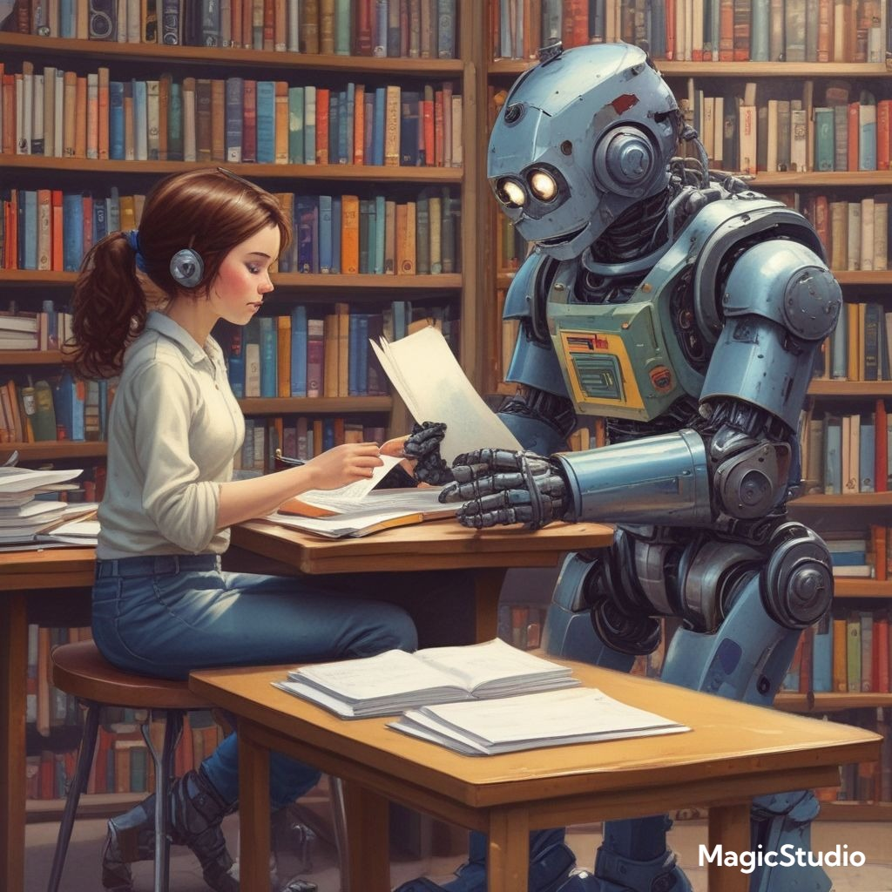
AI as learning support, not replacement
Notes:
Alice?

Slide 10
AI as learning support, not replacement
How might AI bypass the learning/thinking process if used poorly?

Slide 11
AI as learning support, not replacement
Used poorly, AI can bypass the learning/thinking process e.g.
getting AI to write an essay and submitting without any of one’s own thinking/effort
trusting/using an AI summary of an article/topic and failing to fact-check/explore the relevant details in the article/literature
‘mindless paraphrasing’: using AI to paraphrase material without any effort of one’s own
trusting/using references given by AI without checking and verifying them via the BCU Library/Google Scholar
taking the AI’s suggested ideas without critical consideration/further exploration of one’s own
regarding the AI as an authoritative voice without critical engagement of one’s own (e.g. consideration of its biases)
using AI to write a ‘personal’ reflection for you

Slide 12
AI as learning support, not replacement
How might AI enhance the learning/thinking process if used wisely?

Slide 13
AI as learning support, not replacement
Used wisely, AI can enhance the learning/thinking process e.g.
enhancing the brainstorming process → assisting ideation
encouraging exploration of unconsidered aspects → improving coverage/scope
encouraging consideration of alternative viewpoints → improving criticality
questioning of one’s own assumptions → self-criticality
as a way ‘in’ to a complex topic e.g. via initial topic summary to improve comprehension of/engagement with more complex (authentic) materials
AI gives tips without giving the ‘answer’ → guided problem-solving
AI gives guiding questions to deepen exploration/debate (e.g. Socratic dialogue)
AI quizzes for revising/consolidating understanding
AI-produced texts on the same topic from different angles (e.g. political) or tones (e.g. melancholic, whimsical, suspenseful) → develop critical reading skills
produce examples of common ethical dilemmas in a topic; then reflect on one’s own opinions and ethical stance.

Slide 14
Pros and cons of AI
Pros: used wisely, AI can… | Cons: used poorly, AI can…
help us brainstorm when we’re stuck for ideas | erode our creativity if we over-rely on it
break down/explain difficult concepts (e.g. with summaries/quizzes for revision) | erode our critical thinking or problem-solving skills if we over-rely on it
help us with time management (e.g. making a study planner) | make mistakes called ‘hallucinations’ and present false information very confidently
be a conversational partner (e.g. to practice a roleplay situation) | be trained on biased data, which can lead to biased responses (e.g. Western-centric)
help us structure/plan our work | make up sources that don’t exist
help us find relevant sources to back up our points | overshadow the student’s ‘voice’ if used to rewrite work
help us develop our critical thinking skills (e.g. when used as a Socratic partner*) | reduce human interaction if over-used

Slide 15
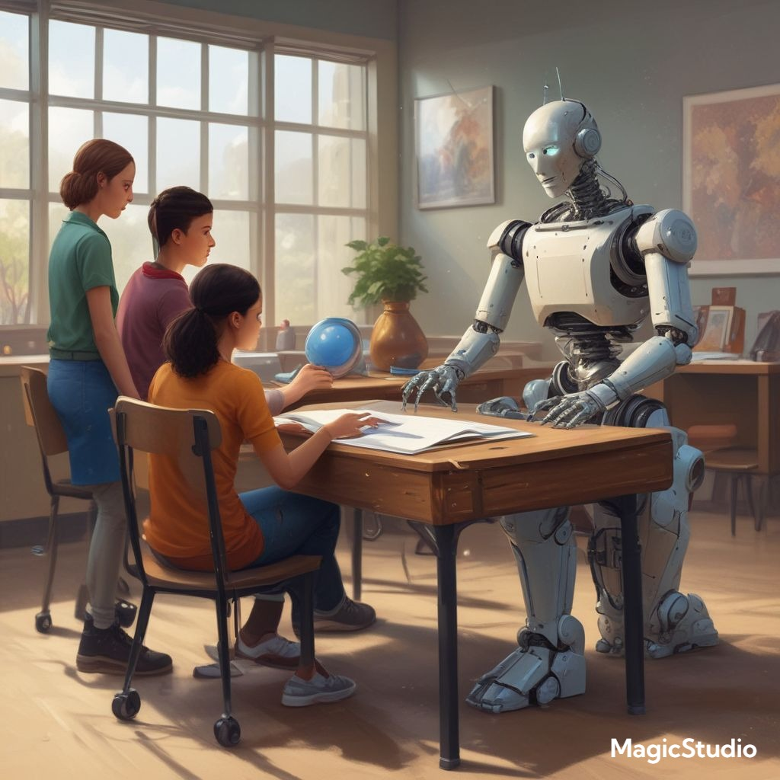
Example AI-assistance
1. Critiquing AI Output
2. AI as Debate Peer

Slide 16

Popular LLM tools
Copilot https://m365.cloud.microsoft/chat (use with BCU account)
Pi https://pi.ai/ (can interact on web without sign up)
ChatGPT https://chatgpt.com/ (needs sign up with personal account)
Gemini https://gemini.google.com/ (log in with existing Gmail account)
Claude https://claude.ai/ (needs sign up with personal account)
Perplexity https://www.perplexity.ai/ (can try out before sign up)
Cyber security note:
Do not use your BCU account to sign up for AI tools
Do not use the ‘sign in with Microsoft’ option
Do create a ‘throwaway’ gmail account that you are happy to use for AI purposes
Use that gmail account to sign up for AI tools
Never give personal or sensitive information to AI tools

Slide 17

Example 1: Critiquing AI Output
Notes:
Rozeena?

Slide 18
Example 1: Critiquing AI Output
A sample of an AI-generated answer:
Break out groups to evaluate/critique the AI’s response for quality, any ‘hallucinations’ (errors), bias, gaps in information by verifying against more reliable sources (books, articles, trustworthy websites etc.)
Checklist to aid critiquing of AI outputs
What assumptions does the AI make?
What’s missing here?
4. Share ideas as a group and discuss how this exercise promotes critical AI literacy.

Slide 19
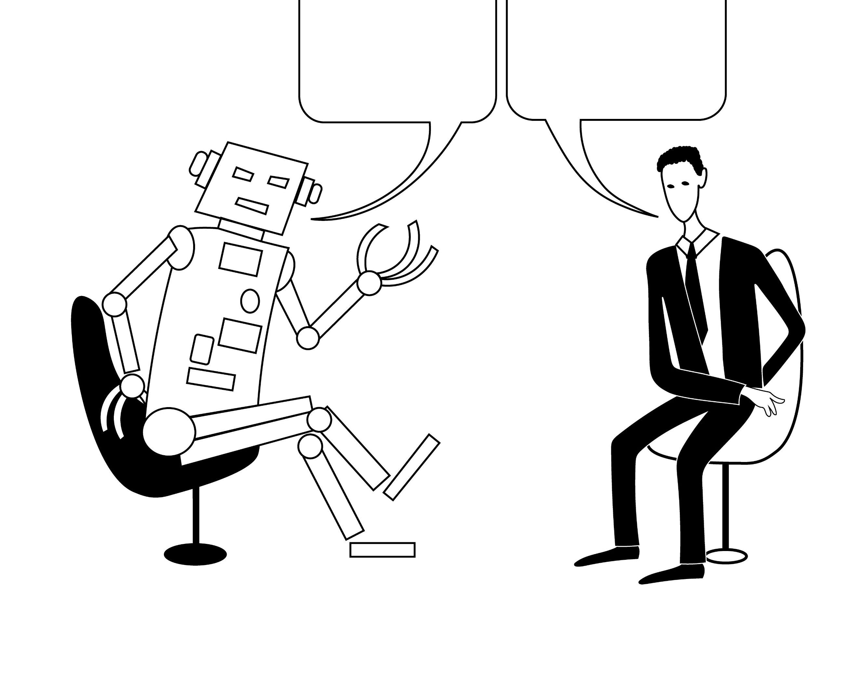
Example 2: AI as Debate Peer
Notes:
Alice?

Slide 20
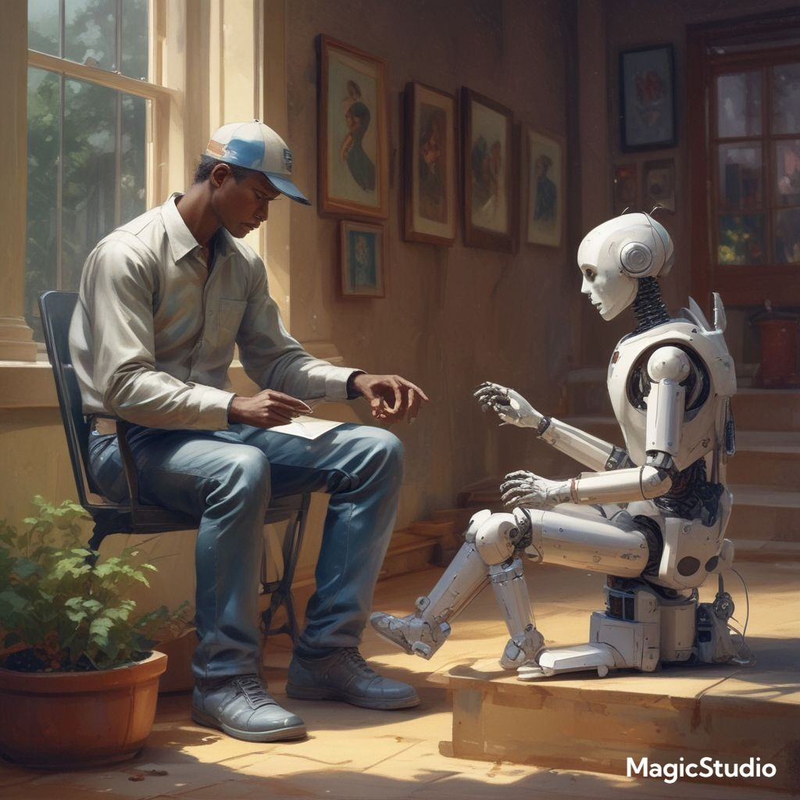
AI as Socratic Partner
Prompt example:
Hi Pi / ChatGPT / Gemini etc. Can you act as a Socratic partner regarding the following debate statement “[…insert topic of choice…]”? Please ask me/us only one question at a time.
This can help us to think more deeply/critically about an issue and help us to see it from different perspectives.

Slide 21

Example 2: AI as Debate Peer
Could you see a version of this working for you?

Slide 22
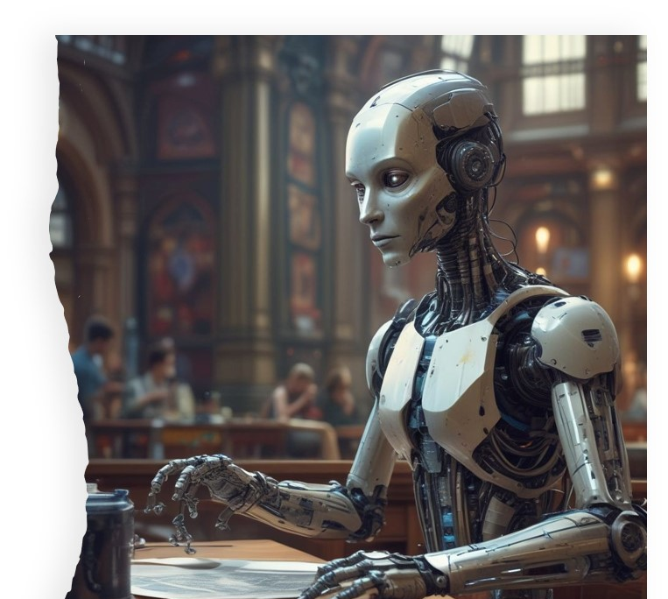
More AI tools to explore

Slide 23
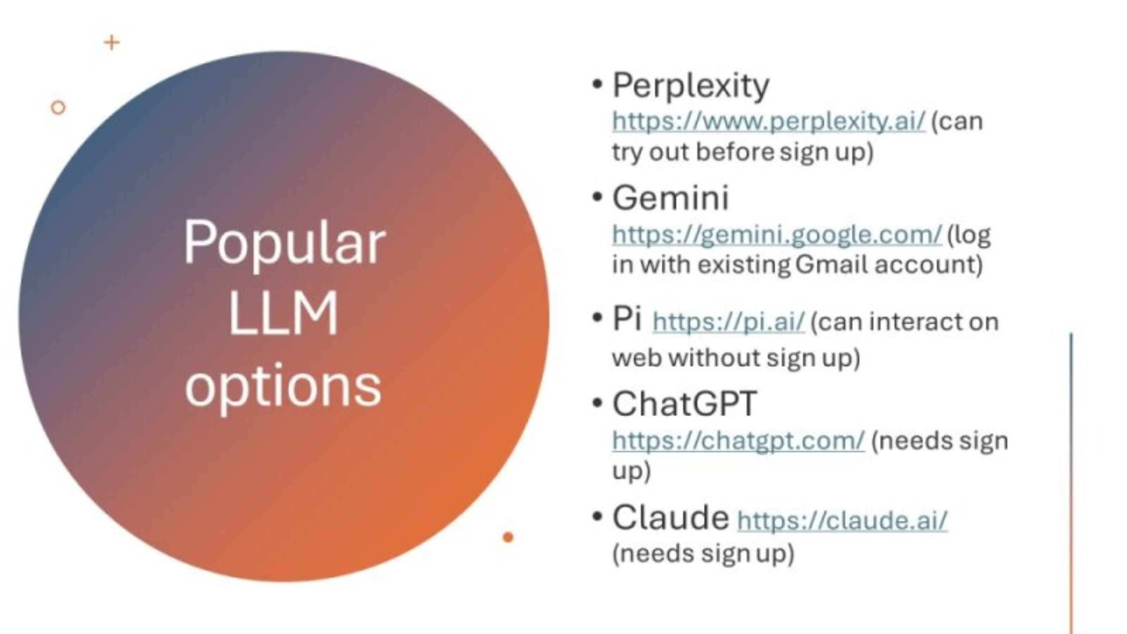

Slide 24

MS Word’s Editor function

Slide 25
MS Word’s Editor function
Do your students need help with proofreading?
MS Word’s in-built Editor function is free
The Internet in-browser version works best
It can make suggestions about:
  grammar
  vocabulary
  formality
  conciseness
  etc.
It doesn’t rewrite your work, so preserves your ‘writer’s voice’
It’s not always correct, so you need to judge for yourselves before accepting any suggestions it makes

Slide 26

Video link here

Slide 27

Google NotebookLM

Slide 28
Google NotebookLM
Great for helping to understand texts
Accessible to anyone with a gmail account
https://notebooklm.google/
Google say:
  “We value your privacy and never use your personal data to train NotebookLM.
  If you are logging in with your consumer google account and provide feedback, human reviewers may review your queries, uploads, and the model's responses to troubleshoot, address abuse or make improvements.”
Do not upload documents/sensitive information you don’t have permission to use
You can upload up to 50 documents – you control the input
Lower (but not zero) chance of hallucinations

Slide 29
Google NotebookLM
Range of functions e.g.
  can ask questions about your texts via the chat
  cites its answers so you can check where the information comes from in your documents
  summarize the selected notes
  suggest related ideas
  create a study guide
  create an outline
  combine the selected notes into a single note
  create AI-generated podcast (two speakers summarise your documents)

Slide 30
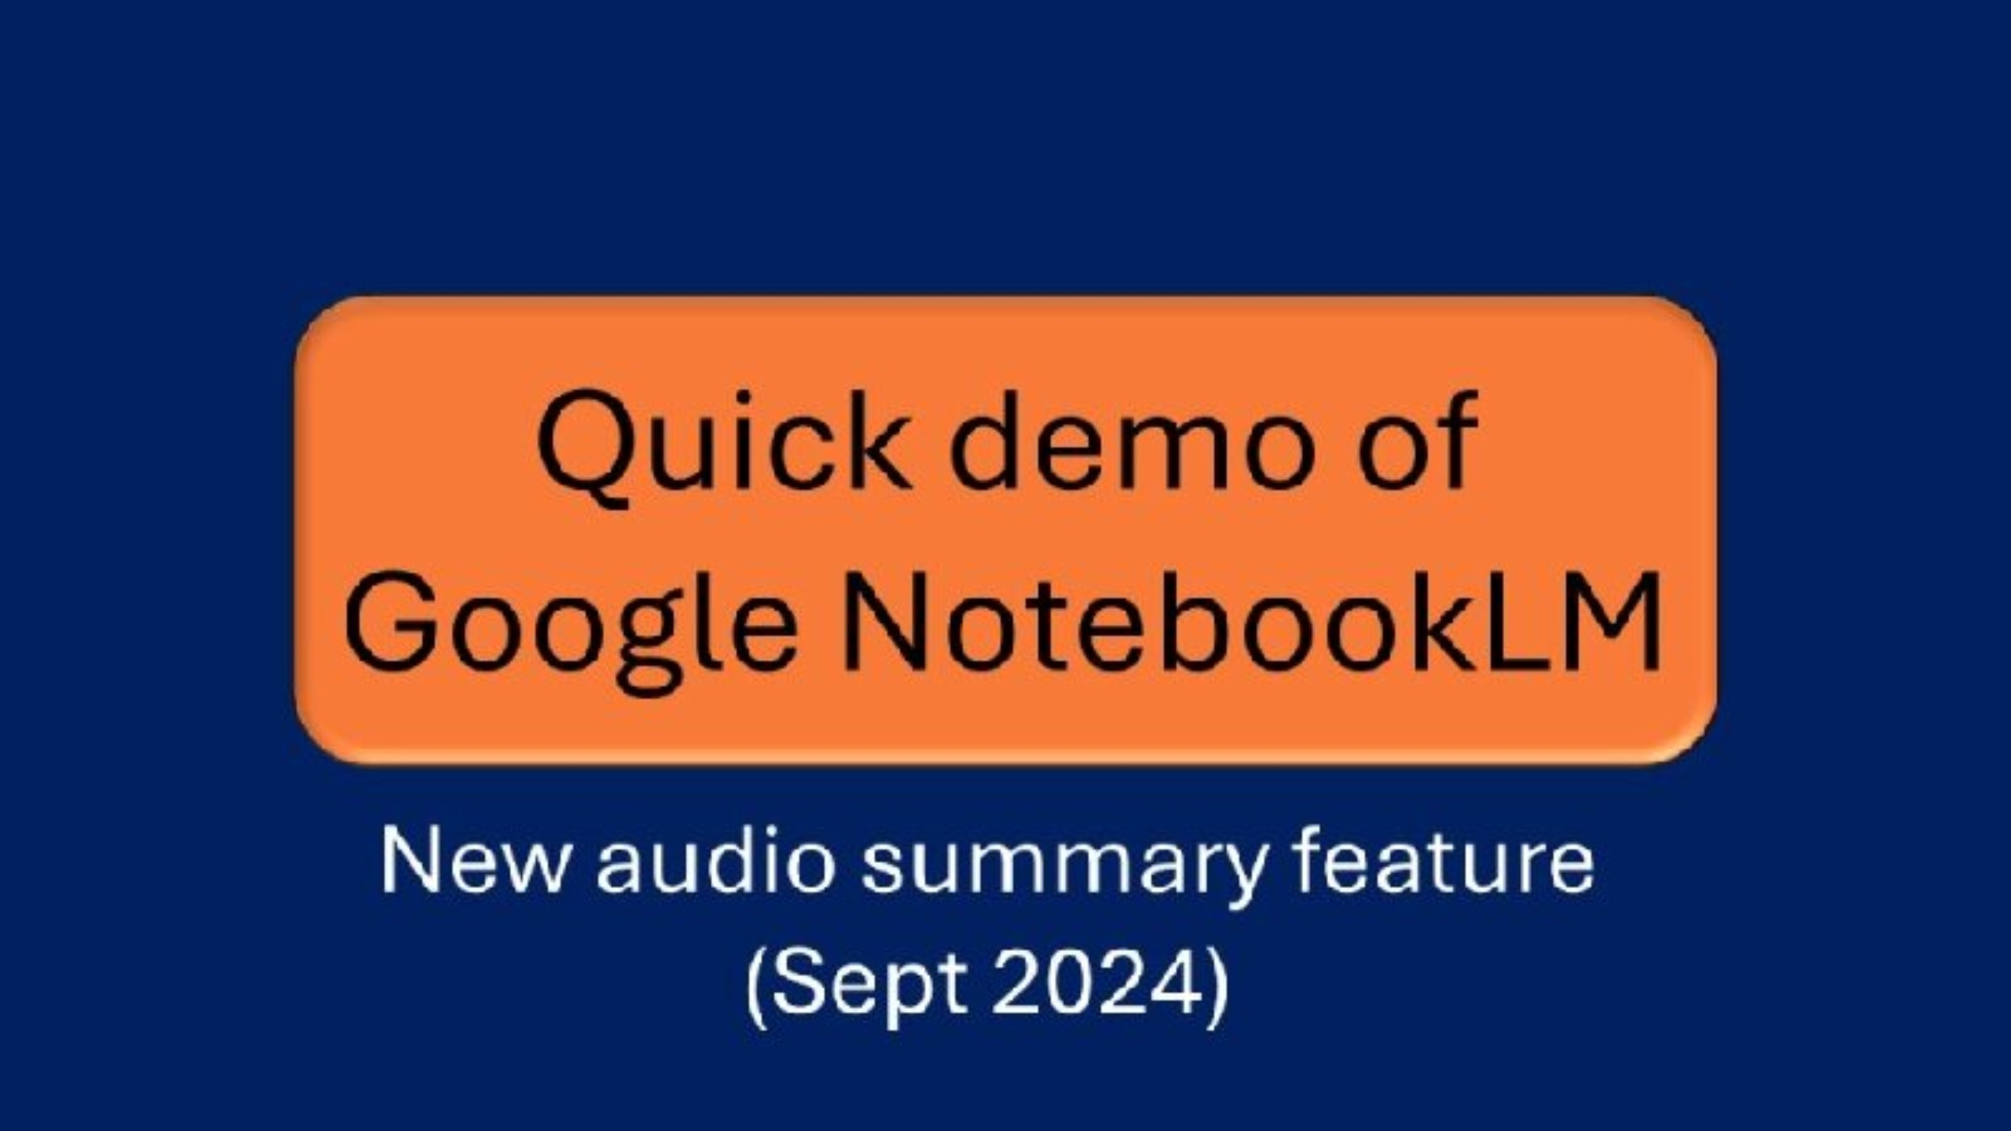
Video link here

