Slide 1

What is musical knowledge and musical learning?
Teaching music musically.
Musicians of Change 2025

Slide 2
The Assignment
Assessment:
Title: ‘To what extent are you “teaching music musically’?
Through a portfolio evidencing your teaching approaches and an accompanying critical commentary, provide an analysis and critical reflection on examples of your teaching with reference to Swanwick’s 3 Principles of Music Education and other supporting literature which explores the nature of musical teaching and learning
Assessment Task
1x Critical Commentary (2000 words).
1x Portfolio (1000 words Equivalence*).
*Equivalence indicates the amount of time and effort required to produce the complete submission, rather than a precise word count.

Slide 3
What is the portfolio?
For the purposes of module assessment, a “portfolio” refers to a collection of smaller pieces of work that combine to create a cohesive whole. Submit a portfolio that evidences how you bring your own knowledge and skills into your teaching context in order to support musical learning promoted through the teaching of your instrument. The evidence might be for a whole class or a small group of learners, as appropriate to your current teaching context. Prepare learning over a few sessions (between 2 and 5, for example); this will provide sufficient evidence of your teaching and learners’ experience whilst too many or too few will present various challenges.
Types of evidence in your portfolio might include, for example:
Video/ and/or audio evidence of learners’ participation in lessons/performances/rehearsals.
Annotated lesson plans/diagrams which demonstrate clearly how your activities and planning are supporting musical learning through your instrument.
Self-devised and/ or annotated resources you are using with your learners.

Slide 4
Learning Outcomes (i.e. What you have to demonstrate).
Demonstrate critical insight into an aspect or aspects of your subject within your teaching setting | What does it mean to teach music musically? What are the barriers to teaching music musically? What perspectives from research and scholarship can illuminate are understanding of this and provide differing perspectives? How is my thinking and reading reflected in my professional decisions relating to musical teaching and learning? What evidence have I for this?
Develop criticality by drawing on appropriate reading and research | How do I draw on research/scholarship/policies etc. to inform my professional decisions and reflect on my professional practice? Do I draw on a broad range of perspectives and critically engage with these? Have I engaged with the recommended readings?
Demonstrate your ability to reflect on your experiences on your journey from expert to educator. | What developments have there been in your thinking and understanding in the first weeks of the course? What are you emerging reflections on your role and identity as a music teacher? How do you resolve tensions between your multiple identities? How have you drawn on models of reflection to inform your own reflections?
Demonstrate your ability to communicate effectively through appropriate use of media | Well presented. Coherent structure. Proof read. Academic writing style. Correct referencing.

Slide 5
Session Aims
To develop understanding of what it is to teach music musically, through:
Discussing what we mean by ‘teaching music musically’; (LO1)
Exploring ideas and concepts from a range of music educators about teaching music musically (LO2)
Applying these ideas to our thinking about how we teach and support children’s musical learning. (LO1&2 and portfolio)
Exploring Swanwick’s three principles of a ‘good enough’ music teacher (Swanwick, 1999/2008) (All LOs)

Slide 6




‘’Just doing music is not enough’’ Mark Phillips 2021
a central purpose of good music education is for pupils to make more music, think more musically and consequently become more musical.
Simply ‘doing music’ is not enough.

Slide 7

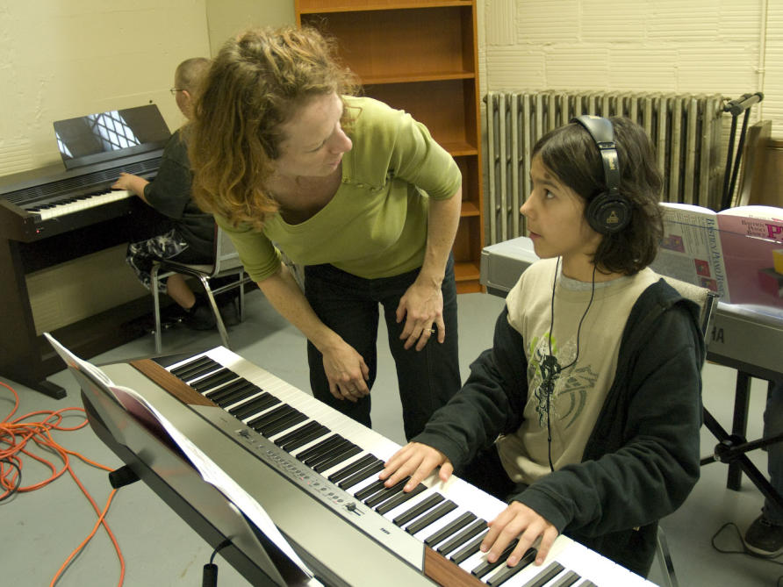
Teaching Music Musically is Challenging:
It doesn’t come easily and needs to be thought about (a lot) and worked at.
It is underpinned by an understanding of the nature of music and what it is to be musical and act musically.
This Photo by Unknown Author is licensed under CC BY-ND

Slide 8
Activity 1 (15 minutes)
Drawing on your own experiences as musical learners and teachers, what are the characteristics of a musical music lesson?
What do you see and hear in the classroom?
What does the teacher do? What pedagogies (teaching approaches) does she adopt?
What do pupils do in musical music lessons? What and how do they learn?
What are the barriers to musical teaching and musical learning (e.g. teaching approaches/assessment/curriculum content).
Develop a short statement which encapsulates for you what musical music teaching is- a music teaching ‘credo’. Add to this through the first few weeks of the course adding to it and amending it.

Slide 9

Two dimensions of musicality
Thinking Musically
Acting Musically
This Photo by Unknown Author is licensed under CC BY-SA-NC

Slide 10
Thinking Musically
Working with musical ideas internally – imagining, manipulating, or predicting musical sounds without necessarily producing them physically.
• Recognising patterns and relationships – such as melody, rhythm, harmony, form, and timbre.
• Drawing on musical knowledge – both formal (e.g., notation, theory) and informal (e.g., stylistic conventions, genre awareness) to make sense of music.
• Linking musical understanding to action – using perception and knowledge to inform performance, improvisation, composition, or analysis.
• Engaging in a musical “mode of thought” – in which problems, solutions, and expressions are conceived primarily in sound and musical logic, not only in words or visual images.
Identity and self-concept – seeing oneself as a musical person.

Slide 11
Acting Musically
To act musically is to apply those sensibilities and capacities in real musical situations, in ways that are recognised as musical by a given community or culture. Acting musically can include:
Performing – singing, playing, or moving in ways that align with musical structures and expressive aims.
Listening – engaging actively and attentively, making sense of music’s patterns and meanings. Making meaning is two-way process.
Composing / improvising – creating music in response to context, intention, and audience.
Collaborating – interacting musically with others, negotiating timing, tuning, expression.
Responding in context – shaping your musical actions according to setting, purpose, and tradition.

Slide 12
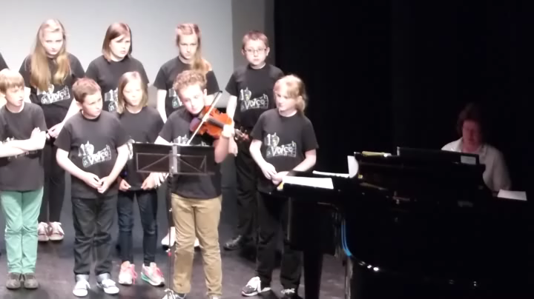
Discussion Point: how is this child Thinking Musically and Acting Musically?

Slide 13



When considering how to teach music musically, we need to think about three elements:

Slide 14
Ontology – what it is to be musical/a musician.
Epistemology- what is musical knowledge?
Pedagogy- how do we best teach music.
Ontology: what it is to be a: teacher/musician/music teacher/musical teacher; expert to educator (Expert to Educator)
Epistemology: what is musical knowledge?/how is it revealed and demonstrated by teachers and pupils?/what musical knowledge is particularly valued? Are these values shared?
Pedagogy: what teaching approaches best support the musical development of students and provide them with meaningful musical and educational experiences?

Slide 15

EPISTEMOLOGICAL PERSPECTIVES
Thinking about musical knowledge.

Slide 16
Epistemology:
Typologies of musical knowledge for teaching (Philpott, 2017)
Knowledge about Music,
Formal and informal knowledge,
Knowledge ‘how’ in music
Formal and informal knowledge.
Knowledge ‘of’ music- Intuitive and supervisory knowledge.

Slide 17
Characteristics of Each Knowledge Type:
Knowledge Type | Features
Knowledge ‘about’ Music | The facts about music e.g. the latest hit by Adele; the instruments in a string quartet; the names of different kinds of African drums; the blues chord sequence. Notation abstracted from the making of music.
Knowledge ‘how’ in music | The practical skills of music. e.g. how to: play to a chromatic scale; tune a guitar; improvise around a blues chord sequence. How to harmonise a Bach chorale.
Knowledge ‘of’ music | Knowledge that comes from deep acquaintance with music as a performer, listener or composer/improviser (or all three)
Notes:
Knowledge of music is difficult but we all as musicians know how important it is- music that we are inside and music that is inside us. BUT music education has a particular propensity to ‘default’ to knowledge about or knowledge how. So that assessment then becomes about propositional knowledge or practical knowledge. They also become separated out in assessments

Slide 18
Practical Working Out of Knowledge Types in Freres Jacques (Philpott, 2007)
Knowledge ‘about’ | Knowledge ‘how’ | Knowledge ‘of’
What a round is… What 4 time is.. Knowing the history and meaning of the words… Knowing what note it starts on… | How to sing and recognise a ‘round’… How to breath in the right places… How to sing in an ensemble… How to conduct in 4 time. | The expressive character of the piece (in the same way a place or person has a character)… The shape or journey of the music as it reaches out and then comes home… The expressive potential of the music. What would happen if we sang is ‘spiky’ or ‘like a lament’…Creative engagement with music. Being inside the music

Slide 19
Knowledge ‘of’ Music is hard to grasp but worth the effort. It’s being inside the music!
The only way to acquire it is by tasting until you know a wine’s signature as instinctively as you might recognise a footballer- not by matching in your brain the words you would use to describe him to someone else (for example, ‘heavy built but fast, with black hair’), but because his gait across the pitch is, that very particular way he leaps to head the ball is a pattern you just know (Victoria Moore in Philpott and Spruce 2007: 92)
KNOWLEDGE OF MUSIC LIES AT THE HEART OF MUSICAL MUSIC TEACHING AND LEARNING.

Slide 20
Activity: Choose a piece of music from your playlist that could be the basis of a lesson for KS2. What knowledge ‘about’ and ‘how’ would you teach from that music? What activities would you do that would enable the children to get inside the music (Knowledge ‘of:).
Knowledge ‘about’ | Knowledge ‘how’ | Knowledge ‘of’
What a round is… What 4 time is.. Knowing the history and meaning of the words… Knowing what note it starts on… | How to sing and recognise a ‘round’… How to breath in the right places… How to sing in an ensemble… How to conduct in 4 time. | The expressive character of the piece (in the same way a place or person has a character)… The shape or journey of the music as it reaches out and then comes home… The expressive potential of the music. What would happen if we sang is ‘spiky’ or ‘like a lament’…Creative engagement with music. Being inside the music

Slide 21

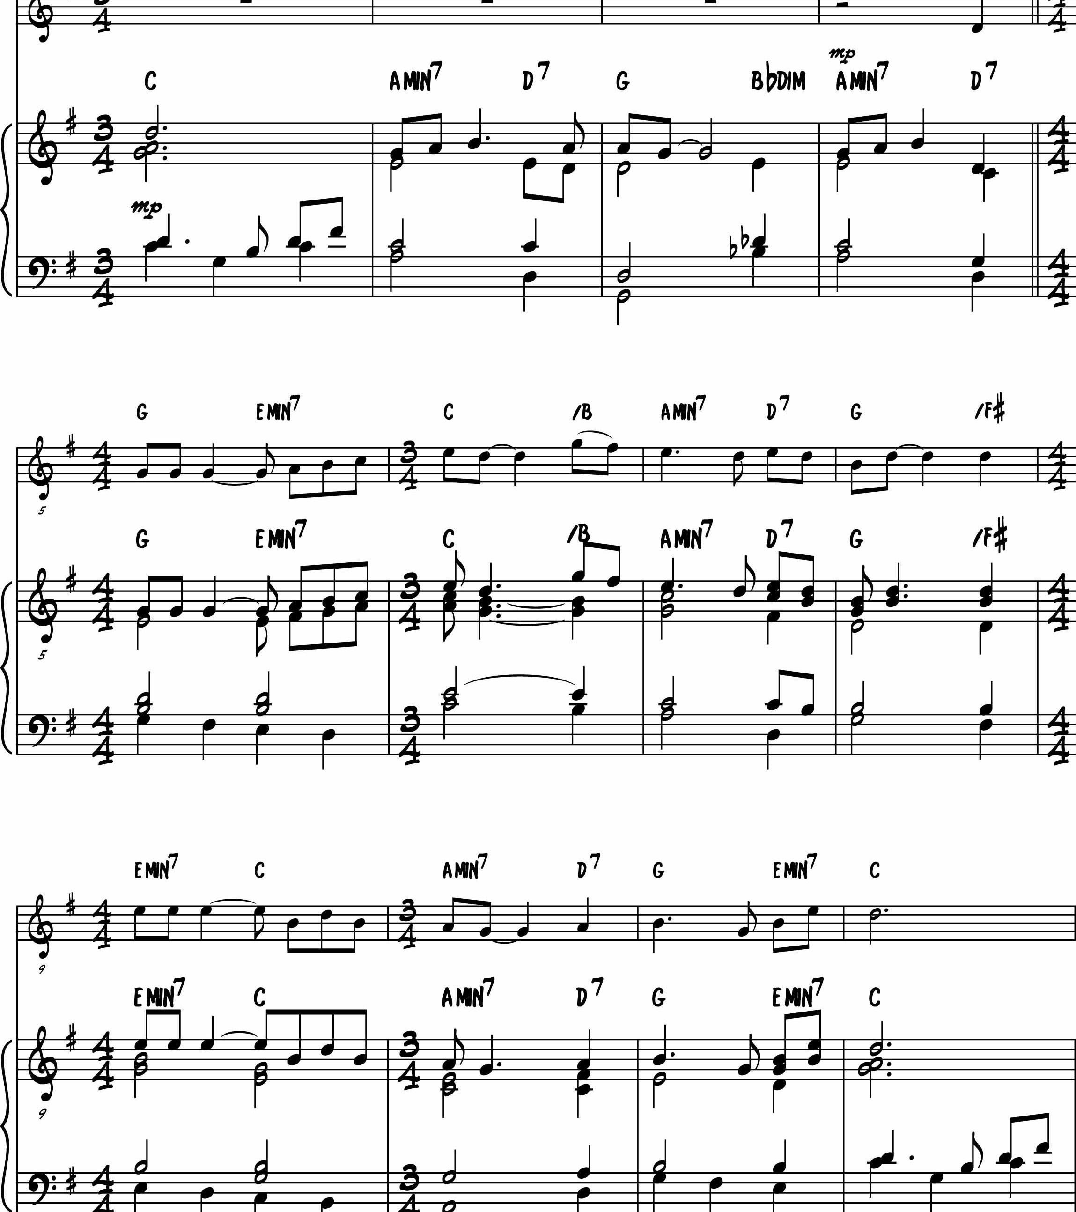

What are the epistemological barriers and challenges to teaching music musically?

Slide 22


Fundamental to being able to teach music effectively [i.e. musically] is to have a clear understanding and philosophy concerning :
What music is
What it is to be musical

Slide 23
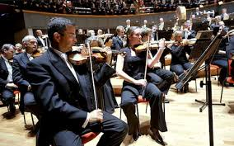
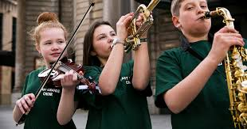

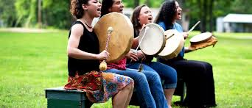
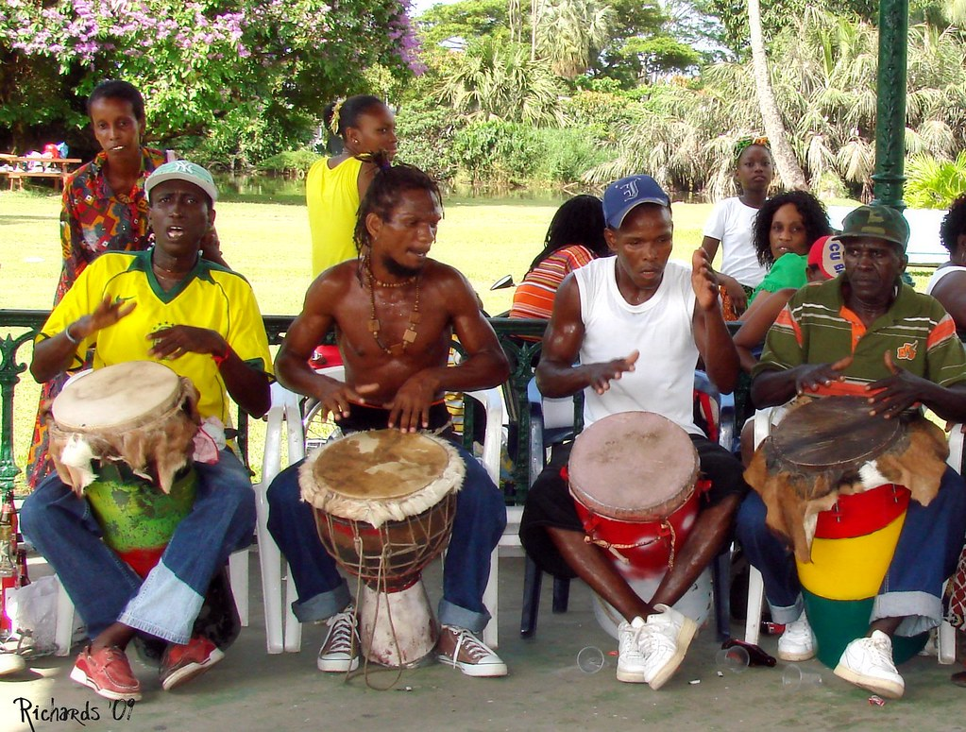
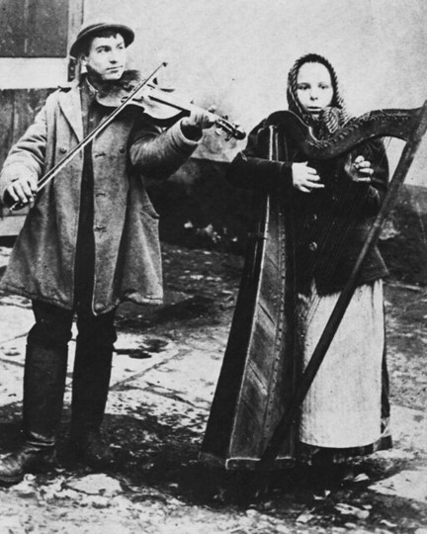
‘the particular teaching method is nowhere near so important as our perception of what music is and what it does’ (Swanwick, 1999. p, 45).
This Photo by Unknown Author is licensed under CC BY
This Photo by Unknown Author is licensed under CC BY-NC-ND

Slide 24
And similarly with learning:
How one understands how music is learned is…influenced not only by what fundamental assumptions one holds about learning but also by prevailing views of music’ (Allerby and Ferm , 2005)

Slide 25
The assumptions you have about learning, and your views of what music is, will govern…
How you teach music- and whether you teaching it musically.
How you plan lessons- and whether the lessons you plan are musical
Assessment: whether what you assess is musical learning and whether your assessment processes are themselves musical
What you decide should and should not be in a music curriculum/scheme of work and how this supports musical development.
Your musical relationships with young people in your music classes and their musical relationships with each other.
The impact you have on young people’s musical lives

Slide 26
Common and uninterrogated assumptions about the nature of music (lack of criticality) and what it is to be musical (ontology) of what is important musical knowledge (epistemology) and ways of teaching music (pedagogies), can explain:
Why music is sometimes taught unmusically
Why music curriculums and examinations are structured as they are and don’t always support musical teaching and learning.

Slide 27
Activity
The following quote is from Nicholas Cooke, emeritus professor of music at Cambridge University. What does he mean and what might be the implications for teaching music musically?
‘…the extraordinary illusion- for that is what it is- that there is such a thing as music rather than simply the acts of making and receiving it, might well be considered the basic premise of the Western ‘’art’’ [classical] tradition.’ (Cook, 2003: 65). (my emphases).
Discuss…

Slide 28
Thinking critically about music.

Slide 29

‘…the extraordinary illusion- for that is what it is- that there is such a thing as music rather than simply the acts of making and receiving it, might well be considered the basic premise of the Western ‘’art’’ [classical] tradition.’ (Cook, 2003: 65). (my emphases).
…as an object (as a thing)
…as a social practice (as something people do)

Slide 30
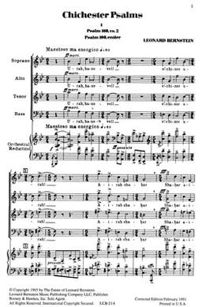
The idea of music as an object has dominated educational thinking and is reinforced through the language we use…
- Bring your music to the next rehearsal
Put your music on the music stand
Compose a piece of music for a radio play
Listen to as many musical works by Mozart as you can
This Photo by Unknown Author is licensed under CC BY-SA

Slide 31

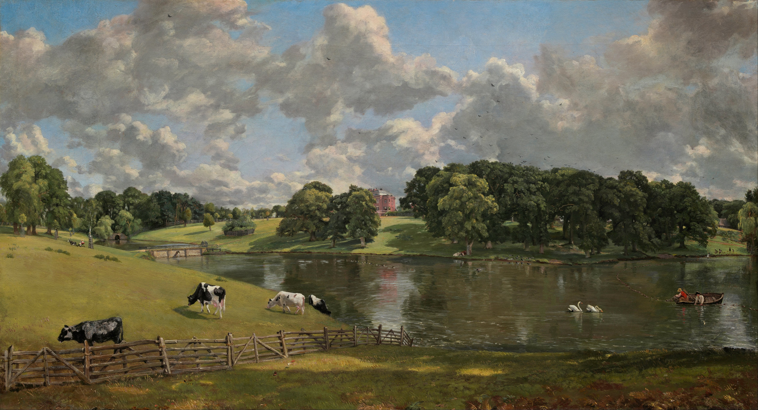
When music is thought about as a ‘thing’- as an object-it sets up a particular relationship with music: It is ‘out there’ and exists separate from us.
Music Education as Aesthetic Education (Musical Appreciation).
This Photo by Unknown Author is licensed under CC BY-SA

Slide 32

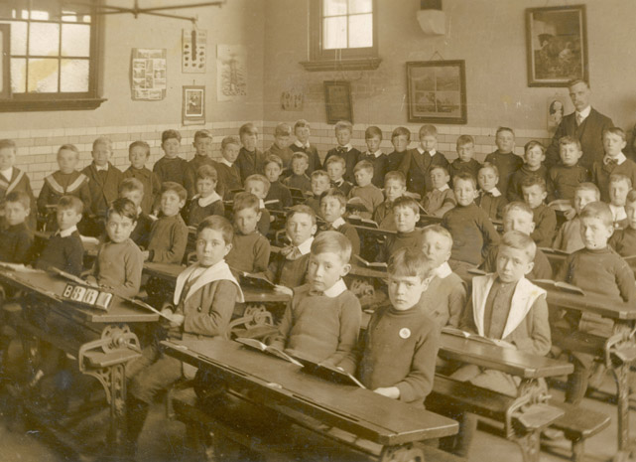
When music is thought of as an object, what can this look like…?
Distanced relationship to music: music to be studied rather than done (object vs practice).
Focus on musical re-creation from the score.
Can lead to an over-emphasis on theoretical aspects of music- how the bits come together to create the object.
This Photo by Unknown Author is licensed under CC BY-ND

Slide 33
Influence of ‘music as object’ on how music is taught.
Separation/hierarchy of composer-performer- listener onto the music curriculum and its assessment processes. Lessons and examinations in those discrete areas.
A focus on the musical bits- the elements and how they fit together as a way of understanding music. Year 7/Term1 in almost every school!
Notation plays a major part in turning music into a thing. Thus, in music education the study of notation is important.
Musical meaning is in the notes and it is the job of listeners to extract this- through understanding how the bits fit together.
All of these are important aspects of musical learning but when they come to dominate at the expense of music making, unmusical teaching can result.

Slide 34
Returning to Cooke (2003)
Over the last couple of hundred years ‘serious’ music-making has become more and to be thought of as the reproduction of a musical text rather than an event. Leading to…
‘…the extraordinary illusion- for that is what it is- that there is such a thing as music rather than simply the acts of making and receiving it, might well be considered the basic premise of the Western ‘’art’’ [classical] tradition.’ (Cook, 2003: 65). SO…

Slide 35
Question (perhaps rhetorical): Does this lie at the root of many young people’s dissatisfaction with formal music education? The difference between how they experience music outside of school (something they make and receive), and how it is sometimes presented in school (as an object of study)? Between enculturation and socialisation.

Slide 36
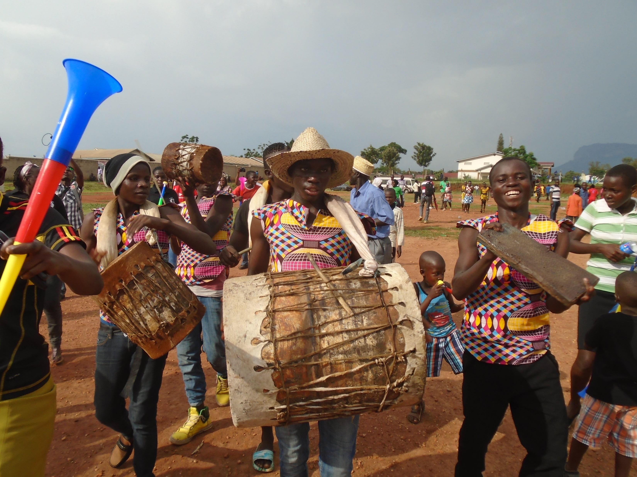
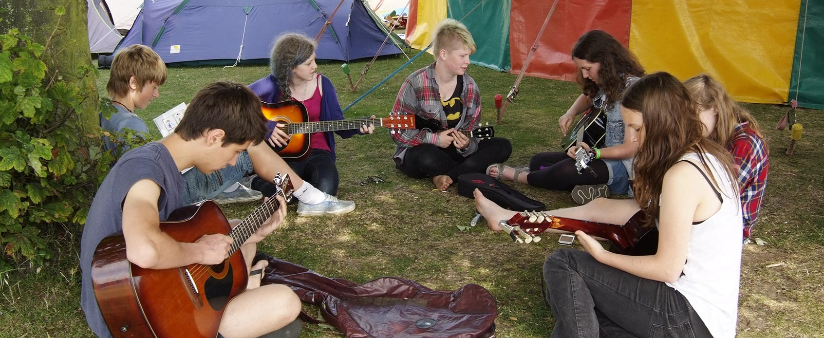
Music as social practice- as something that people do!
Is this closer to the way young people (most people!) think about music?
Is thinking about music in this way likely to lead to more musical teaching and more motivated pupils?

Slide 37
Music as Object VS. Music as social practice: Challenges for musical teaching.
As Object:
Theoretical learning can come to dominate;
Performing pre-existent music dominates- narrowing the curriculum.
Young people can come to feel no ownership or sense of self in their music making.
As practice (something people do)
Music is made but there is not progress in musical learning and understanding (Doing music is not enough).
Making music is not necessarily musical music making.

Slide 38
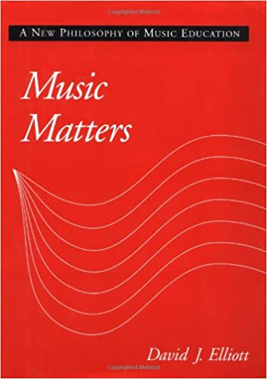


A Praxial Approach to Music Education Might Help.
Two main proponents : David Elliott and Thomas Regelski.

Slide 39
Music Education as ‘Praxial’ Education.
‘A musical performance is a rich, nonverbal explanation of what a performer [or composer or listener] understands …about a particular example of music and the musical practice of which it is a piece. If I know how to interpret and perform a work well, then I understand it and know how to listen to it. My knowing [knowledge] is in the actions of my artistic music making …if I compose or arrange artistically- in relation to the relevant standards and traditions of a genre- then I have a working musical understanding of that practice…’ (Elliott, 1995: 105).
Ofsted would refer to this as domain specific knowing.
Is this why music making is so important? It is how one demonstrates musical knowledge and learning.

Slide 40
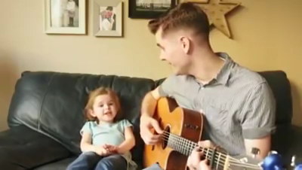
Discussion/Activity What ‘praxial’ knowledge is this girl demonstrating non-verbally here?
How do you think she has learnt to sing this song?
How do the three types of knowledge (how/about/of) interact?

Slide 41



Maybe Knowledge ‘of’ music is embodied knowledge.

Slide 42
Musical Knowledge as Embodied Knowledge leading to musical fluency.
Until the current flows from the toes to the fingers … and you feel the weight and movement of the body … you won’t get the music.’ … ‘Don’t try for accuracy before you get the feeling of the motion …’ (Yehudi Menuhin)
‘The grooves are the feeling and the participatory experience of music …’ (Steven Feld)
Finney 2016.
Notes:
Embodied knowledge leads to musical fluency

Slide 43
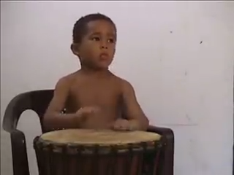
Activity 4: Embodied Musical Knowledge in Action
What musical knowledges (how/about/of) are demonstrated in this performance? What can the ‘pupil’ do? What musical attributes and dispositions does he demonstrate?
What is the role of the ‘teacher’ here? How does he help the child make musical progress?
Notes:
Want to now discussing how inportnat ideologies are

Slide 44
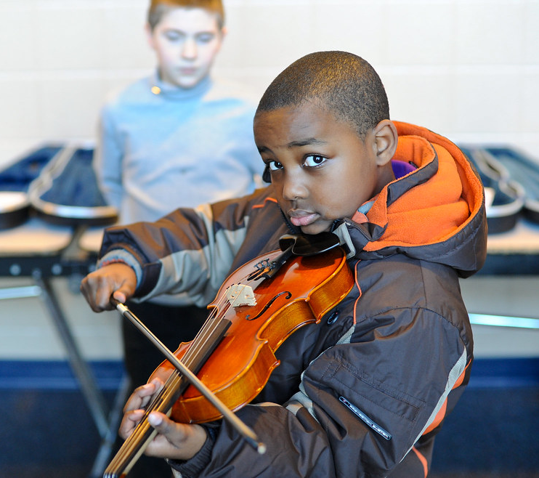
MUSICAL LEARNING THROUGH MUSICAL ENCOUNTERS.
This Photo by Unknown Author is licensed under CC BY

Slide 45

The typical planning sequence adopts an ‘input-output’ model that assumes learning outcomes can or should be predetermined and predicted.
Step 1
Step 1
Defined, predicted and observable Learning Aims (Includes differentiation)
Step 2
Step 2
Teaching strategies adopted that are aimed at helping children to achieve observable Learning Aims
Step 3
Step 3
Assessment to find out if Learning Aims have been met.
Notes:
Problems with this is that learning not always observable; Other learning might take place; Learning takes place in different placesxd

Slide 46
Planning for Musical Encounters:
Acknowledge that musical understanding involves both cognitive (probably observable) and emotional (probably not observable) engagement (Finney, 2006).
Has as its primary focus, the initiation of musical encounters rather than the prescription of outcomes.
Foregrounds ‘knowledge of’ music through those musical encounters.

Slide 47

A Sort of Hinterland- Howard Skempton
Speak a poem, verse or rhyme
So quietly that the words seem veiled;
Not quite whispered
But loud enough to make sense
To those next to you.
Play the rhythm of the words:
Not loudly;
But loudly enough to be heard
By those around you.
Reflect the rise and fall of a phrase
In the rise and fall of notes,
Within a small range;
Or in loudness and softness:
Swelling and subsiding
Always gently.
After a time
Just listen and imitate
As if in a conversation

Slide 48

Additional Stimuli
Snowball
Shelly Silverstein
I made myself a snowball
As perfect as could be.
I thought I'd keep it as a pet
And let it sleep with me.
I made it some pyjamas
And a pillow for its head.
Then last night it ran away,
But first it wet the bed.
[using or not using Skempton’s directions]
Water Lilies and Japanese Bridge. https://images.app.goo.gl/onu8uTuPSHxb5ME97

Slide 49
A framework for teaching music musically.
The three principles of the ‘good enough’ music teacher.

Slide 50
Keith Swanwick (1999) suggests that to teach music musically music teachers must:
The ‘good enough’ music teacher. is governed by three principles:
Care for music as a form of human dialogue and communication.
Have care and respect for the music-making and musical interests of children and young people.
Prioritise musical fluency.

Slide 51
Music as discourse and Communication
Music is central to almost all children and young people’s lives
Music is used to think and communicate through musical gestures and music structures.
Being ‘fluent’ in music: being able to ‘share, produce and collaborate’ through music.

Slide 52
Principle 1: Care for Music as Dialogue and Communication.
‘One aim of the music teacher is to bring music from the background into the foreground of awareness. Whenever music sounds, whoever makes it and however simple and complex the resources may be, the musical teacher is receptive and alert, is really listening and expects students to do the same’ (Swanwick, 1999: 44)

Slide 53
Working as an effective, musical, ‘good enough’ music teacher.
‘To watch an effective music teacher at work (rather than a ‘trainer’ or ‘instructor’) is to observe this strong sense of musical intention linked to educational purposes: skills are used for musical ends, factual knowledge informs musical understanding.
Music history etc…are only seen through the doors and windows of particular musical encounters. For it is only in these encounters that the possibilities exist to transfer tones into tunes, tunes into forms and forms into significant life events (Swanwick, 1999: 45)

Slide 54
Principle 2: Care for the musical making and interests of children.
‘Each student brings a realm of music understanding into [schools]. We do not introduce them to music, they are well acquainted with it, though they may not have subjected to the various forms of analysis that we may feel are important for their development’ (Swanwick, 1999: 53)
Almost all young people care for music .... It is important to them. This generates a spontaneous and self-motivating desire to learn music.
This can be nurtured and built on by teachers through…

Slide 55
Curiosity
Introducing them to music which stimulates their interest and telling them about it.
Give them space to make musical explorations.
Inviting them to ‘get messy’ with the musical materials
Thinking point: Are pupils in your lesson interested and curious about the music they are working with and have been introduced to?

Slide 56
Competence
Competence is not achieved through ad-hoc musical activity but through planned musical encounters
Competence is different in different musical settings -individual and group- and in different musical traditions.
Knowing how to work together with others is a competence.
Competence is linked to curiosity in making of musical decisions: can pupils make appropriate musical decisions within the musical tradition.

Slide 57
Emulating (Musical role models).
Musical Role models that instigated musical interest and become part of a musical identity
The teacher as a musical role model:
Does the teacher model Being Musical and Acting Musically?
Does the teacher use their own musical skills in a musical way?
Do pupils listen to good performances/compositions/improvisations?
Does the teacher teach in ways that go beyond the routinized?
Do/can the pupils use each other as musical role models?

Slide 58
Principle 3: Fluency First and Last
‘Musical lessons are musical encounters which develop pupils’ musical fluency as performers, composers, listeners.
The development of the ‘ear’ is crucial to developing musically
Musical fluency takes place over musical literacy (which is not to say that children should not work with notations).

Slide 59
Implications of Principle 2 for Lesson Planning – an integrated approach
an integrated approach to musical learning: performing, composing and listening are brought together rather than pulled apart- allows different pupils to excel in different ways but within the same musical encounter .

Slide 60
Things that work against these principles: against lessons that are musical encounters.
Teaching where the balance and relationship between the knowledge types is wrong e.g. where priority is given to knowledge about or how music or where this knowledge is unrelated to the lesson as a musical encounter
Musical fragmentation and atomisation: an emphasis on units smaller than the musical phrase. Music then lacks meaning
Where notation is a barrier to fluent music making rather than the facilitator of it.

Slide 61
Activity : Applying the Principles
Applying these three principles at all times in your planning and teaching will result in a musical environment where pupils learn music musically.
Working together, outline a short activity or teaching session where these three principles of the ‘good enough’ music teacher are put into practice? Use your musical and instrumental skills to model musical teaching and learning.
Care for music as discourse
Care for the musical discourse of children and young people
Musical fluency first and last.

Slide 62
References
Alerby, EW. And Ferm, C. (2005) ‘Learning Music: Embodied Experience in the Life World’. In Philosophy of Music Education Review. 13(2) pp. 177-185
Elliott, D. (1995) Music Matters. Oxford: Oxford University Press.
Spruce, G. (2016) ‘An Integrated Approach to Lesson Planning’ in Cooke, C. Evans, K. Philpott, C and Spruce, G. Learning to Teach Music in the Secondary School. Abingdon: RoutledgeFalmer pp88-94
Swanwick, K . (1999) Teaching Music Musically. Abingdon. RoutledgeFalmer
Swanwick, K. (1988) Music, Mind and Education. Abingdon. Routledge.

Slide 64
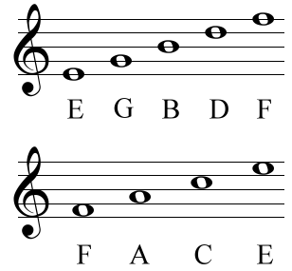
The Notation Debate:
We have tackled that [pupils lack of preparedness for A Level] not by dumbing down A Level but by increasing the challenge of GCSE. At GCSE, students now have to read and write notation. (Nick Gibb, 2016)
A small primary school choir sang with reasonable accuracy and good diction. The specialist teacher sang and modelled well. But the pupils were only shown the song words and not the notation. Good opportunities for pupils to see and understand melody shape, rhythm, beat and rests were missed. (Ofsted Report: 2013)
Notation is the gateway into the world of music. Without being able to read music a child is shut out from the world and the riches it has to offer (Anon)
For the majority of the world’s people, musical literacy does not involve the ability to read and write music…For many musical literacy operates as the ability to communicate with others in a practical way. [musical discourse]. (Robert Kwami, 2001)
The learning of staff notation will only be of value to specialist performers who intend to spend the greater part of their professional lives performing or studying an existing musical literature. If the National Curriculum is genuinely intended to encourage all pupils at Key Stages 1 to 4 to engage with sound, then there is no practical reason why they need to be burdened with an anachronistic notational system: technology allows students to compose directly onto a retrievable system. (Terry, 1994, p. 110)
From a psychological perspective, and if I must teach notation, then the sequence of learning is always from the music to the sign[sound before symbol]. In short, we need to be fully immersed in sounds and meaning before we code them. This is an obvious and long standing mantra but is less easily turned into a pedagogy that has musical integrity. (Philpott, 2017)
“Music must not be approached from its intellectual, rational side, nor should it be conveyed to the child as a system of algebraic symbols, or as the secret writing of a language with which he has no connection. The way should be paved for direct intuition.” (Kodaly 1974. p. 120)
This Photo by Unknown Author is licensed under CC BY-SA

Slide 65
Activity:
What are your thoughts about the role of notation in classroom music?
What does it mean ‘to read music’?
When should notation be taught?
How should notation be taught?
What forms might notation take?
Activity:
List all forms of notation that you are aware of.
What is the relationship between notation and the sound of music in each case?
Devise a way of teaching a simple aspect of rhythmic notation (e.g. crotchets and quavers) as a ‘good enough’ music teacher. (Sound before symbol)

Slide 66
References
Alerby, EW. And Ferm, C. (2005) ‘Learning Music: Embodied Experience in the Life World’. In Philosophy of Music Education Review. 13(2) pp. 177-185
Elliott, D. (1995) Music Matters. Oxford: Oxford University Press.
Spruce, G. (2016) ‘An Integrated Approach to Lesson Planning’ in Cooke, C. Evans, K. Philpott, C and Spruce, G. Learning to Teach Music in the Secondary School. Abingdon: RoutledgeFalmer pp88-94
Swanwick, K . (1999) Teaching Music Musically. Abingdon. RoutledgeFalmer
Swanwick, K. (1988) Music, Mind and Education. Abingdon. Routledge.

