Slide 1



Policy and the wider context of music education.
Musicians of Changes. August 2025.

Slide 2
Aims of Session
To explore the place of music in the curriculum
Consider recent policy developments in English music education
Explore some key music education organisations and examine the role they play in school music education.

Slide 3

The Wider Context of Music in School.
Music in Schools: curricula and extra-curricular
Government and Policy
Music Education Hubs (MEHs)
Young People’s Musical Lives.
External Music Education Organisation including subject organisations and research. And instrumental exams

Slide 4

PART 1: THE PLACE OF MUSIC IN THE CURRICULUM

Slide 5

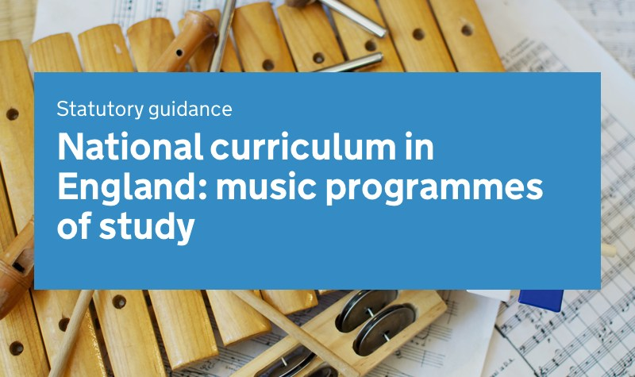
EXPLORING THE NATIONAL CURRICULUM PROGRAMMES OF STUDY IN MUSIC.

Slide 6
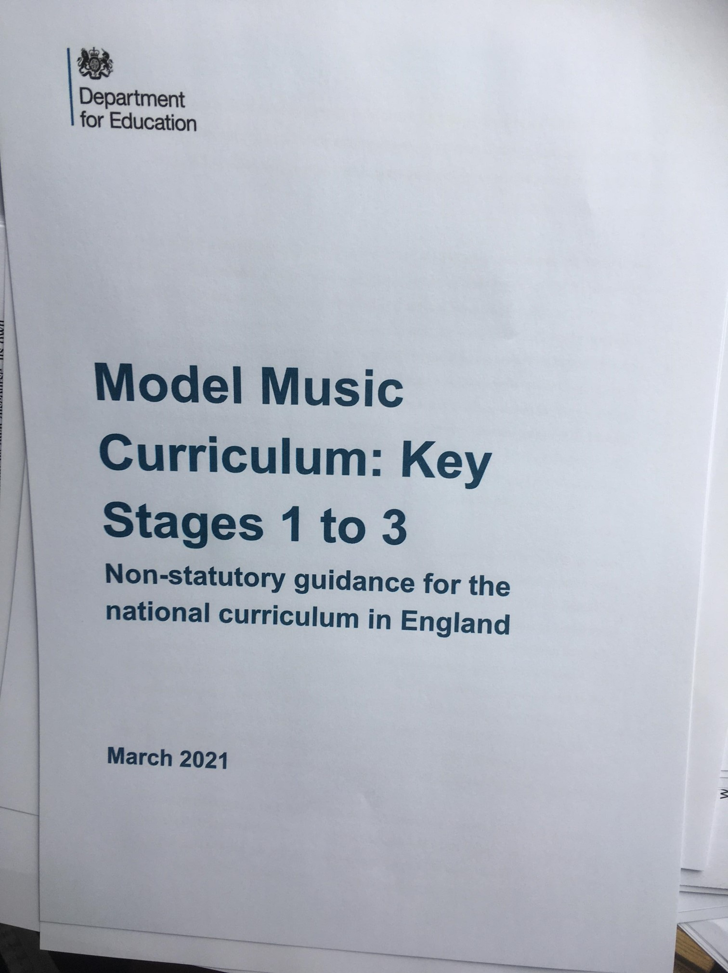



FIVE MAIN POLICY DOCUMENTS IN MUSIC EDUCATION.

Slide 7
EXPLORING THE NATIONAL CURRICULUM PROGRAMMES OF STUDY IN MUSIC.

Slide 8
The National Curriculum: Overall Aims
Aims
The national curriculum for music aims to ensure that all pupils:
perform, listen to, review and evaluate music across a range of historical periods, genres, styles and traditions, including the works of the great composers and musicians
learn to sing and to use their voices, to create and compose music on their own and with others, have the opportunity to learn a musical instrument, use technology appropriately and have the opportunity to progress to the next level of musical excellence
understand and explore how music is created, produced and communicated, including through the interrelated dimensions: pitch, duration, dynamics, tempo, timbre, texture, structure and appropriate musical notations

Slide 9
Attainment Targets for Key Stage 1
Pupils should be taught to:
use their voices expressively and creatively by singing songs and speaking chants and rhymes
play tuned and untuned instruments musically
listen with concentration and understanding to a range of high-quality live and recorded music
experiment with, create, select and combine sounds using the interrelated dimensions of music

Slide 10
Attainment Targets for Key Stage 2
Pupils should be taught to sing and play musically with increasing confidence and control. They should develop an understanding of musical composition, organising and manipulating ideas within musical structures and reproducing sounds from aural memory.
Pupils should be taught to:
play and perform in solo and ensemble contexts, using their voices and playing musical instruments with increasing accuracy, fluency, control and expression
improvise and compose music for a range of purposes using the interrelated dimensions of music
listen with attention to detail and recall sounds with increasing aural memory
use and understand staff and other musical notations
appreciate and understand a wide range of high-quality live and recorded music drawn from different traditions and from great composers and musicians
develop an understanding of the history of music

Slide 11
Attainment Targets for Key Stage 3
Pupils should build on their previous knowledge and skills through performing, composing and listening. They should develop their vocal and/or instrumental fluency, accuracy and expressiveness, and understand musical structures, styles, genres and traditions, identifying the expressive use of musical dimensions. They should listen with increasing discrimination and awareness to inform their practice as musicians. They should use technologies appropriately and appreciate and understand a wide range of musical contexts and styles.
Pupils should be taught to:
play and perform confidently in a range of solo and ensemble contexts using their voice, playing instruments musically, fluently and with accuracy and expression
improvise and compose; and extend and develop musical ideas by drawing on a range of musical structures, styles, genres and traditions
use staff and other relevant notations appropriately and accurately in a range of musical styles, genres and traditions
identify and use the interrelated dimensions of music expressively and with increasing sophistication, including use of tonalities, different types of scales and other musical devices
listen with increasing discrimination to a wide range of music from great composers and musicians
develop a deepening understanding of the music that they perform and to which they listen, and its history

Slide 12
Activity 1
Below are what pupils are expected to be taught in key stage 2. Identify some of the activities you might do which would help pupils achieve these aims:
Pupils should be taught to:
play and perform in solo and ensemble contexts, using their voices and playing musical instruments with increasing accuracy, fluency, control and expression Group 1
improvise and compose music for a range of purposes using the interrelated dimensions of music Group 2
listen with attention to detail and recall sounds with increasing aural memory Group 3
use and understand staff and other musical notations Group 4
appreciate and understand a wide range of high-quality live and recorded music drawn from different traditions and from great composers and musicians Group 5

Slide 13
EXPLORING THE MODEL MUSIC CURRICULUM

Slide 14

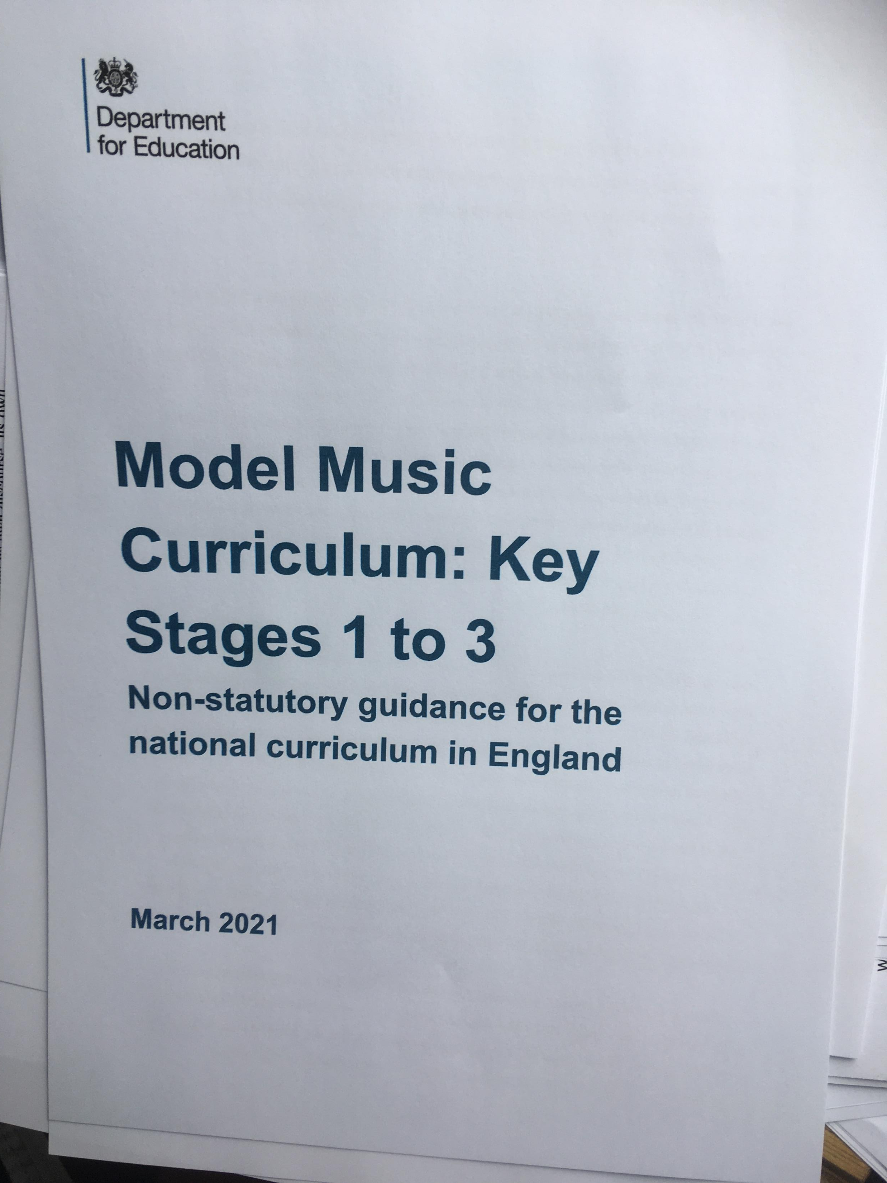
The Model Music Curriculum

Slide 15
Overview of Model Music Curriculum
Provides a ‘working out’ of the national curriculum for music across key stages 1-3
There is no reference to Early Years
It is an extensive document 100+ pages with long lists of suggested repertoire.
Broadly welcomed by subject associations as an indication of the government’s support for music by government.
It is non-statutory i.e. schools do not have to teach it and no Ofsted requirement that it is used.
Promoting the MMC in schools was a requirement latest round of Hub funding.
Been subject to significant critique (e.g. for lack of reference to any model of musical development and its focus on western art music).

Slide 16
Model Music Curriculum (MMC) and School
It will be valuable for you to:
Be familiar with the MMC and critically engage with it- what are the musical values that underpin it…?
Are your schools aware of it? If so…
How- if at all- are they using it in the school? Is it being adopted in its totality or being drawn on selectively i.e. informing curriculum revisions and decisions; being used as a list of ‘approved’ repertoire.
How can you support the school with their curriculum development and implementation?
Issues to be explored more fully in future sessions.

Slide 17
EXPLORING THE OFSTED RESEARCH REVIEW: MUSIC (2021)

Slide 18
Ofsted Research Review: Music
Important to understand this does not claim to provide a survey of music education research- reference to music education research quite limited
Draws on that research which it feels supports its inspection emphases – and those of government. Is explicit about this. Little research cited around musical development; informal approaches to music teaching; sociology of music education.
Strong emphasis of research on Cognitive Load Theory; Learning-as-Memory; Direct Instruction.
PV: It is clearly multi-authored which leads sometimes to lack of coherence.

Slide 19
BUT….
Some very strong core messages, (Mark Phillips, HMI and Ofsted lead for music) including overarching statement:
This review starts from the assumption that a central purpose of good music education is for pupils to make more music, think more musically and consequently become more musical.
Simply ‘doing music’ is not enough. Needs a securely sequenced curriculum and strong pedagogy.

Slide 20
Review Identifies Different Forms of Musical Knowledge
Tacit | Procedural | Declarative
Tacit knowledge refers to the knowledge gained through experience that is often difficult to put into words. | Procedural knowledge is the knowledge exercised in the performance of a task. | Declarative knowledge refers to facts or information stored in the memory.
Example: An awareness that the opening of Schubert’s ‘Erlkönig’ is tense and dramatic, even without understanding the text or knowing about minor keys and triplet rhythms. | Example: Well-developed competence in creating drum grooves. | Example: Factual knowledge about eras, styles, composers or performers, as stated in a written essay about musical culture.

Slide 21
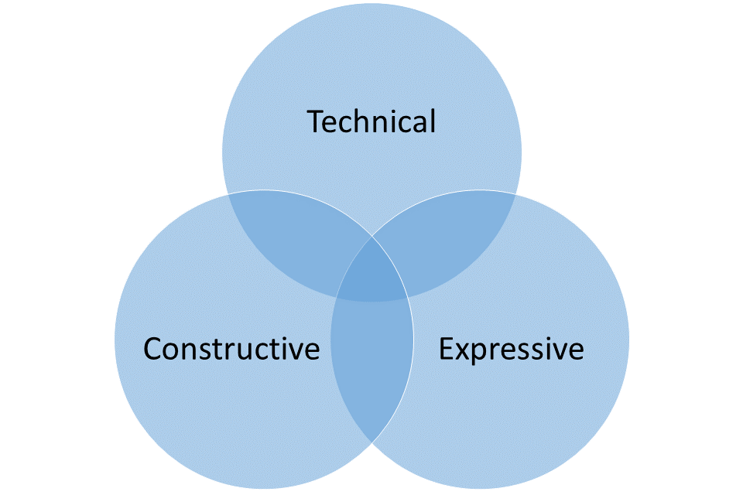
Proposes three forms of musical knowledge or ‘Pillars of Progression’
Technical (How?) | Constructive (About?) | Expressive (of?)
Competence in controlling sound (instrumental, vocal or with music technology) - Use of a communication system, such as staff notation or guitar tab | Knowledge of the musical elements/interrelated dimensions of music - Knowledge of the components of composition | Musical quality - Musical creativity - Knowledge of musical meaning across the world and time

Slide 22
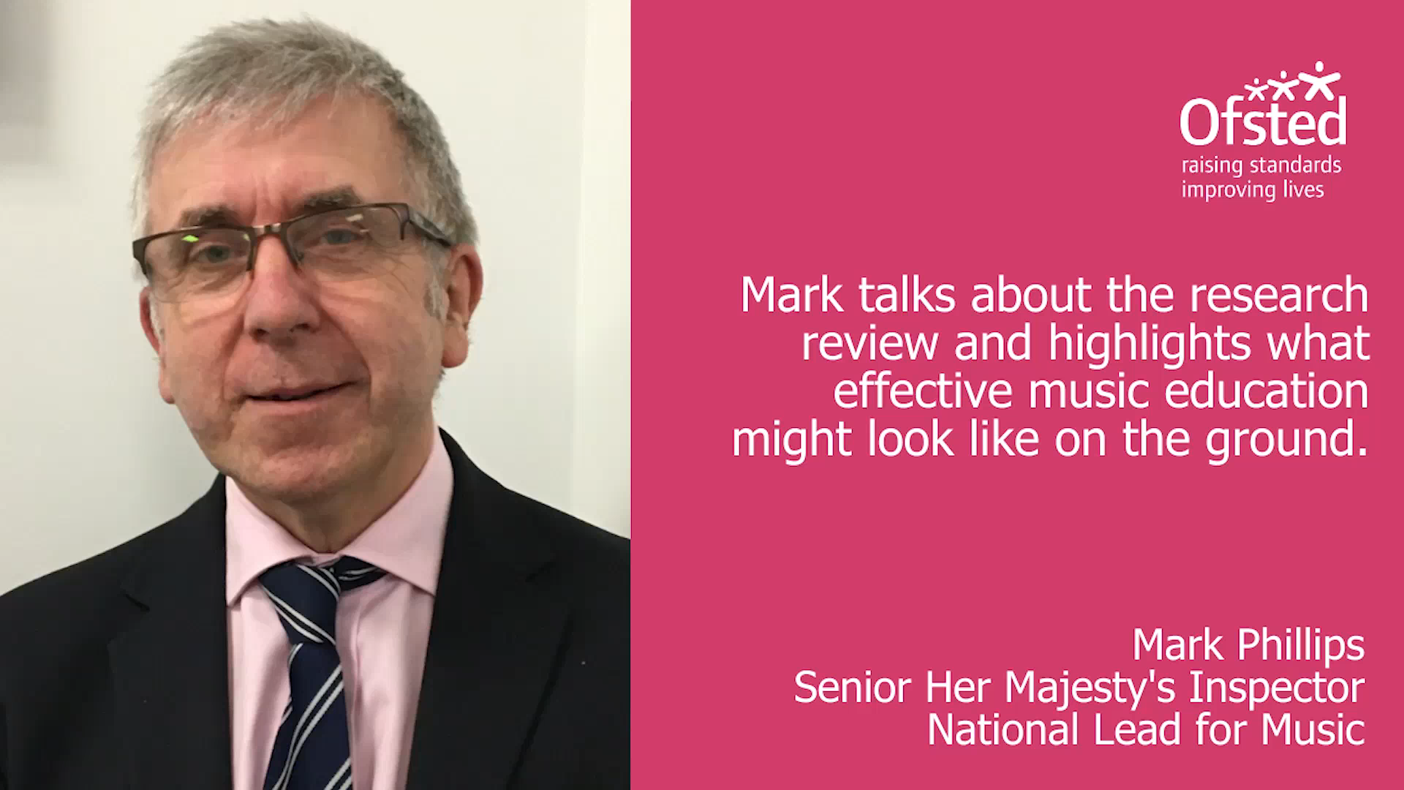

Slide 23
Striking the Right Note: Ofsted Music Report 2023
Findings relating to music in EYFS and Primary Schools:
Curriculum in Reception prepares children well for music in KS1
There is adequate time for music in most primary schools. Strongest aspect is singing. Composition least well taught
Sometimes too much focus on ad hoc musical opportunities rather than a curriculum which incrementally supports progression in musical skills and understanding.
Disparity in achievement in music between children from families who could afford instrumental tuition and those that could not.
Reduction in schools providing instrumental tuition- resulting in increasing disparity between children from different socio-economic circumstances.
Disparity in extra-curricular offering in music amongst schools.

Slide 24
EXPLORING THE NATIONAL PLAN FOR MUSIC EDUCATION (2).

Slide 25
The Plan has 3 Goals:
High Quality Music Education
Partnership Working
Supporting Progression

Slide 26
Goal 1:
High Quality Music Education
All children and young people receive a high-quality music education in the early years and in schools:
Early years providers offer a strong grounding in music up to age five.
Schools and trusts promote a broad musical culture, with opportunities to play and sing together, perform, create and experience live music.
All primary and secondary schools deliver a quality music curriculum reflecting the breadth and ambition of the national curriculum, such as the Model Music Curriculum.
All special schools and alternative provision settings have equally high expectations.
Music is represented in every school’s leadership structure, with a designated lead or head of department at school or academy trust level, for primary and secondary.
Staff are supported with appropriate skills development and resources

Slide 27
Goal 2
Partnership
All music educators work in partnership, with children and young people’s needs and interests at their heart
• A refreshed Music Hub programme with ever stronger partnerships that build a vibrant and sustainable offer of music education in every part of the country.
• Schools, academy trusts and Hubs work together to improve the quality and breadth of music education for children and young people.
• Music and arts organisations, and the music industry, contribute to music education as partners in Hubs, and working with education settings at local, regional and national level.
• All music educators have a stronger understanding of the role of technology in teaching music, including as a creative tool, and in enhancing teaching and in making music more accessible and inclusive

Slide 28
Goal 3
Progression.
All children and young people with musical interests and talents have the opportunity to progress, including professionally:
• Schools and trusts have clear approaches to supporting their pupils to progress music through and beyond the curriculum, including opportunities to study for qualifications, such as graded exams, GCSEs and A level and vocational and technical qualifications.
• Music Hubs proactively work with schools and, where relevant, trusts, to support children’s progress, including specifically through group instrumental and/or whole-class ensemble tuition, with opportunities suited to their needs, ambitions and interests.
• Hubs, schools and trusts develop an understanding of opportunities for specialist and advanced musical tuition individually and in groups, and support children and young people to access local, regional and national youth music opportunities.
• All music educators, including in further and higher education, help young people to understand routes into careers in the music and wider creative industries

Slide 29
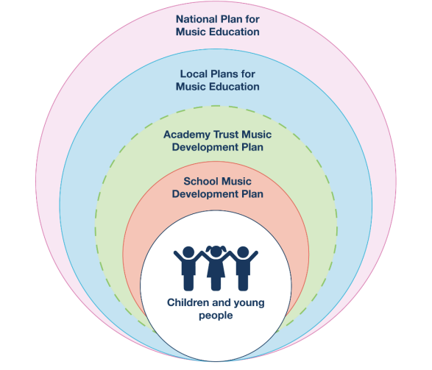
Creating a coherent musical experience and education for children and young people.
All Schools to have a music development plan by September 2023.

Slide 30
Discussion Point.
What worked well in your own music education? Did music education work equally well for your friends/peers?
If you presently work as a music teacher, what works well and what are the barriers to children and young people’s music education?
What is it in your power to change?

Slide 31
Part 2
The policy landscape of music education.

Slide 32

A BRIEF HISTORY OF POLICY DEVELOPMENTS IN MUSIC 2010-2024

Slide 33
The Policy of Music Education in England: A Brief History 2010-19
2010-11 Henley Review of Music Education
2012-Publication of ‘National Plan for Music Education’
2021-13 Music Education Hubs Established
2013 Revised and slimmed down National Curriculum- greater emphasis on classical music and notation.
2016-EBacc Introduced for state schools
2010-18 Reduction in ITE (teacher training) numbers and music teachers in schools
2010-19 Increasing number of schools becoming academies
2016-19 Increasing focus of Ofsted inspections on core and EBacc subjects

Slide 34
Recent Policy Developments in England 2019-2025
Publication of All Party Parliamentary ‘State of the Nation’ Report into Music Education ISM/University of Sussex 2019
2021 (March) Publication by Department for Education (DfE) of a ‘Model Music Curriculum’
2021 (July) Ofsted publishes Research Review in Music Education
2021 (August) DfE establishes advisory group for National Plan for Music Education 2.
2022 Publication of the National Plan for Music (2): The Power of Music to Change Lives
2023 Publication of Ofsted Report : Striking the Right Note
Awaiting: OAK Materials

Slide 35
Recent Policy Developments in England 2019-2025
Important Policy Events
Publication of All Party Parliamentary ‘State of the Nation’ Report into Music Education ISM/University of Sussex 2019
2019-20 Consultation into the proposed ‘Model Music’ Curriculum
2021 (March) Publication by Department for Education (DfE) of a ‘Model Music Curriculum’
2021 (July) Ofsted publishes Research Review in Music Education
2021 (August) DfE establishes advisory group for National Plan for Music Education 2. June 25th 2022 NPME 2 is Published

Slide 36

Policy has in some cases weakened the place of music in the school curriculum.

Slide 37
The Language of Policy towards Music Education
Distinction between ‘academic’ and ‘non-academic’ subjects.
Some subjects to be ‘studied’ others to be ‘enjoyed’.
Conflation of music as part of a liberal curriculum for all and specialist instrumental tuition.

Slide 38
Through Accountability Measures.
Challenges:
Provision in primary schools is variable due to:
- Teachers lacking confidence in teaching music (Limited time in ITE due to focus on core subjects)
- Limited curriculum time often reduced to make time for core subjects which are the focus of Ofsted Inspections and SATS. (Accountability Measures).
Secondary Schools:
- Carousel timetabling (greater focus on core subjects)
- Reduction of key stage 3 to two years to improve GCSE grades (accountability measures).
-EBacc and Progress 8- Policy

Slide 39
Access and equality
The school is the only place where all children are entitled to access a music education.
If schools do not give children a sustained music education through the curriculum, it becomes the preserve of those who can afford to pay.

Slide 40
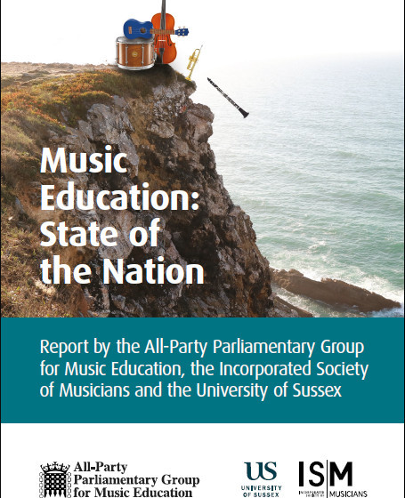
APPG Report into Music Education. Issues of Social Justice.

Slide 41
A Secure Place in the Music Curriculum is Crucial for Music.
‘There is a strong sense that the statutory requirement of being included in the National Curriculum provides a basis for all other music provision in and out of school. Without the obligation for music lessons to be a part of the school curriculum, there is a very real concern that the subject might well wither away in many schools – and in the worst case scenario, could all but disappear in others.’
Darren Henley (2011)
However, according to APPG this principle has been eroded by policy. EBacc a significant factor

Slide 42
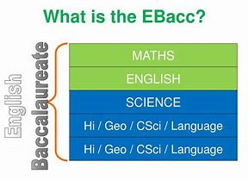
EBACC

Slide 43
Year 9 Provision
In 2018/19, more schools reported Year 9 music being optional than compulsory, despite the requirements of the National Curriculum:
Increasingly, it is either optional (48.4%) or not taught at all as a curriculum subject.

Slide 44
Are any changes to the provision / uptake of music in your school (within and beyond the curriculum) as a result of the introduction of the English Baccalaureate (EBacc) performance measure, positive, neutral, or negative?
Number of responses
2.5%
37.5%
60%

Slide 45
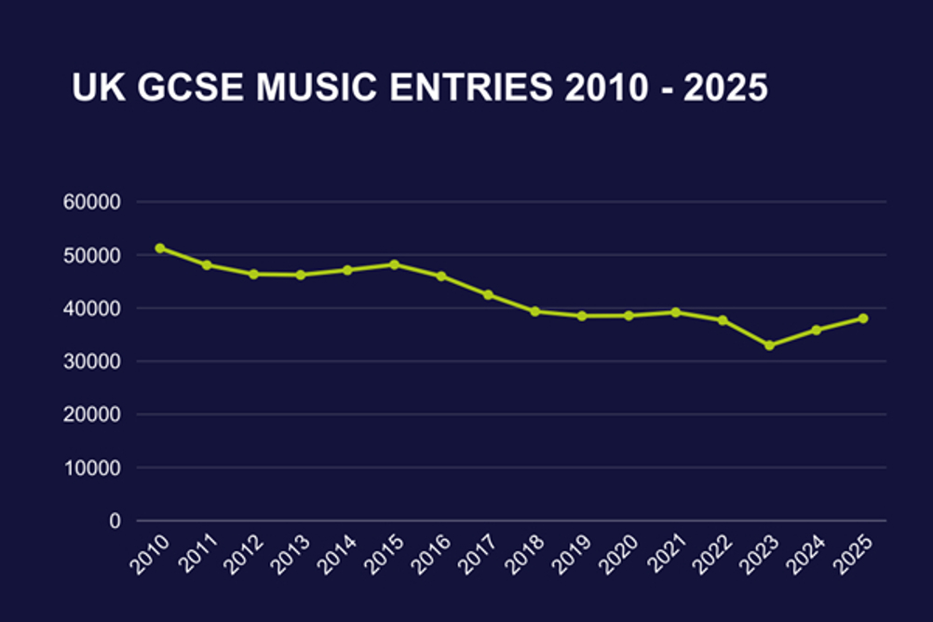
General Decline in GCSE Entries

Slide 46
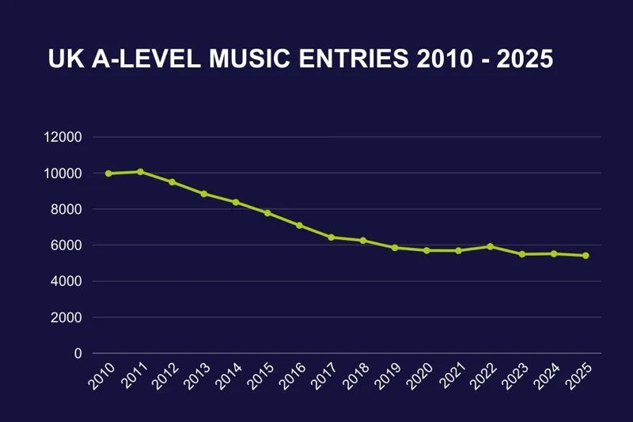
Significant decline in A Level Music Entries (2023)

Slide 47
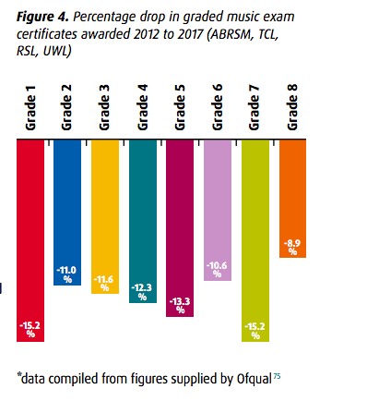
It isn’t just ‘school’ qualifications!
In terms of ABRSM exams, the difference between 2012 and 2017 equates to 42,000 less students in 2017 than 2012.
There is also a 14% drop in the number of students taking ABRSM Grade 5 theory 2012-17. This potentially inhibits the progression routes of certain students. The drop is only very partially made up by the other exam boards.

Slide 48
Another link between postcode and access
In 2017, only 3.5% (15 students from a cohort of 430) of entrants to UK music conservatoires were from Quintile 1 backgrounds (a drop of 1.7% from the previous year) compared to 39.5% from Quintile 5. The data from UCAS shows that there is a direct correlation between socio-economic grouping and likelihood gaining a place to study music at a conservatoire.

Slide 49

Discussion : What can instrumental music teachers do to support and promote music in schools?

Slide 50
Schools need to be vibrant musical communities, drawing upon great teachers based in schools to facilitate this
“Make music the hub of the school, bring it around the school and put on concerts as often as possible that students organise!”
“Exposure - making sure Music is in every newsletter, we run extra-curricular consistently, organise workshops and trips and do this by forming relationships with local bodies such as Rotary Club, Music Hub, who can offer support and funding. Also events in the community.”
Music teacher, Sussex 2016-2018 study

Slide 51
What else works?
“Offering as much extra-curricular opportunities as possible and a really good recruitment programme for instrumental lessons - we recruited nearly 50% of our current Year 7 cohort into instrumental lessons at the beginning of the year. This was partly through persuading the school to invest in DA students [in receipt of PP] lessons and working with [our MEH] to able to deliver these at an appropriate cost.”
Music teacher, Sussex 2016-2018 study

Slide 52
Discussion Point
Drawing on your experience and learning in this session, what one change to music education policy would you make and why?
Justify your choice in terms of the impact that it will have on:
Young people’s music education.
Your work in schools.
The wider context of music education.

Slide 53



Other Music Education Organisations

Slide 54

Youth Music.
A Grant Awarding Body focusing on supporting music education organisations that work with young people out of school.
Particularly focuses on young people who cannot access music making and music education opportunities.
Has published a number of significant reports into barriers to music education.
Close links with the ‘music industry’.
https://youthmusic.org.uk/
We're a national charity investing in music-making projects which support children and young people aged 0-25 to develop personally and socially as well as musically.
We work particularly with those who don’t get to make music because of who they are, where they live, or what they’re going through.

Slide 55

Sound Connections
Mainly London-based but now with a more national reach.
Adopts a broad approach to music making.
Good recent materials for Early Years Music.
https://www.sound-connections.org.uk/
Sound Connections exists to create change. We work across the music community to achieve inclusion, equity and social justice with young people.
We focus on four strands of work
Youth Voice and Participation
Training and professional development
Advocacy
Consultancy
Together, these strands ensure that all children and young people age 0 to 25 can access music opportunities and progression routes.

Slide 56

Sound Sense
The professional association for community organisations.
https://www.soundsense.org/

Slide 57

Musical Futures/Informal Learning

Slide 58
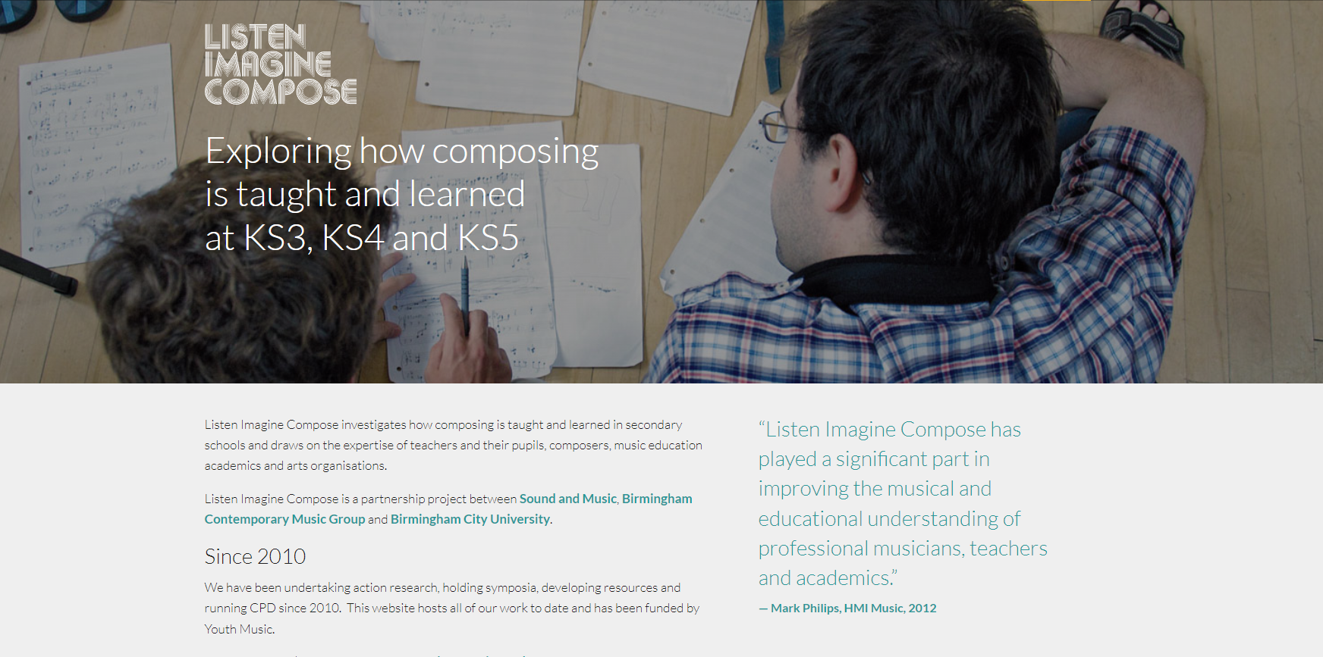

Slide 59
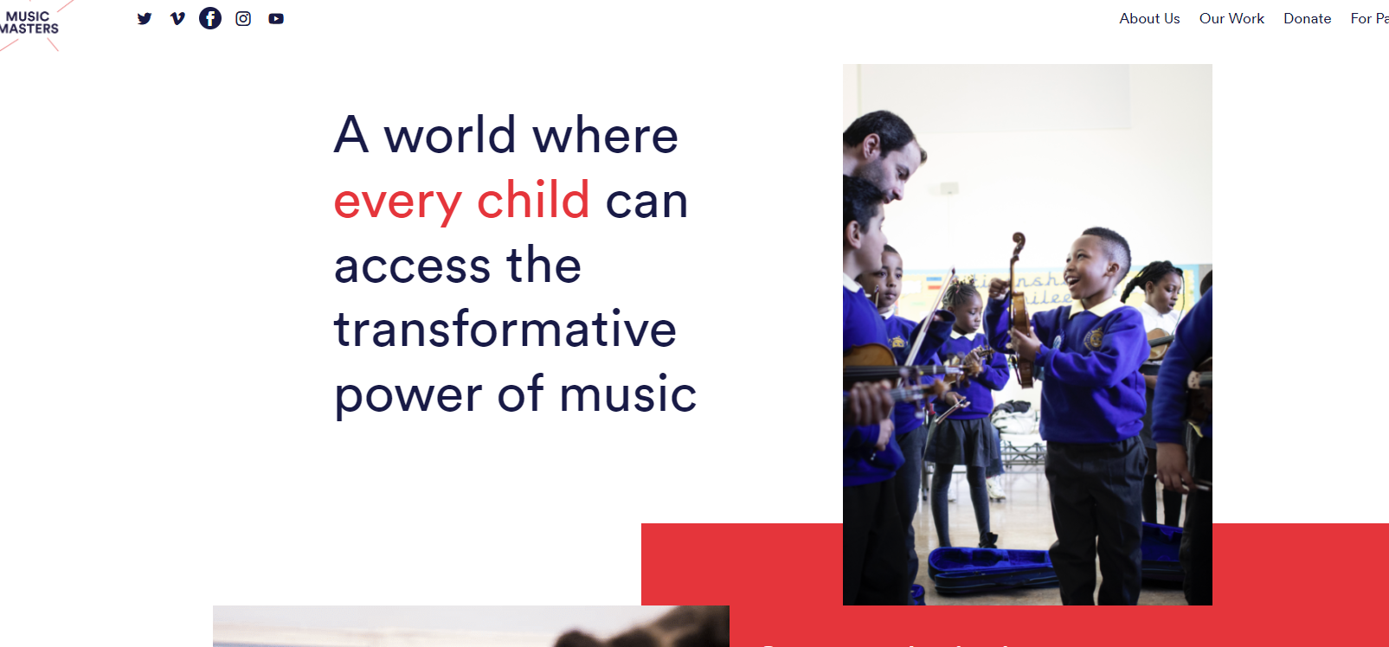

Slide 60
Discussion Point: Music’s Transformative Powers
What is the transformative power of Music and /or Music Education?
What kind of transformations have you experienced yourself?
What transformations have you observed in children you have worked with?
What was the context/teachers' actions that enabled these transformations

Slide 61
Useful Weblinks
National Plan for Music Education + resources (2) https://www.musicmark.org.uk/resources/national-plan-for-music-education-2022-the-power-of-music-to-change-lives/
National Curriculum for Music https://www.gov.uk/government/publications/national-curriculum-in-england-music-programmes-of-study/national-curriculum-in-england-music-programmes-of-study
Model Music Curriculum https://assets.publishing.service.gov.uk/government/uploads/system/uploads/attachment_data/file/974366/Model_Music_Curriculum_Full.pdf
Ofsted Research Review: https://www.gov.uk/government/news/simply-doing-music-is-not-enough
Striking the Right Note (Ofsted Music Report) Striking the right note: the music subject report - GOV.UK (www.gov.uk)
ISM https://www.ism.org/
MusicMark https://www.musicmark.org.uk/
Music Teachers Association https://www.musicteachers.org/
Music Education State of the Nation Report https://www.ism.org/images/images/State-of-the-Nation-Music-Education-WEB.pdf

Slide 62
References
Department for Culture, Media and Sport; Department for Education (2022) The power of music to change lives: a national plan for music education. London: Crown Copyright
Department for Education (2021) The Model Music Curriculum, London: Department for Education
Department for Education (2013) National Curriculum in England: Music Programmes of Study. London: Department for Education. National curriculum in England: music programmes of study - GOV.UK (www.gov.uk)
Ofsted (2021) Research review series: music. London: Crown Copyright.

Slide 63


A BRIEF LOOK AT THE TEACHERS’ STANDARDS

Slide 64
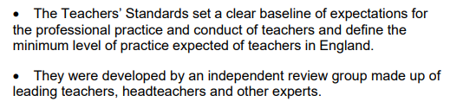
What are the Teachers’ Standards.

Slide 65

Preamble: The Teachers’ Standards

Slide 66
The Teachers’ Standards set out what all teachers must do:. They are in two parts
Part 1 (Relating to teaching). Teachers Must:
Set high expectations which inspire motivate and challenge pupils.
Promote good progress and outcomes by pupils.
Demonstrate good subject and curriculum knowledge
Plan and teach well-structured lessons
Adapt teaching to respond to the strengths and needs of all pupils.
Make accurate and productive use of assessment
Manage behaviour effectively to ensure a good and safe learning environment.
Fulfil wider professional responsibilities

Slide 67
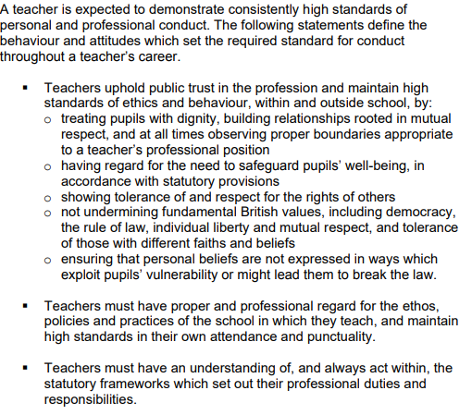
Part 2: Personal and Professional Conduct:

Slide 68
Activity
With the aid of the prompt sheet identify
One teaching standard where you think you have particular strengths, and why.
One teaching standard which you feel you particularly need to develop further. What aspects need development?
Set high expectations which inspire motivate and challenge pupils.
Promote good progress and outcomes by pupils.
Demonstrate good subject and curriculum knowledge
Plan and teach well-structured lessons
Adapt teaching to respond to the strengths and needs of all pupils.
Make accurate and productive use of assessment
Manage behaviour effectively to ensure a good and safe learning environment.
Fulfil wider professional responsibilities

