Slide 1



From Expert to Educator
Beliefs, Visions and Identities.
Musicians of Change: August 2025

Slide 2
Session Aims
Developed further understanding of what it means to think and write at master’s level (level 7).
Begin to look at the requirements for the first assignment.
Consider identity as a musician and music teacher
Examined how your beliefs and musical values and those of young people develop
Considered how these beliefs and values impact on how and what you teach
Explore the ‘Teaching Standards’

Slide 3
Assignment Learning Outcomes (i.e. What you have to demonstrate).
Demonstrate critical insight into an aspect or aspects of your subject within your teaching setting | What does it mean to teach music musically? What are the barriers to teaching music musically? What perspectives from research and scholarship can illuminate are understanding of this and provide differing perspectives? How is my thinking and reading reflected in my professional decisions relating to musical teaching and learning? What evidence have I for this?
Develop criticality by drawing on appropriate reading and research | How do I draw on research/scholarship/policies etc. to inform my professional decisions and reflect on my professional practice? Do I draw on a broad range of perspectives and critically engage with these? Have I engaged with the recommended readings?
Demonstrate your ability to reflect on your experiences on your journey from expert to educator. (Friday). | What developments have there been in your thinking and understanding in the first weeks of the course? What are you emerging reflections on your role and identity as a music teacher? How do you resolve tensions between your multiple identities? How have you drawn on models of reflection to inform your own reflections?
Demonstrate your ability to communicate effectively through appropriate use of media | Well presented. Coherent structure. Proofread. Academic writing style. Correct referencing.

Slide 4
Assessment criteria for a very good response to the LO3.
You demonstrate your ability to reflect on your own experiences in your journey from expert to educator very well using appropriate and reflective models which help inform your teaching decisions and identify assumptions about musical learning

Slide 5



What is the relationship between ‘theory’ and ‘practice’ for Masters level work.

Slide 6


A key aspect of writing and thinking at Master’s Level is an understanding of the symbiotic relationship between ‘theory/ideas’ and ‘practice’.

Slide 7
What’s a ‘symbiotic relationship’!?
A symbiotic relationship is one in which organisms, people, or things exist together in a way that benefits them all.
In other words, theory and practice interrelate – it’s not a servant-master/mistress relationship.

Slide 8
Theory and Practice United
‘Theory and practice must go hand in hand, because theory is nothing but thinking about practice, and the practice which is worthwhile must be thought about, that is, must grow out of theory’. (Moore, 1915: 4-5)

Slide 9
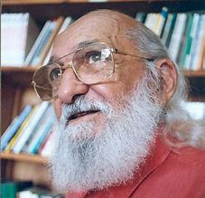
... It’s about critical reflection on the relationship between theory and practice.
Critical reflection on practice is the requirement of the relationship between theory and practice otherwise theory becomes simply ‘’blah, blah, blah’’ and practice pure ‘’activism’’. (Freire)

Slide 10
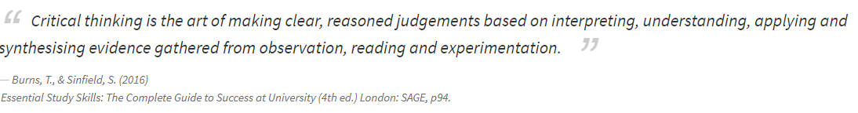
What is critical thinking?

Slide 11
Getting the relationship right between theory and practice is crucial to success on the course.
In your thinking and writing you need to be able to:
Critically engage with and reflect on concepts, theories, policies of music education, relating these to your work as a music teacher
Make explicit the relationship between the key concepts and theories of music education and your own music education practice and vice versa
Describe the extent to which theories and research are borne out in your experiences of teaching music. Do these theories stand up!
Be able to explain how your music teaching is informed by music education theory and by research in music education, including the work of key music educators.

Slide 12

The Importance of ‘theory’ and ‘ideas’:
’… it is only through theorising that any wisdom won by practical experience …can be formulated, shared and refined. Reflections on practice can only be exchanged through a mutually shared network of ideas…No profession can develop without debating key ideas or theories bringing its assumptions on to the table for public scrutiny.’ (Swanwick, 1988. p, 8)

Slide 13
Activity
We all ‘theorise’- it is what gets us through our daily lives. In groups, spend 10 minutes creating a ‘theory’ of music/music education. It should be:
Derived from experience;
Shaped into a form/statement that is understandable by others;
Is applicable in a wide range of contexts.
Example: ‘Children should learn to sing the music before trying to play it. This is because…’
GO THEORISE!

Slide 14

THEORISING MUSICIAN IDENTITY AND TEACHER IDENTITY

Slide 15
Important things to remember about identity:
Important things to remember about identity:
We all have multiple identities (musical and otherwise)
Identities are not fixed but dynamic.
Identities change and adapt in relation to a range of factors including context: your identity as a musician and music teacher will change as a result of this course and, your time in school.
Identity is a two-way process- how you perceive yourself is not necessarily how the children perceive you!

Slide 16
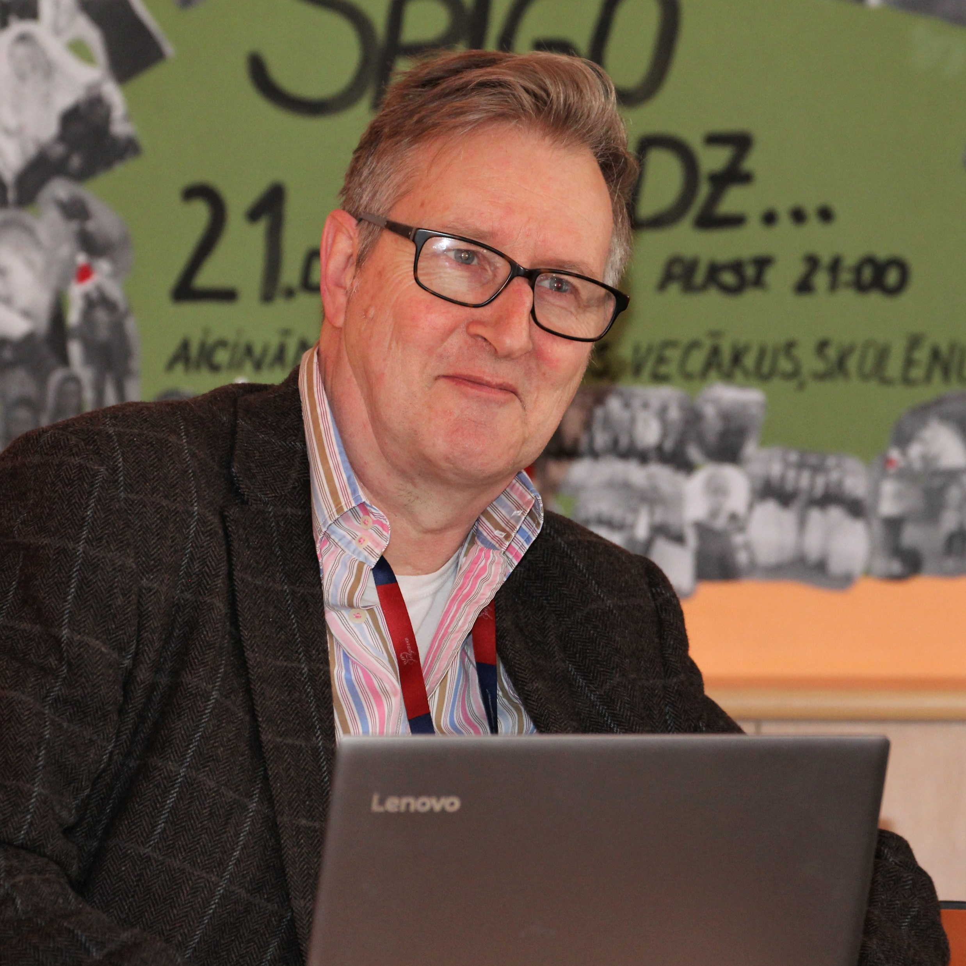
MY IDENTITIES
Musician- Theatre musician, choral director, composer
Teacher- secondary school music teacher, university lecturer (The Open University and Birmingham City University)
Writer- books on teaching and teaching music; social justice and pupil voice
Professional Development Leader: Initial Teacher Education (ITE); Master’s courses; secondary and Primary CPD
Uncle, brother, friend etc. etc….
What are your identities?

Slide 17
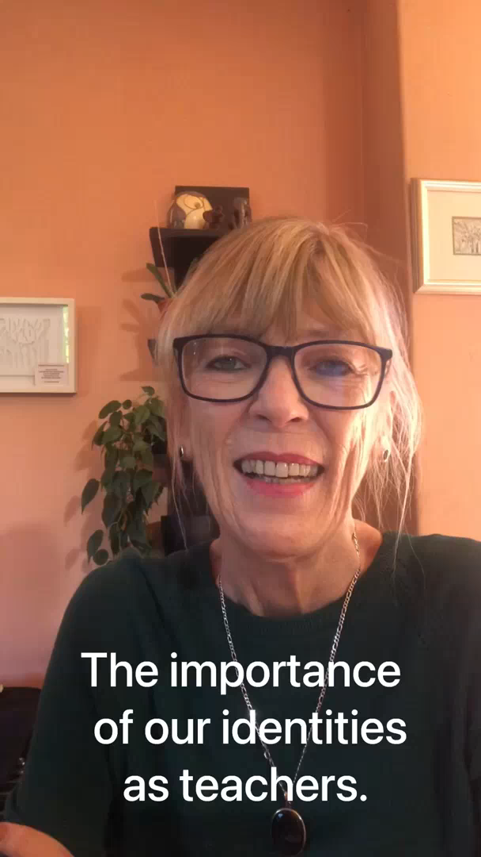
‘’knowing who you are is the greatest gift you can give to yourself and to your children’’.

Slide 18

Teacher Development as Identity Learning
Learning to teach is an identity making process which ‘concern[s] teachers’ overall conception of who they are as teachers, who they believe they are, and who they want to be as …Teacher learning, therefore, can and should be conceptualised as teacher identity learning’ (Beijaard, 2019: 1).
‘ student teachers undergo a shift in identity due to the range of experiences they gain in the process of becoming a teacher’ (Oric, 2013:208)

Slide 19

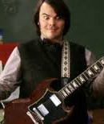
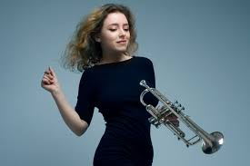
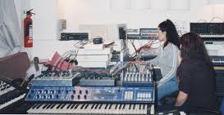
What makes music teachers different from other teachers?
[music teachers] are often unique among most of …other teachers …who do not typically ‘do’ the subjects they teach (art teachers sometimes are an exception). Unlike music teachers who, independently of their teaching, are trained musicians, most teachers are not trained physicists, chemists, historians, or the like, but have mastered their subject to the degree needed to teach it… (Regelski, 2009: 3)
Being a Musician is very much a part of a music teachers’ identity. A key question is how ‘the musician’ identity and the ‘music teacher’ identity interact and the relationship between these identities.

Slide 20
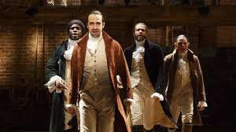
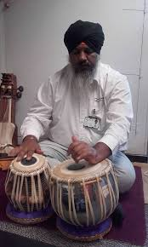
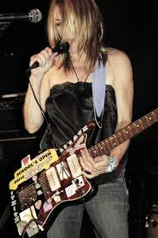
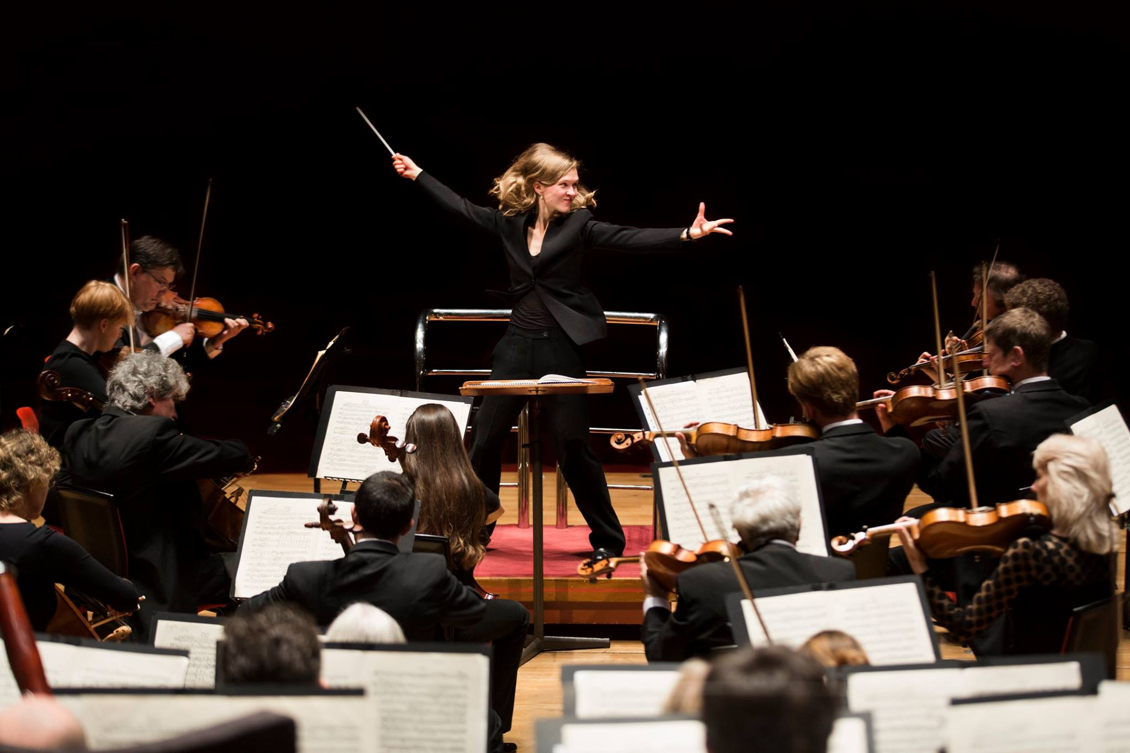
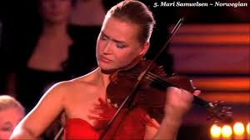
Being a musician can mean many different things and involve different values and beliefs about what music is and does.

Slide 21
Beliefs and Identity are closely related.
‘A particular teaching method is nowhere near so important as our perception of what music is and what it does’ (Swanwick, 1999: 45).
‘...the way in which music is perceived - the understanding of its nature and purpose - is critical to … what we teach and the way we teach it’ (Spruce 2002: 4).

Slide 22
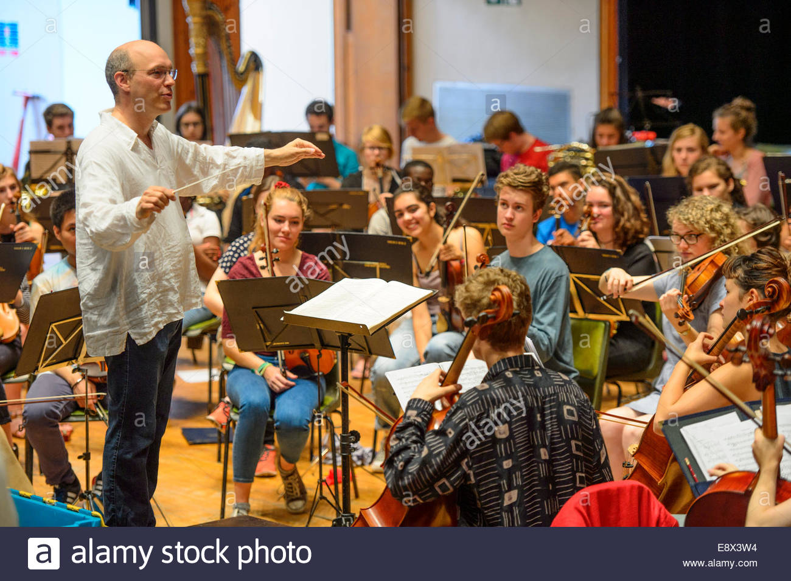

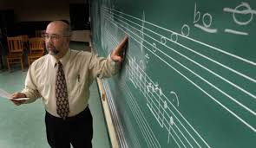
This can translate into different approaches and beliefs about what is important in music education.

Slide 23
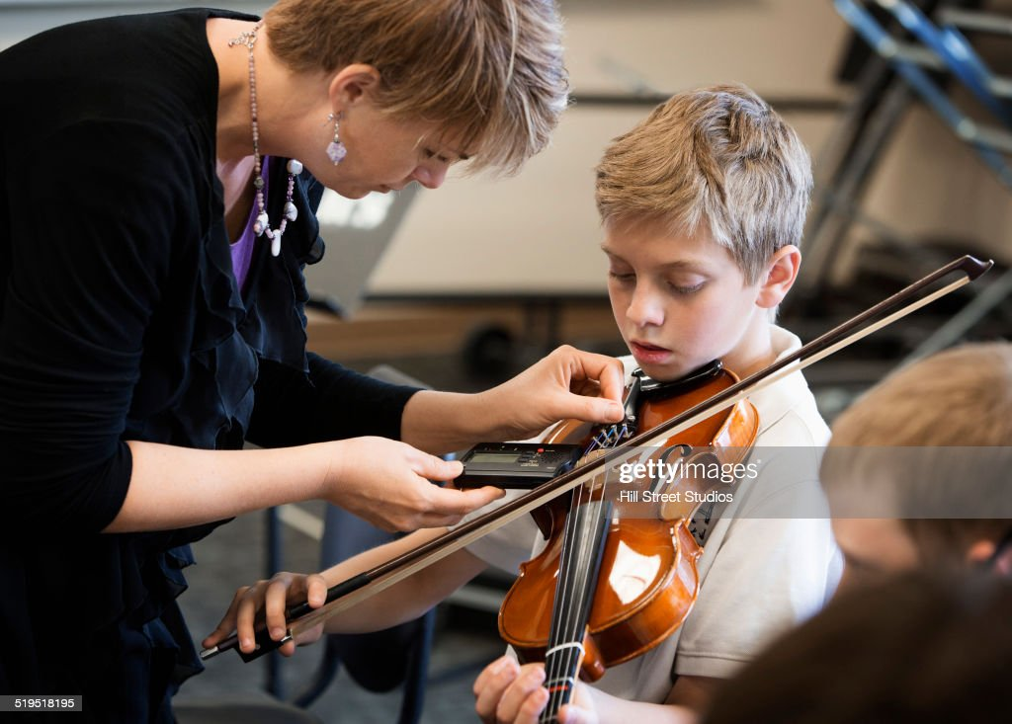
Activity
How would you describe your own musician identity and teacher identity? What are the differences and what are the commonalities?
How do you think your beliefs as a musician impact on what and how you teach as a music teacher?

Slide 24
At the heart of both musician identities and teacher identities are questions of Ontology and Epistemology
Beliefs about:
What it is to be a musician and what it is to be musical (ontological views)
What is important musical knowledge/understanding (epistemological views).

Slide 25
How musical identity formed (Yours and your pupils).
Identities are formed through a process of
(Musical) Socialisation
and
(Musical) Enculturation.
What is the difference? Suggestions???

Slide 26
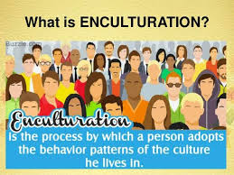
(Musical) Enculturation
Musical learning, understanding, tastes and preferences learnt through daily life. Informal Knowledge

Slide 27

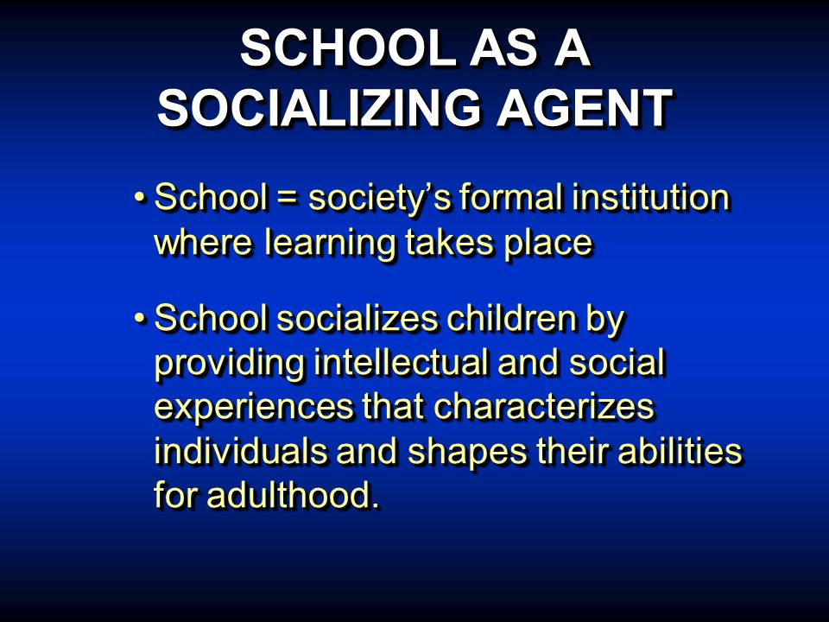
Musical Socialisation
Intentional and planned learning mostly in formal contexts such as schools. Formal Knowledge.
Tensions between musical enculturation and musical socialization can cause young people to become disengaged from formal musical education.

Slide 28

Activity: Key Landmarks in Your Musical Development.
Did they result from informal (enculturation) musical education or formal (socialisation) musical education?
Why are these significant?
How have they influenced you?
Identify 4-6 significant landmarks in your learning journey so far…

Slide 29

Activity
Based on your enculturation and socialisation as a musician
How do you define what it is to be a musician and to act musically?
What do you believe are important/valuable musical knowledge and skills that should be taught? Justify these.
What are the pedagogies (teaching approaches) that you feel are the most effective when teaching music?

Slide 30
The Music Teacher Challenge
That the young people you teach will all have…
Different musical enculturation and socialisation experiences which have led their present musical identities
These identities are important and valued by young people and need to be respected
This does not mean that identities are fixed and immutable. You as a teacher have immense influence over these- use this influence wisely!
Recognition of young people’s musical identities is crucial to an inclusive and socially just approach to music education.

Slide 31
Activity : Identifying Musical Identities
Think of someone you know well (perhaps a young person you teach).
What would you consider to be their musical identity/ identities?
What are their different musical enculturation and socialisation experiences that have led to the formation of these musical identities
What do these identities tell you about the approaches and pedagogies you might adopt to support their musical progress?

Slide 32


A BRIEF LOOK AT THE TEACHERS’ STANDARDS

Slide 33
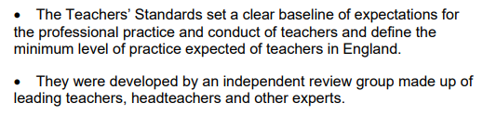
What are the Teachers’ Standards.

Slide 34
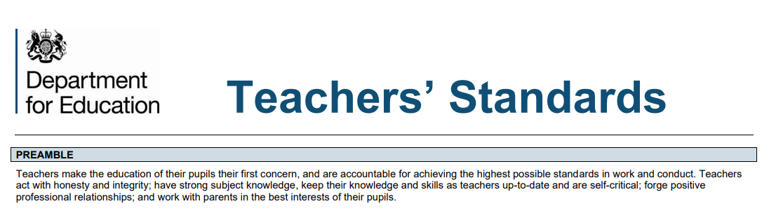
Preamble: The Teachers’ Standards

Slide 35
The Teachers’ Standards set out what all teachers must do:. They are in two parts
Part 1 (Relating to teaching). Teachers Must:
Set high expectations which inspire motivate and challenge pupils.
Promote good progress and outcomes by pupils.
Demonstrate good subject and curriculum knowledge
Plan and teach well-structured lessons
Adapt teaching to respond to the strengths and needs of all pupils.
Make accurate and productive use of assessment
Manage behaviour effectively to ensure a good and safe learning environment.
Fulfil wider professional responsibilities

Slide 36
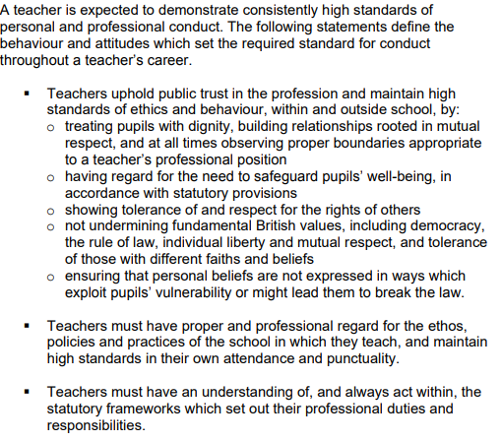
Part 2: Personal and Professional Conduct:

Slide 37
Activity
With the aid of the prompt sheet identify
One teaching standard where you think you have particular strengths, and why.
One teaching standard which you feel you particularly need to develop further. What aspects need development and what support do you need?
Set high expectations which inspire motivate and challenge pupils.
Promote good progress and outcomes by pupils.
Demonstrate good subject and curriculum knowledge
Plan and teach well-structured lessons
Adapt teaching to respond to the strengths and needs of all pupils.
Make accurate and productive use of assessment
Manage behaviour effectively to ensure a good and safe learning environment.
Fulfil wider professional responsibilities

Slide 38
Activity
Post Session
Engaging with music education literature:
Read Pellegrino, K (2009) Connections Between Performer and Teacher Identities in Music
Make brief notes on the points made in the article and ideas explored
Write a short paragraph which outlines the implications of what Pellegrino writes for:
- your own professional development and identities.
- your approaches to teaching young people in your teaching contexts.

Slide 39
References.
Beijaard, D. (2019) ‘Teacher learning as identity learning: models, practices, and topics’, Teachers and Teaching, 25:1, 1-6
Dwyer, R. (2016) Music Teachers Values and Beliefs. London: Routledge.
Pellegrino, K. (2009) ‘Connections Between Performer and Teacher Identities in Music Teachers: Setting an Agenda for Research’ in Journal of Music Teacher Education 19; 39
Philpott, C. (2010). The Sociological Critique of Curriculum Music in England: Is Radical Change Possible? In. R. Wright, ed; Sociology and Music Education, 1st ed. Farnham.: Ashgate; pp. 81-92.
Regelski, T. A. (2009). The Ethics of Teaching as Profession and Praxis. Visions of Research in Music Education, 13(January), 1-34.
Spruce, G. (2002). Ways of thinking about music: political dimensions and educational consequences. In. G. Spruce. Ed; Teaching Music in Secondary Schools: A reader, 1st ed. London: RoutledgeFalmer; pp, 3-24.
Spruce, G. with Matthews, F. (2012) Musical ideologies, practices and pedagogies. In. Philpott, C. and Spruce, G. eds; Debates in Music Teaching, 1st ed. London: RoutledgeFalmer; pp, 118-134.
Swanwick, K. (1999) Teaching Music Musically. London: Routledge
Wagoner. C.L. (2012) Defining Music Teacher Identity for Effective Research in Music

