Slide 1


Examples used for B flat instruments

Slide 2
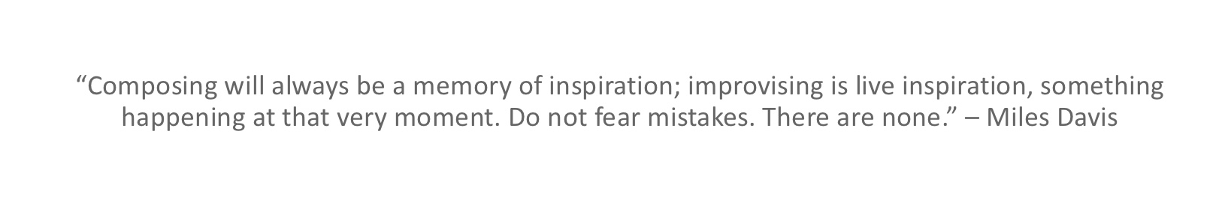

Slide 3
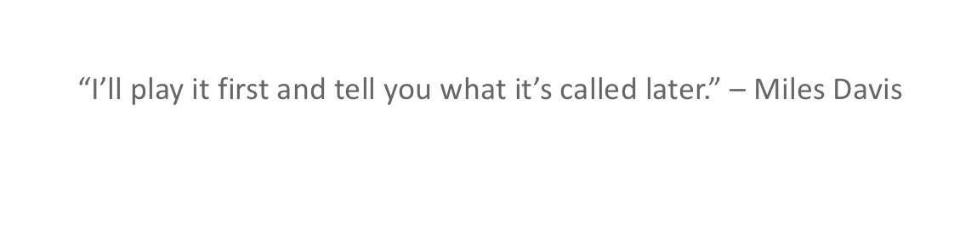

Slide 4
Musical fluency
Aural awareness
Contextual understanding
Developing the mindset of a musician
Holistic approaches
Creativity
Ownership and self evaluation

Slide 5
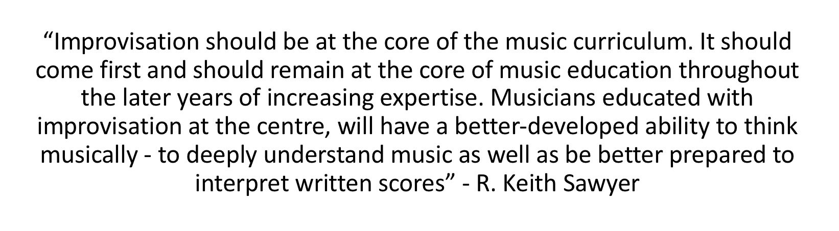

Slide 6
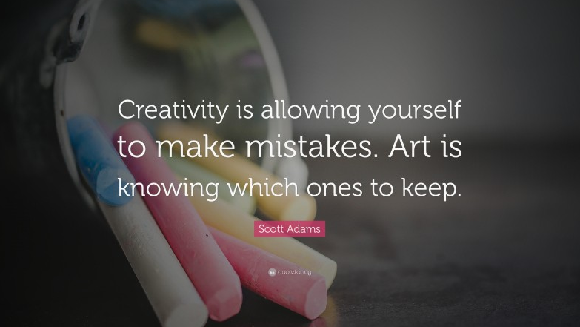
Mis-takes are opportunities for growth

Slide 7
Effective composing is supported by a developing understanding of the building blocks of music, and by critically listening to a broad range of music. Supported with this knowledge and understanding, pupils should be given the opportunity to improvise, create and share their own music, as a key part of their classroom curriculum provision.
(National Plan for Music Education 2022)

Slide 8
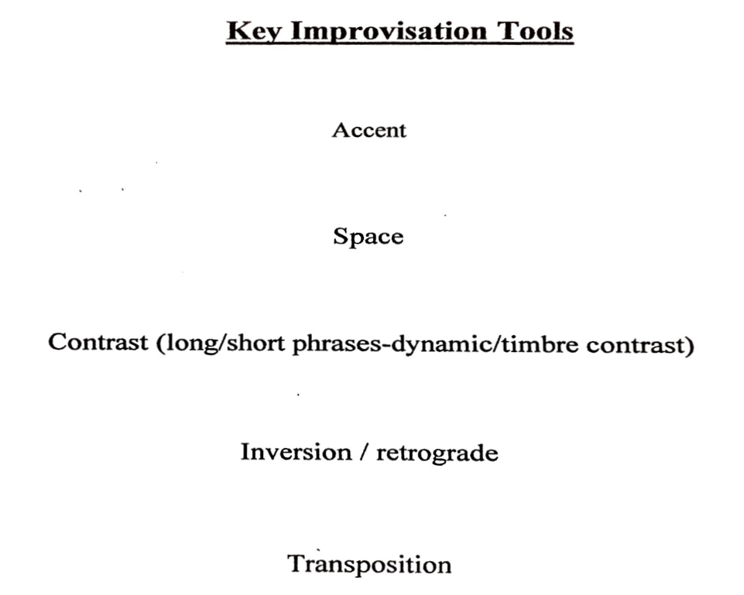

Slide 9
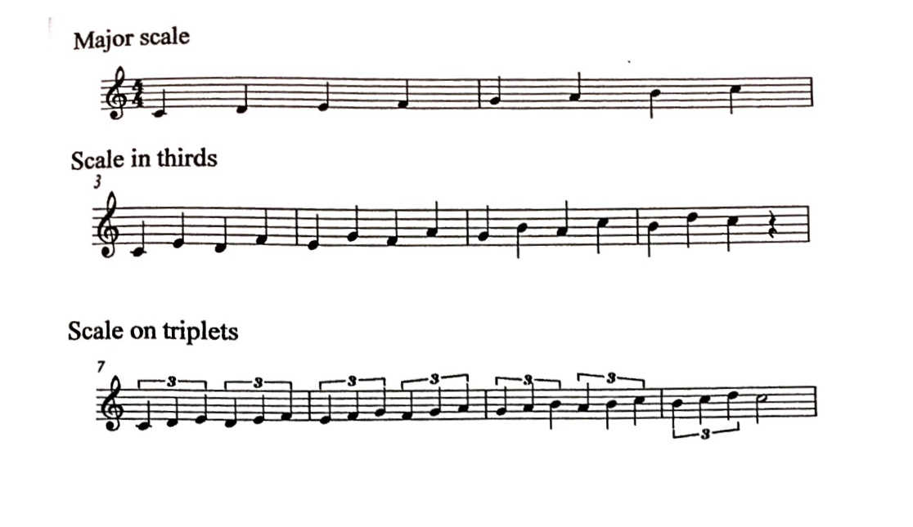

Slide 10
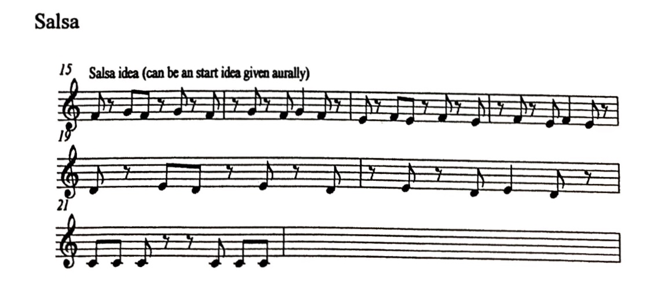
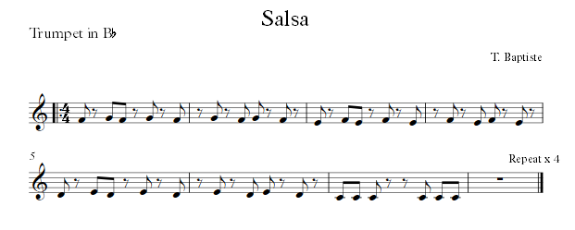

Slide 11
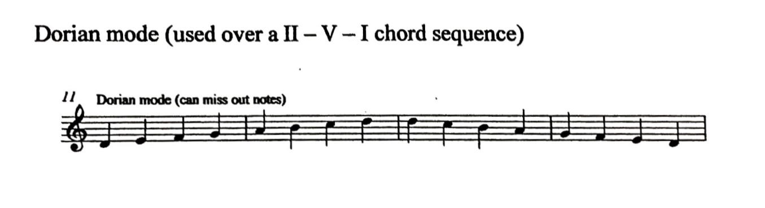

Slide 12
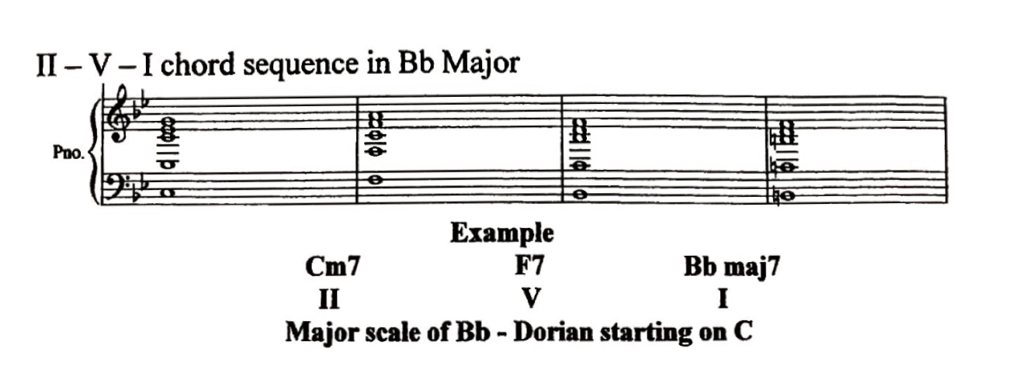

Slide 13
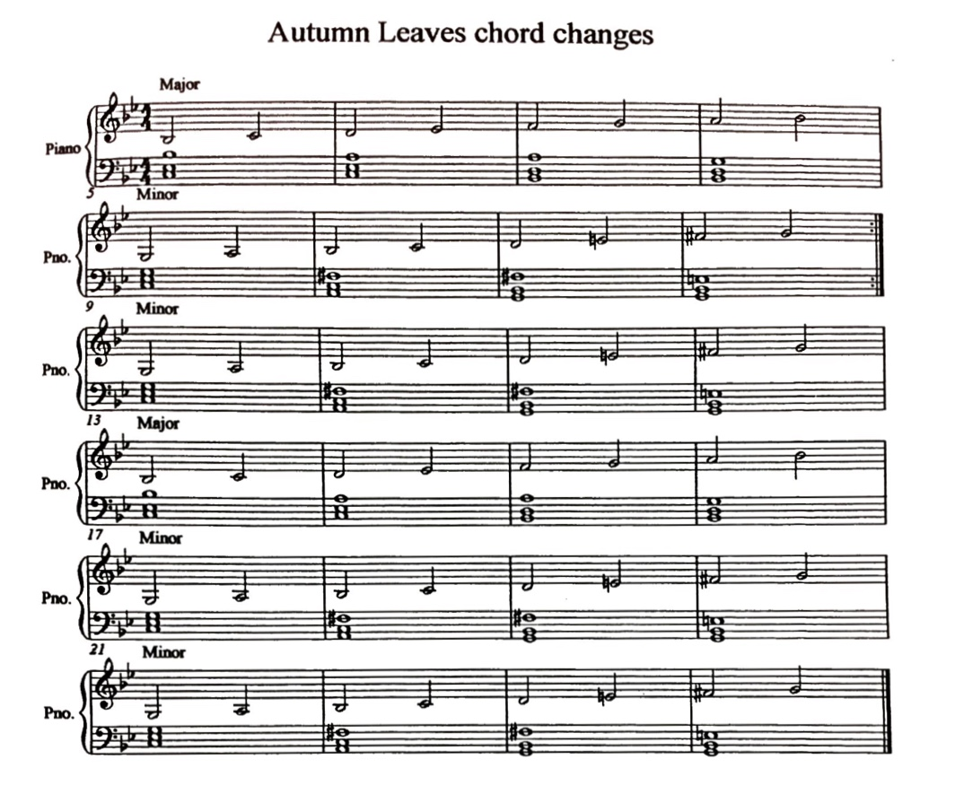

Slide 14
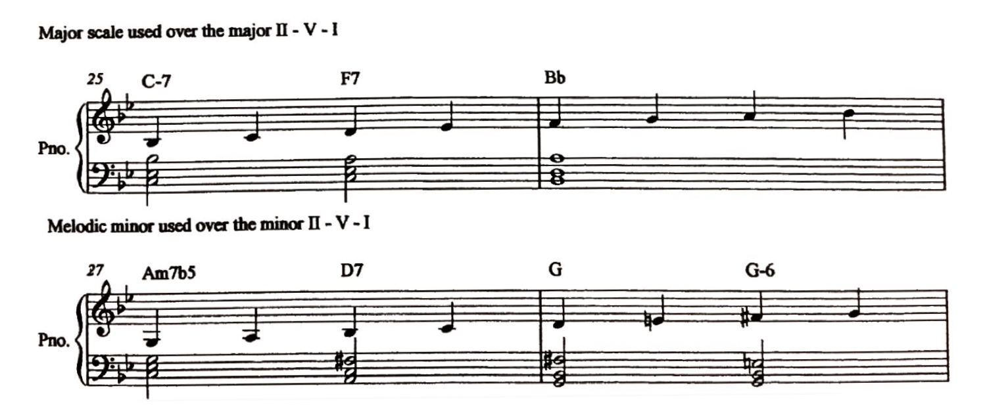
Autumn Leaves first 16 bars

Slide 15
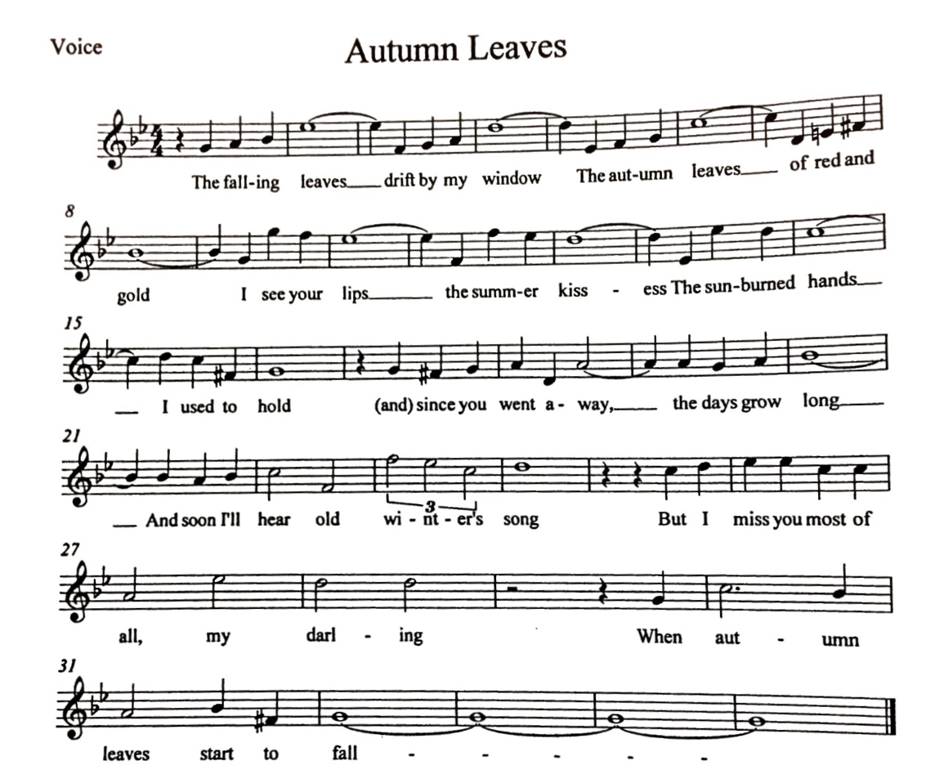

Slide 16
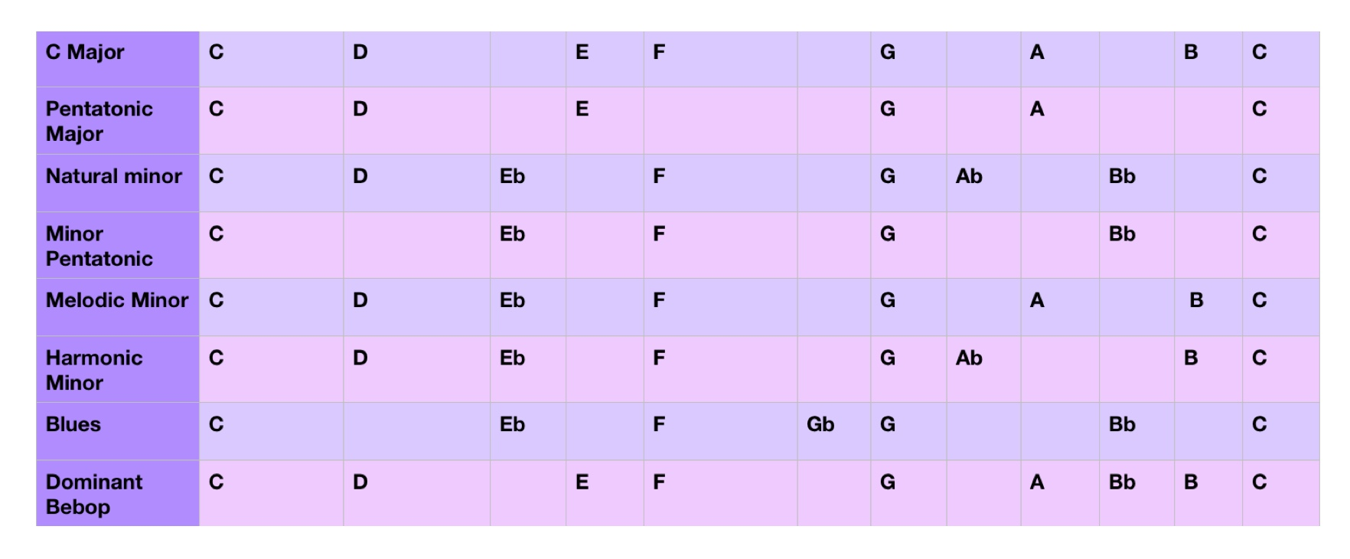

Slide 17
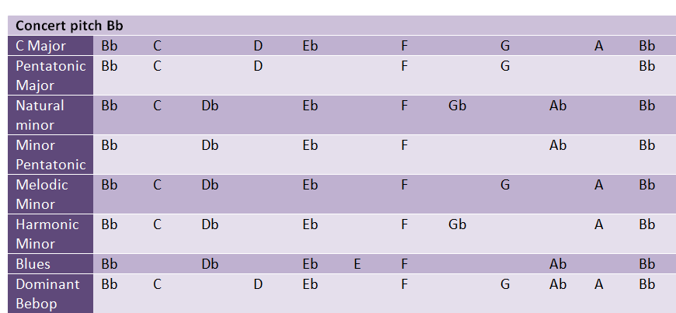

Slide 18
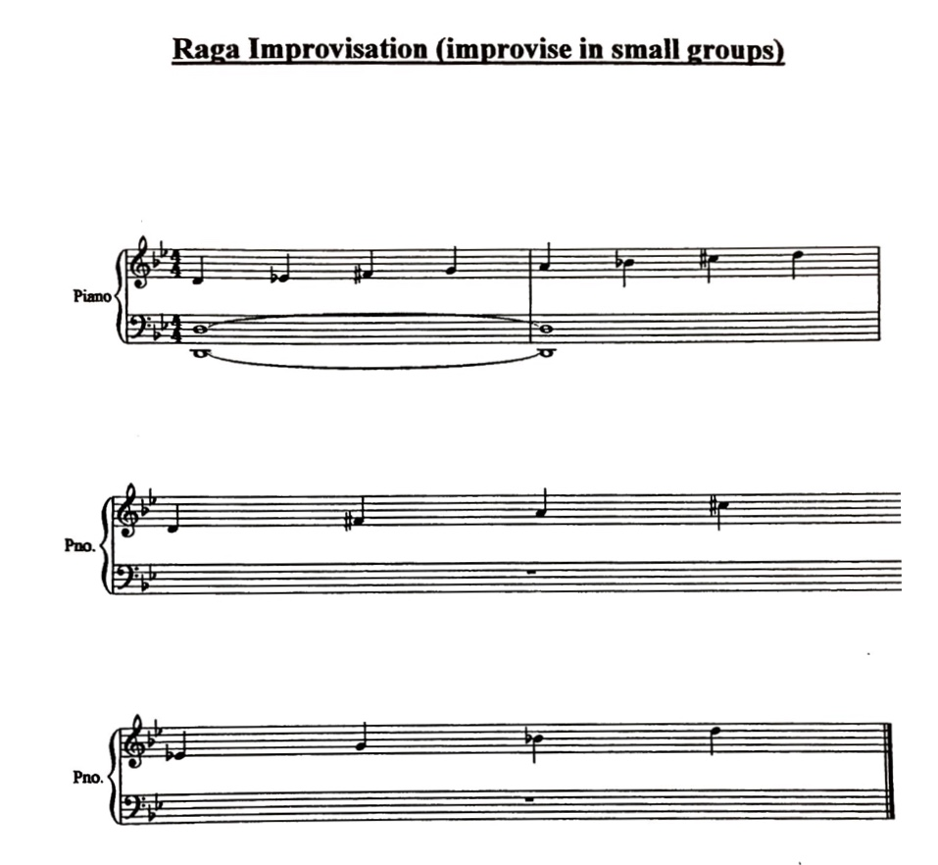
Arpeggios and chromatic movement
in free time
Part One
Part Two

Slide 19
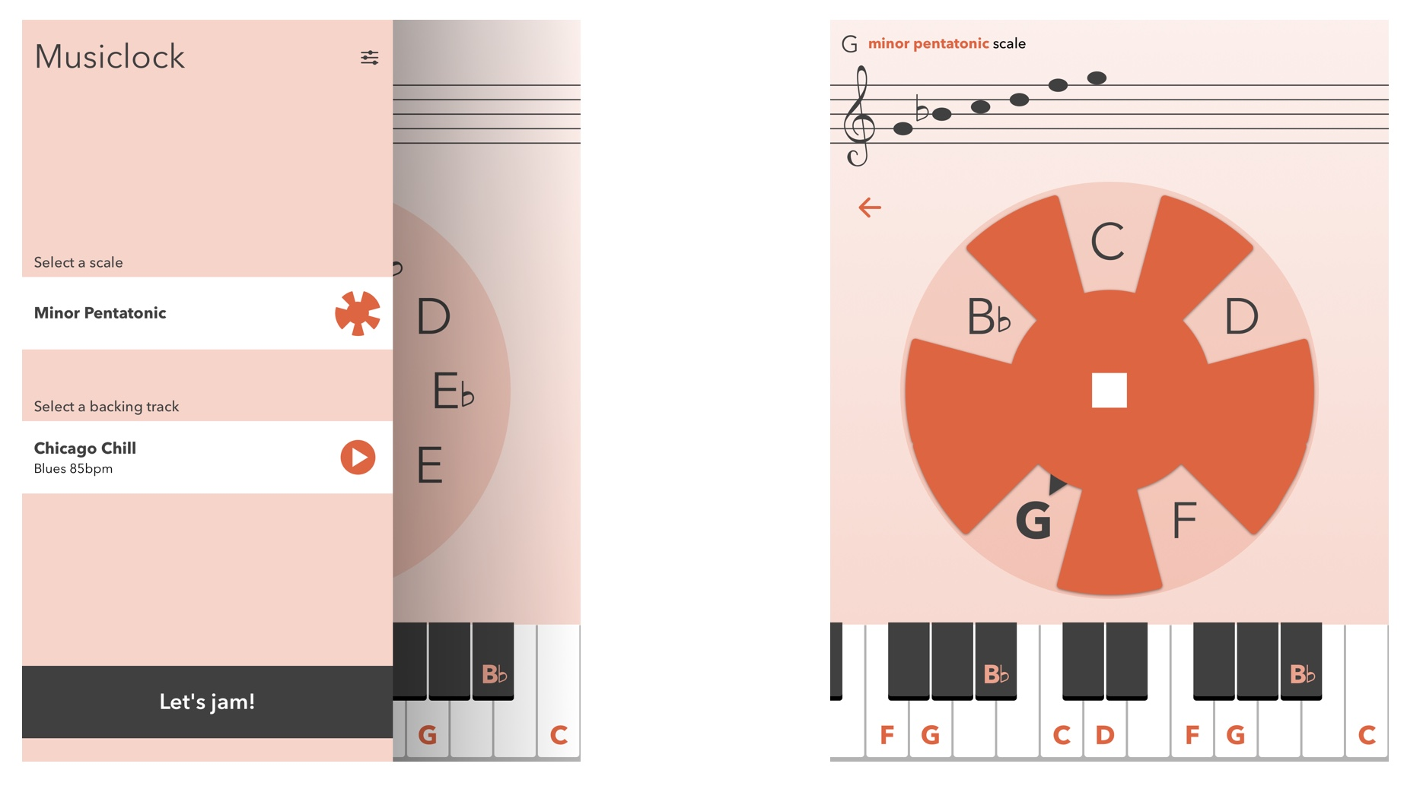
Useful resource

Slide 20
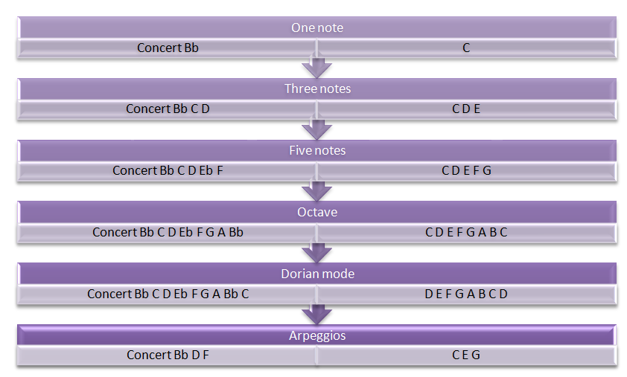
Summary of progression steps

Slide 21
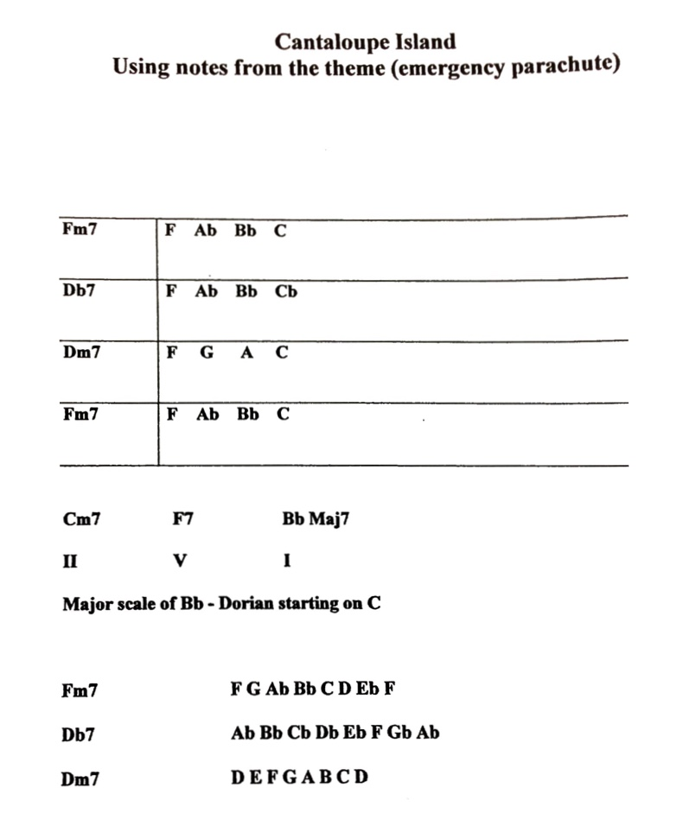

Slide 22
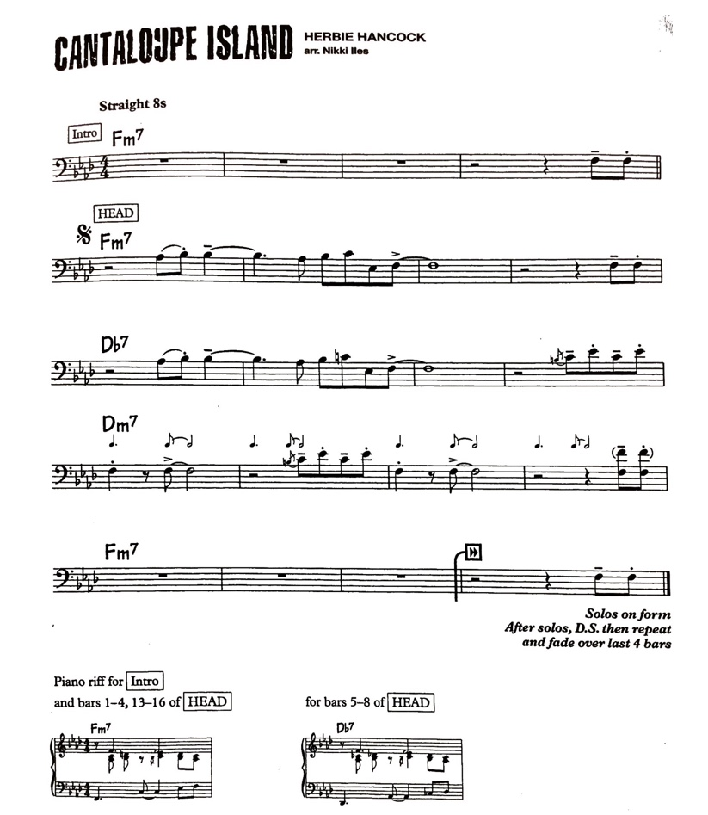

Slide 23
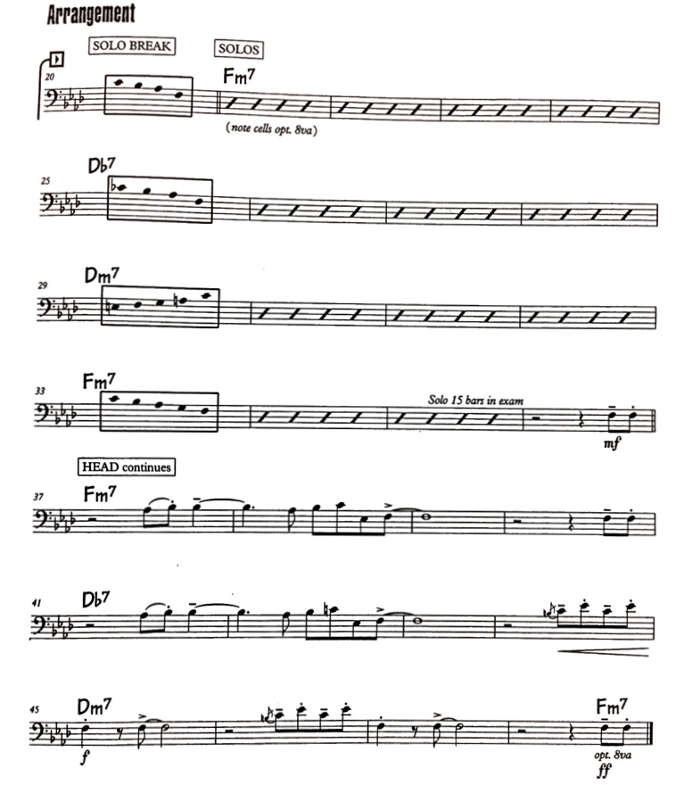

Slide 24
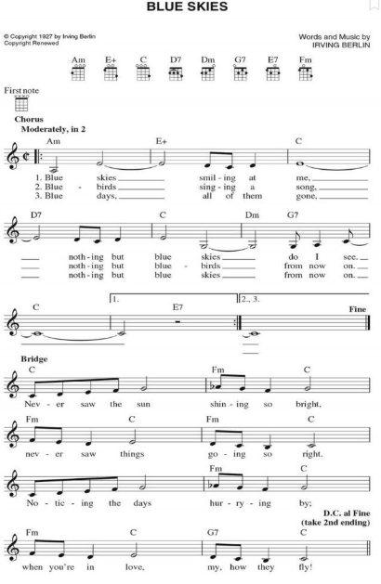
Composition linked project –
Blue Skies

Slide 25
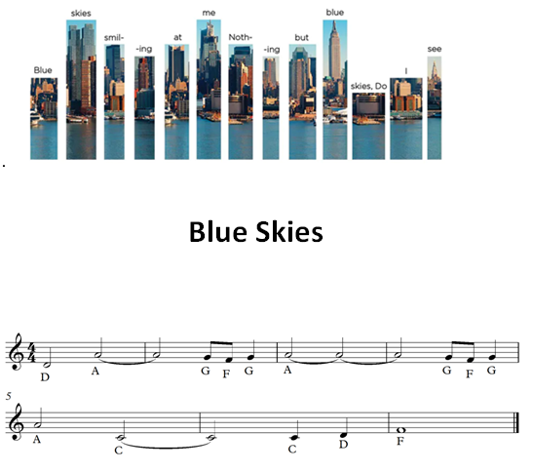


Slide 26
Composition stimulus ideas
  Soundscapes – pupils explore new techniques (trills, free expression, fanfares) – relevant to where they live – Blue Skies New York landscape
Respond to and understand the individual - Give access to a varied stimulus pictures
- words
- music heard
- rhythm grids, tonal grids
- graphic scores
- composer notepads
- environments
- cultures
Range of resources – App’s

Slide 27
Reflections on the relevance of creativity for the Music teacher
Music is a creative subject area
We are preparing and educating pupils for a future that we do not understand, however by understanding creativity and nurturing the curious mind, means that we are equipping them to be successful.
Creativity is the process of having original ideas that add value, it comes about through the discipline of seeing things in different ways.
Creativity encourages a broadened outlook with new opportunities and possibilities.
Encourages the question, Why do we do what we do and why do we do it in a particular way?

Slide 28
Small group and individual teaching
A tool to enhance the holistic approach
- Musical fluency
Aspects of technique
Reinforce and assess musical understanding (rhythms, key centres)
Link to classroom based projects

Slide 29
What characteristics are revealed in pupils through the composition or creative process
Pupils have more ownership of their learning as they have more input
They become problem solvers
They view mistakes as learning opportunities – Mis-takes
They are more creative and adaptive
They learn to explore and experiment
They think outside the box – and on occasions create a new box
They develop a growth mindset – awareness of other styles of music
They develop iterative thinking – repeating successful steps or processes

Slide 30
Contact details
Email – tim.baptiste@servicesforeducation.co.uk
tim.baptiste@btinternet.com

