Slide 1
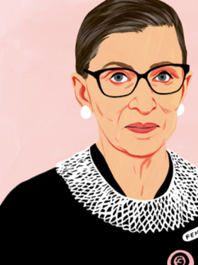
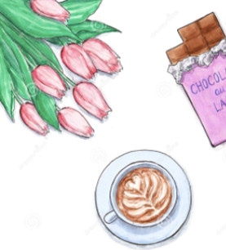


Musicians of Change Course Values

Slide 2
Brave Space
We commit to creating not just a safe space, but a brave one — where vulnerability, honesty, and risk-taking are welcomed as part of growth.
Ruth Bader Ginsburg – American lawyer and pioneer for Civil Rights

Slide 3
Assume the best
We choose generosity over judgement. By giving others the benefit of the doubt and listening with curiosity, we build trust and deeper understanding.

Slide 4
Take a moment
We take responsibility for checking in with ourselves. Pausing, breathing, or stepping back helps us regulate emotions, care for ourselves, and maintain a supportive environment.

Slide 5
I noticed, I liked, I wondered
We practise an open, enquiring mindset. This framework turns criticism into curiosity and encourages constructive, reflective dialogue.

Slide 6
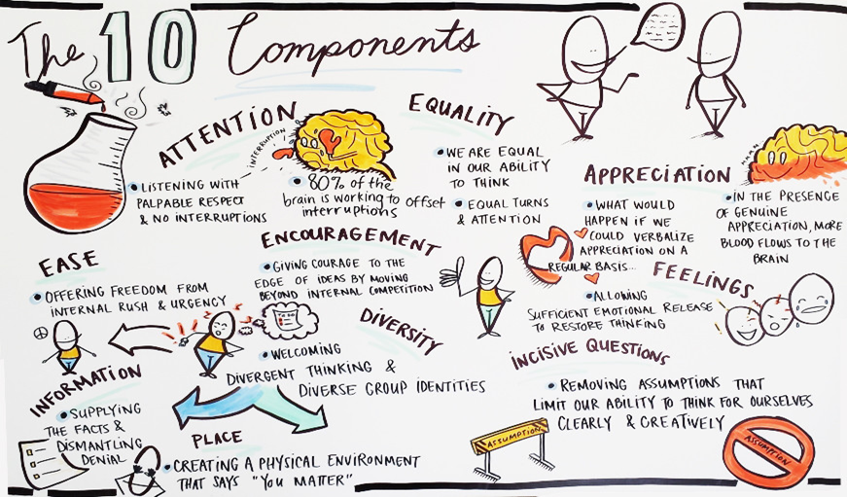
Nancy Kline – 10 Components of a Thinking Environment

