Slide 1
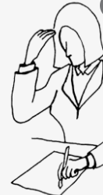

What is the Practice of Reflection?
Results in changing ideas through learning
Involves problematising teaching- recognising that it is not straightforward or without dilemmas and issues and encourages and values nuance
But can apply to positive or negative experiences
Is an active process, not a linear but a cyclical one: leads to the development of new ideas which feed into planning for next learning
Is a practice that has been theorised and considered a cornerstone of any social or educational profession.
Key learning outcome for this course and all other teaching PGCE quals. Incorporated in all your assignments and especially in Module 4
Encourages looking at issues from different perspectives which helps to scrutinise own values, assumptions and perspectives.
Antithesis to a top down approach such as ‘Guru’ or ‘master and apprentice’

Slide 2
Dewey’s 3 attributes of a thinking teacher:
Evidence of the success/importance of reflective learning was developed by the American philospopher, John Dewey, in the 1930s.
He came up with the ‘3 attributes of a thinking teacher’:
Open mindedness – to new/alternative ideas and approaches
Whole heartedness – commitment to seeking out ways that best engage learners
Responsibility- understanding the impact of your actions on learners
‘Reflective Practice supports a shift from routine actions rooted in common sense thinking to reflective action emerging from professional thinking, drawing on externally based sources’ (McGregor & Cartwright 2011: 7)

Slide 3


What does it require to be reflective?
Reflective Practice requires a willingness to learn!
A learner/growth mindset, rather than a knower/fixed mindset.
Teachers who value the desire to get better over the desire to be getting it right.
Take a second to think - how successfully am I currently doing this?

Slide 4
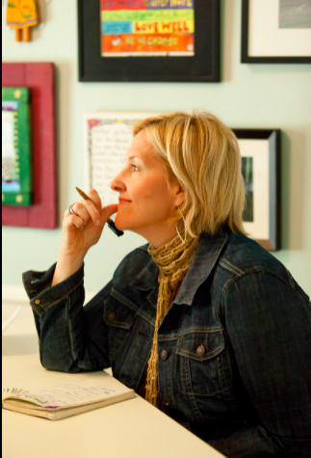
Knower vs Learner Mindset
Reflective Practice assumes a ‘Learner’ mindset rather than a ‘Knower’ one
Difference between being a knower and being right vs being learner and getting it right
Growth Mindset Model, or the Knower vs Learner mindset is a more recent incarnation of applying reflective practices to all manner of professional environments including business, healthcare, Brene Brown and Matthew Syed are some of the public key researchers working in this area as well as the OG Carol Dweck author of ‘Mindset’.

Slide 5
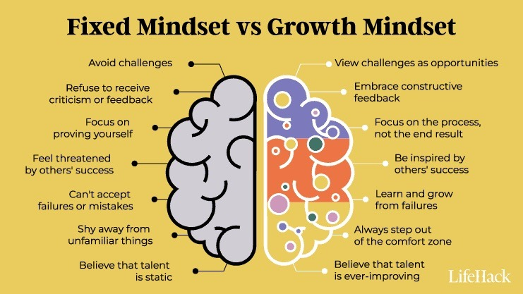

Slide 6
What does the fixed mindset sound like?

Slide 7
What does the fixed mindset sound like?
Well it’s worked like this so far.
I have always done it that way.
You can do it that way but I think I’ll stick with this thanks.
I just don’t think you really understood what I was doing.
The student just didn’t get it.

Slide 8
What does the growth mindset sound like?

Slide 9
What does the growth mindset sound like?
I’m up for giving it a go!
I really love how they did it, how can I try that out?
I think there is something to learn from what just happened.
Do you have any feedback for me?
I want to get better at this.

Slide 10
Self reflection
What mindset do you most relate to?
What areas are you currently in the fixed mindset?
What can you do this week to shift into the growth mindset?

Slide 11
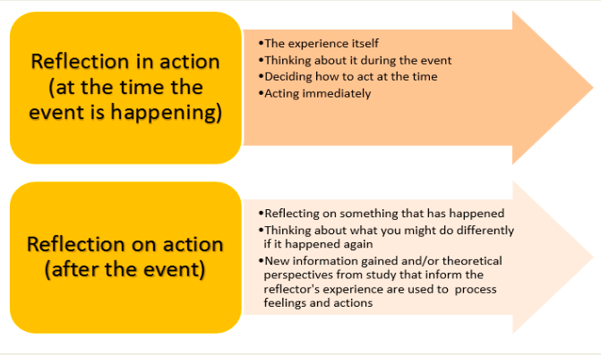
Schon (1982) Reflective thinking has two broad aspects:

Slide 12
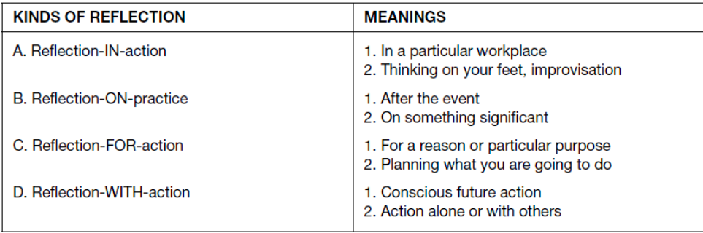
(Ghaye 2010: 7)

Slide 13
How will Reflection be incorporated into the course?
Every assignment will have a learning outcome where the depth of you reflection will be considered.
Module 4 will incorporate opportunities for you to reflect on a specific experience or ‘incident of note’
Modules 1,2,3 will require you to ‘critically reflect’ continually evidence reflection on your teaching techniques, your approaches, your lessons.

Slide 14
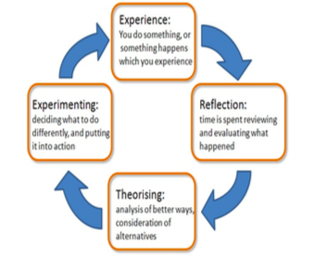
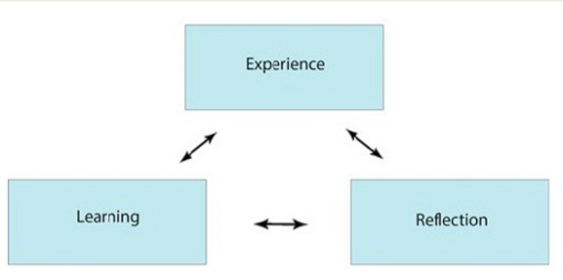
Models of Reflection
Kolb (1984)
Boud (1985)

Slide 15
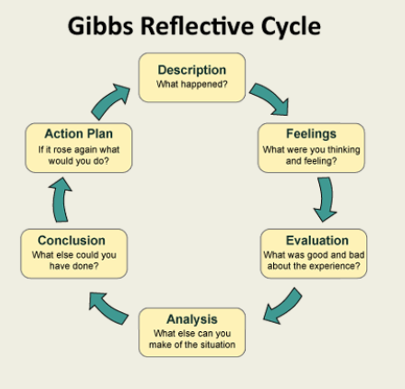
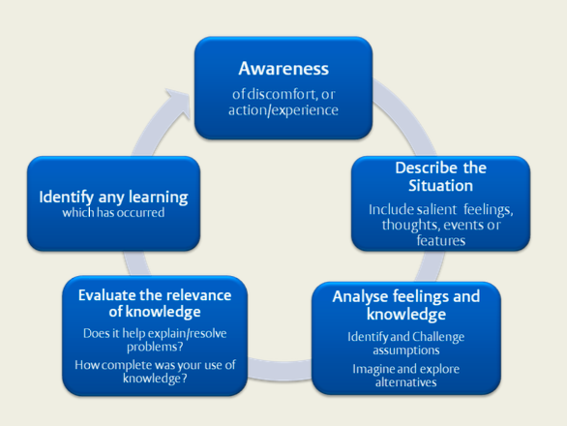
Gibbs (1988)
Atkins and Murphy (1995)

Slide 16
Individual Activity
Think of a recent teaching or professional experience that has stuck with you in some way and prompted a change in your thinking (2 mins)

Slide 17

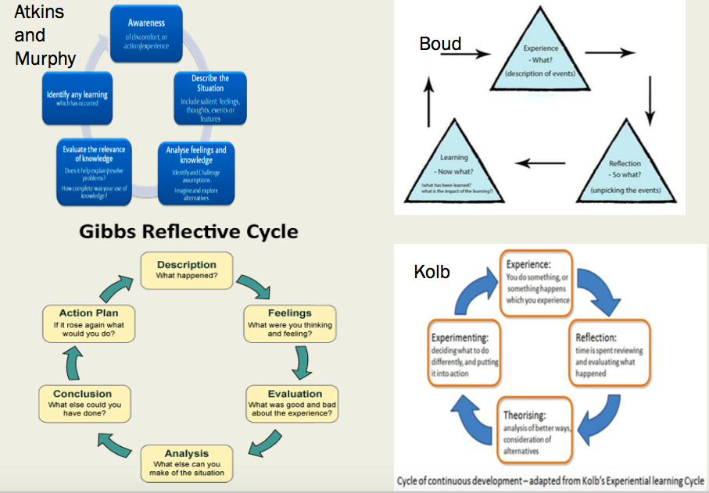
Over to you! Which Reflection cycle are you going to put this experience through? (10 mins)

Slide 18
Which mindset? Which Models of Reflection?
Example 1
‘What I believe makes me a good teacher is the fact that I teach every student how to practise while practising with them. Sharing different ways to practise, means that they become independent, and independency is a sign of progress in my opinion. My student and I have talked a lot about how to practise semiquavers at a fast tempo. Recently he played the Gavotte from Suzuki Book 1 and stumbled on the slurred semiquavers in the second half. I asked him to remember all the ways he could practise those bars in and he responded by: “first separately, then separately but faster, then slurred”. This proves that short-term progress springs from a lifelong-progress philosophy.’
Example 2
When we presented the students with conventional notation for Dark Horse, two troublesome misconceptions were revealed. Firstly, they could not distinguish the difference between pitch names and rhythm solfege. Secondly, they had mistaken the floor stave as a depiction of their open strings. I was interested in the roots of these misinterpretations and sought out information about children’s understanding of symbols through researching Cultural Learning Theory. When I considered that the visual symbols they had been following involved looking down their fingerboard at four strings it was quite logical that they would intuit the strings as the primary visual symbol for their pieces. In reflecting on this, my co- teacher and I decided to change our approach by reviewing notation symbols away from the stave.

Slide 19
Group Activity
In groups of 4 (20 mins total)
Each person takes 3 mins each to talk through their chosen reflection cycle
Facts - Listener 1 notes down facts associated with experience eg. what happened, how did the learners respond
Feelings - Listener 2 notes down the feelings and emotions with experience eg how does the teacher feel
External Perspectives - Listener 3 notes down the different perspectives considered when evaluating the experience eg what other research or advice could be helpful in creating adaptions
2 mins for listeners to feedback their notes.

Slide 20
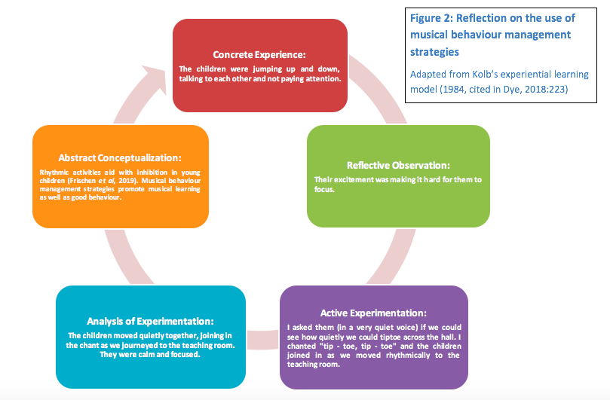

Slide 21
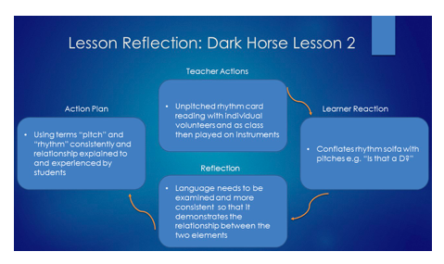

Slide 22
References
McGregor, D & Cartwright, L (2011) McGregor, D. Developing Reflective Practice: a guide for beginning teachers. Maidenhead: Open University Press.
Ghaye, T (2010) Teaching and Learning through Reflective Practice: a practical guide for positive action. Routledge Taylor & Francis Group.

Slide 23
Pix & Mix links on Reflection
Brene Brown's book: Dare to Lead, encapsulates the difference between the Knower/Learner mindset. It includes lots on empathy, vulnerability and learning through feedback/reflection. The Knower/Learner mindset is also expressed as Fixed/Growth mindsets.
Brene Brown has written a blog post about being a knower v learner here her TED talk on the importance of vulnerability is a key watch on this topic.

Slide 24
Reflection Templates: remember to reference which model you’ve used!

